Slide 1
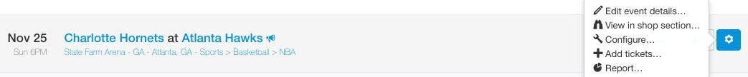
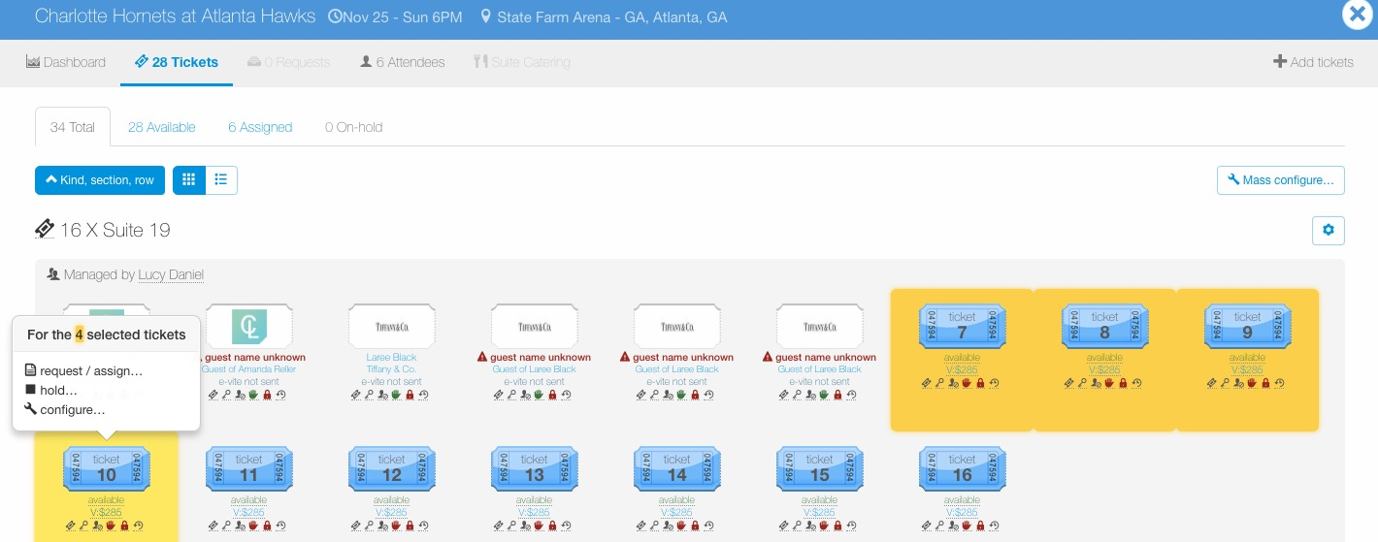
Configure – Management Permissions
To configure tickets for an entire event, go to the Manage page, find the event, click the wheel icon to the right of the event and then click “Configure…”.
To configure a certain ticket group or individual tickets within an event, go to the Manage page, find the event and click the ticket icon to view tickets for the event.
Once in the event, click the “cog” icon next to the ticket group to edit an entire ticket group or click individual tickets to configure, then select “configure…”..

Slide 2
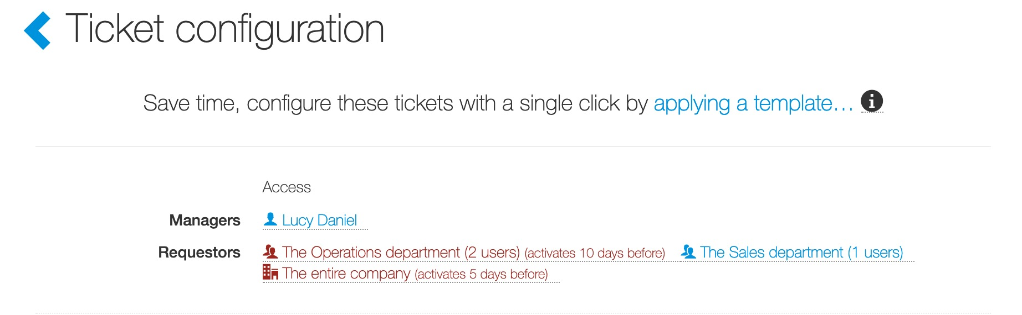
Configure – Management Permissions
Next to Managers, click a manager’s name or as seen in the screenshot below “Lucy Daniel”.

Slide 3
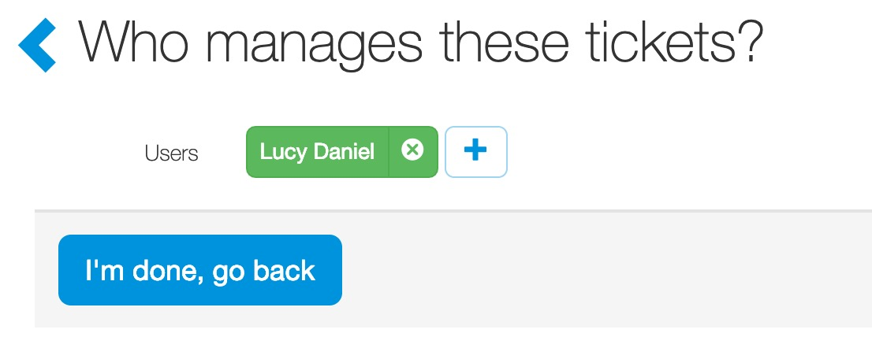
Configure – Management Permissions
Managers:
When a ticket admin adds tickets, they are automatically added as a manager.
Tickets can multiple ticket admin. Ticket admin can add other users to manage the tickets.
When a user is added as a ticket admin, they have the same rights to the tickets as you (i.e. approve requests, configure, etc.).
To add another ticket admin/manager, click the the “+” next to Users.
To remove a ticket admin/manager, click the “X”.

Slide 4
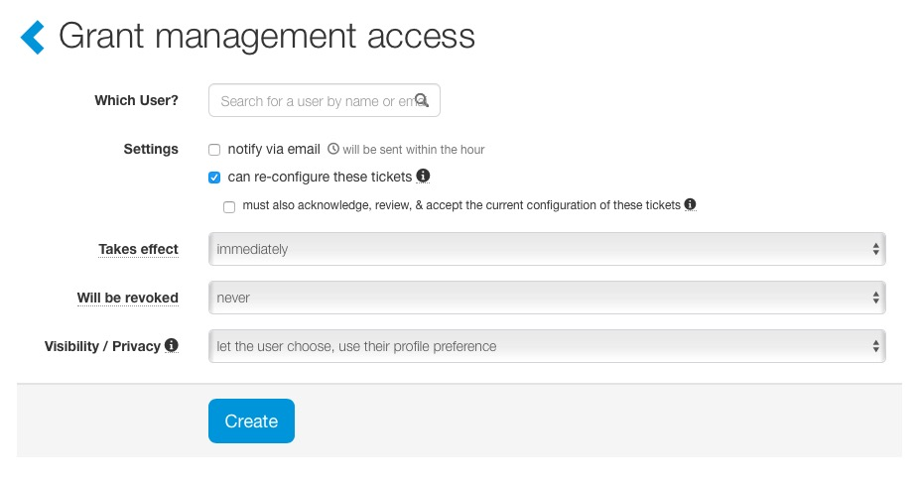
Configure – Management Permissions
Managers:
When adding a manager, ticket admin can also click on advanced options to:
  Activate and deactivate management rights based on timeframes. We refer to as a “trigger.” The default triggers takes effect immediately and will never be revoked.
When a user is added as a ticket admin, they have the same rights to the tickets as you (i.e. approve requests, configure, etc.). To remove configure permissions, uncheck the “can re-configure these tickets” option under the user’s name.

