Slide 1
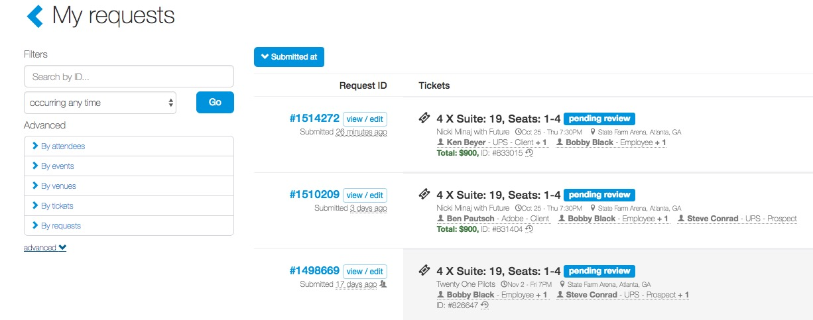
Editing Attendees
A user can edit their attendees for an event.
Some fields cannot be edited including an attendee’s name or email address. This requires a system admin level of permission.
To edit an attendee, click your name (top right of the page), then select “My Request History”.
From the request summary, users can access their request history. Find the event where you need to edit attendees.
Click “view/edit” under the request to edit the attendees.

Slide 2
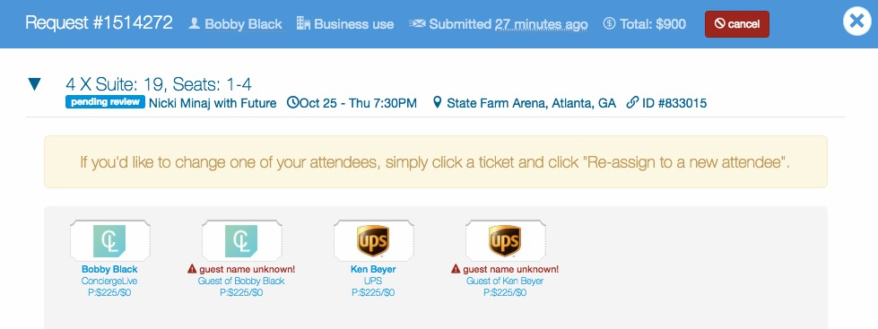
Editing Attendees
This takes the user into the request.
To return to the request queue, click cancel or the “X” in the upper right-hand corner.

Slide 3
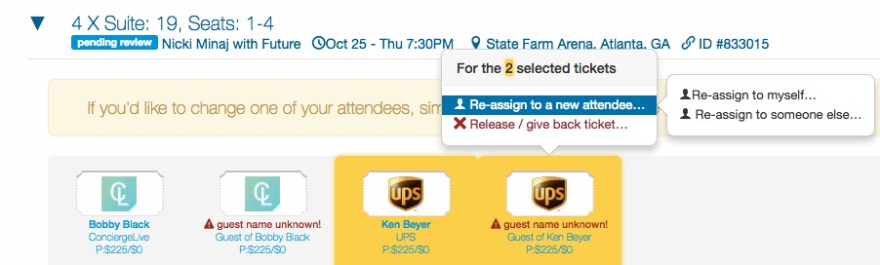
Editing Attendees
To change attendees for a request, select the attendee(s) you wish to change and click “Re-assign to a new attendee” from the pop-up box and ”re-assign to someone else…”.

Slide 4
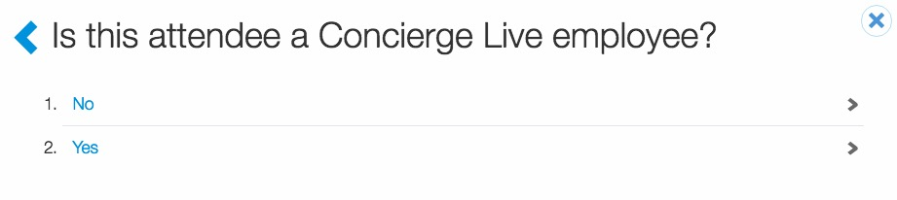
Editing Attendees
If the user chooses to create a new attendee, they will be asked to classify if the attendee is an employee or not. This step determines the attendee types a user sees.

Slide 5
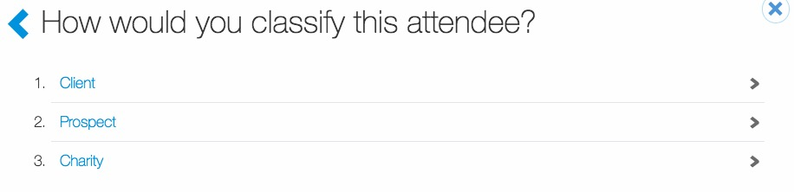
Editing Attendees
In the next step the user selects the attendee type for their attendee.

Slide 6
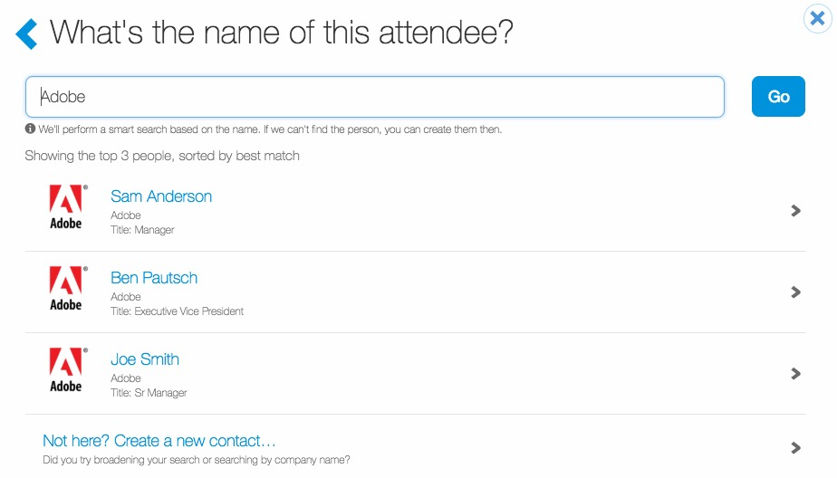
Editing Attendees
Users can search to select the new attendee.
Users can search by attendee name or company name.
Once searched, if the attendee does not appear, users can add the attendee by clicking “Not here? Create a new contact…”

Slide 7
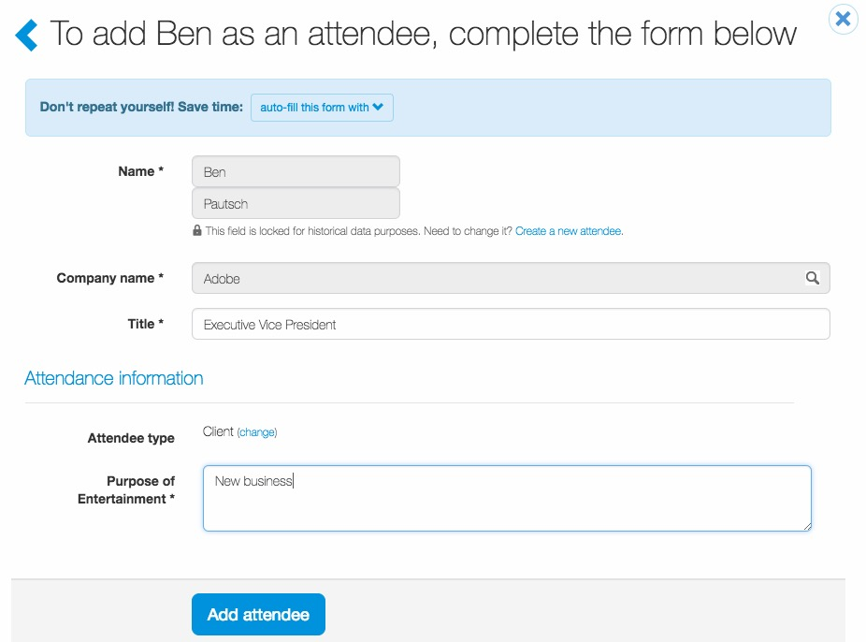
Editing Attendees
Users must complete all the necessary information on the attendee.
Once completed, click “Add attendee”.

Slide 8
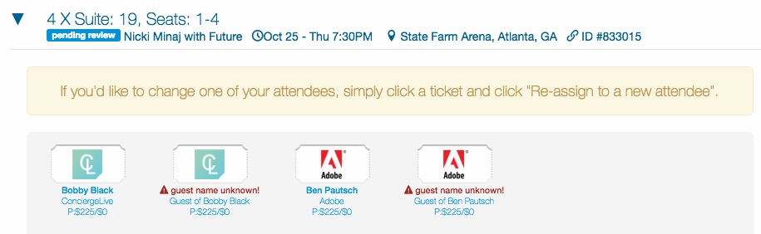
Editing Attendees
Once the user completes the attendee information and adds the attendee, they are redirected back to the request.
If guest information for attendees is required, users will be prompted to enter guest information.
You will also follow the same process to assign a ticket to yourself or to replace other attendees.

Slide 9
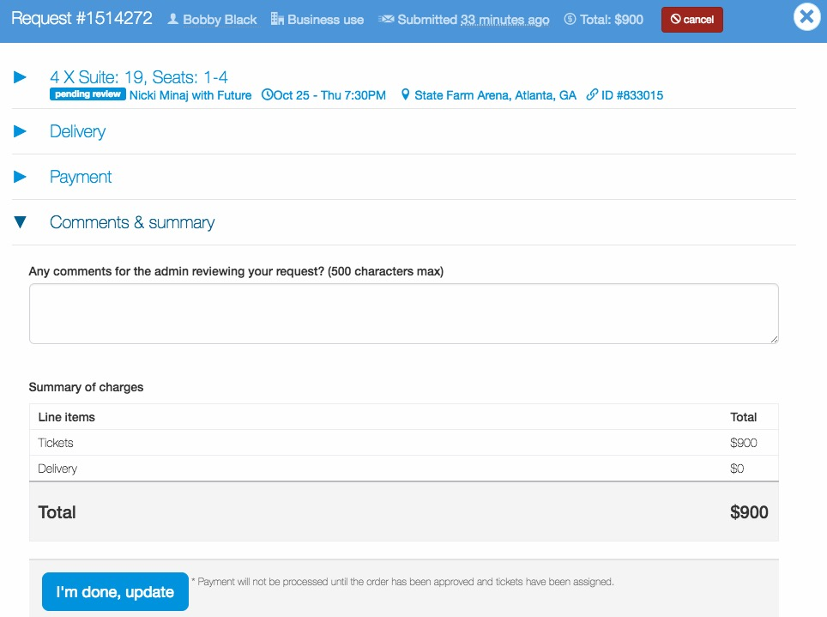
Editing Attendees
Once all attendees are edited, users can review/edit any other request details.
Once satisfied, click “I’m done, update”.

