Slide 1
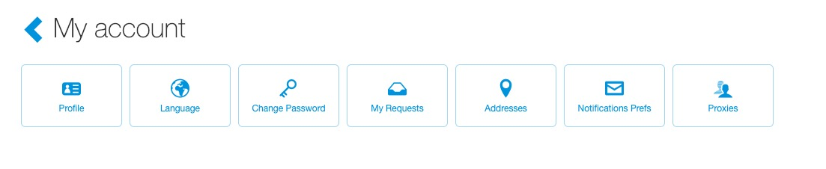
Proxy
The proxy feature was designed for users to allow their support people to make and manage requests on their behalf.
When a user gives proxy rights to another user, that user has the exact same access and permissions as the user.
To access proxies, click your name (top right of the page), then select “My Account”. Click the “Proxies” button.

Slide 2
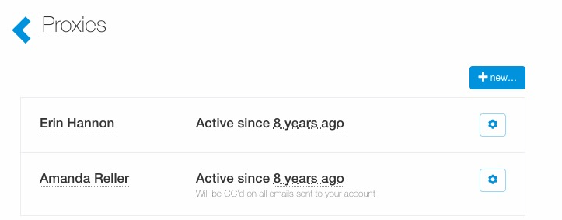
Proxy
To add a new proxy, click the “+ new…” button.

Slide 3
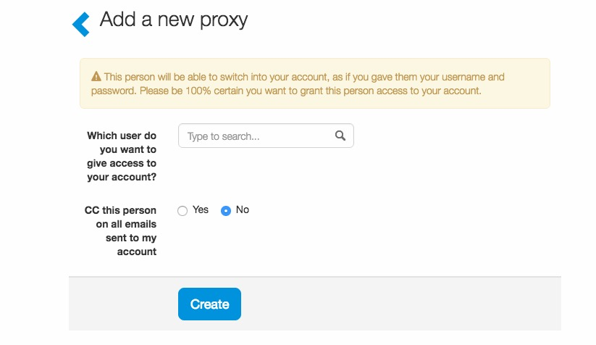
Proxy
Search for the user to give proxy permissions.
Determine if the proxy user will be copied on all emails related to ticket requests and access.
Click “Create”.

Slide 4
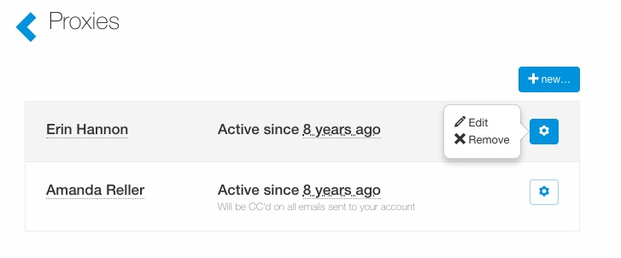
Proxy
To edit a current proxy, click the “cog” icon, next to the proxy’s name, then “Edit”.

Slide 5
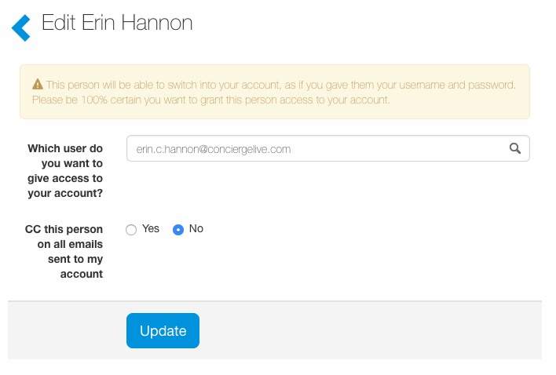
Proxy
Make any edits and click “Update”.

Slide 6
Proxy
To remove a current proxy, click the “cog” icon, next to the proxy’s name, then “Remove”.

Slide 7
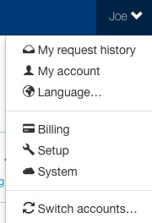
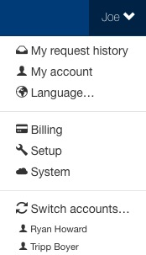
Proxy
To proxy into another account, click your name, in the upper right-hand corner, then click “Switch accounts”.
The accounts a user has recently proxied appear below the “switch accounts” button
Select the name to proxy into their account.

Slide 8
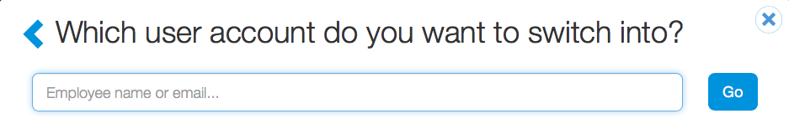
Proxy
If a user has not recently proxied into a different account, the user can search for the employee’s name then select “Go”.

Slide 9
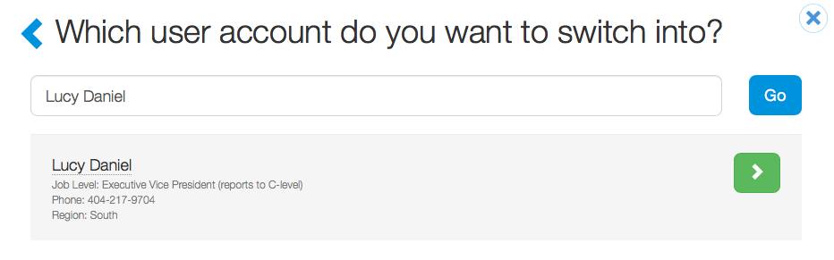
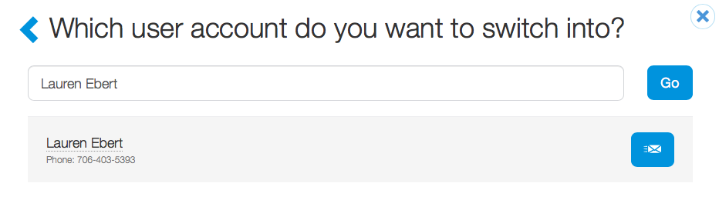
Proxy
If a user has proxy permissions after searching, the user will see a green arrow.
Select the green arrow to proxy into the user’s account.
When switching accounts, if a user doesn’t have proxy permissions, they can request to be a proxy by clicking the “email” icon to notify the user to request proxy permissions.

Slide 10
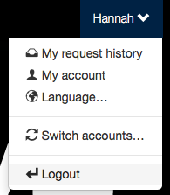
Proxy
When a proxy wants to return to their account, select the proxied user’s name, then “Logout”.
This logs the user out of the proxy account and back into their account .

