Slide 1
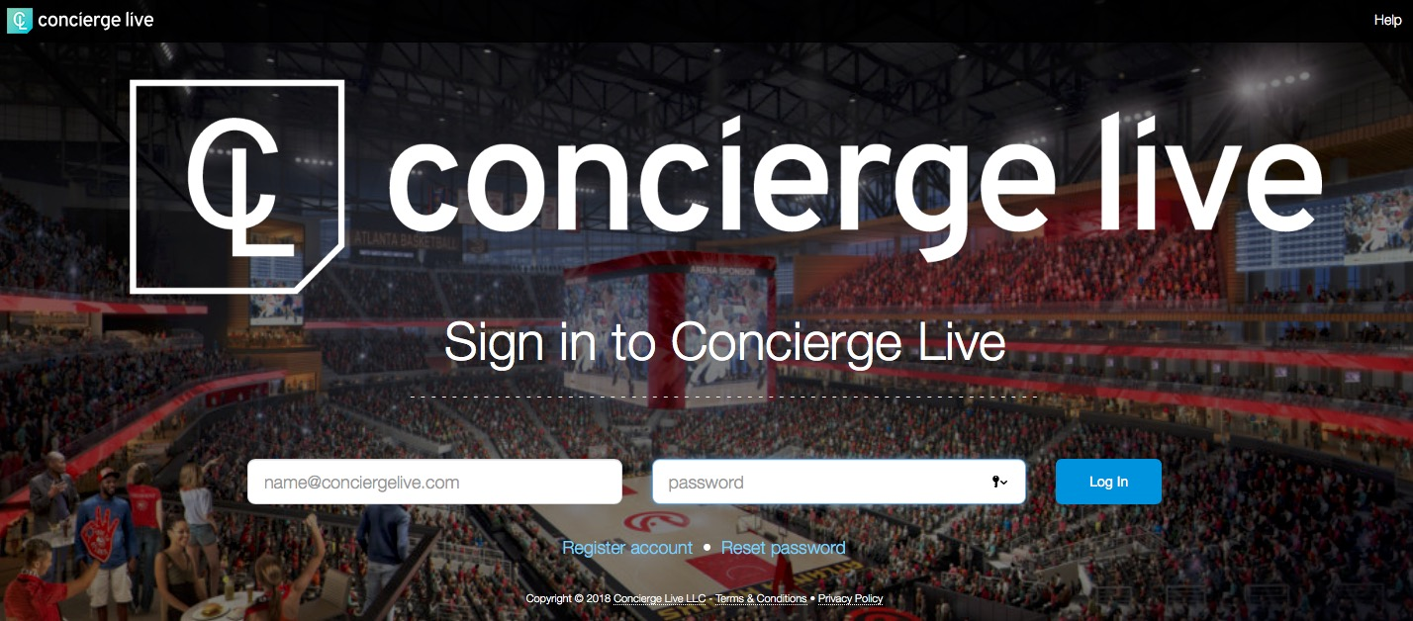
Login
Go to your site’s private web address.
Log in using your email and password.
If you forgot your password, click the “Reset password” link.
To register for an account, click “Register account” (left-hand side under the email address field.

Slide 2
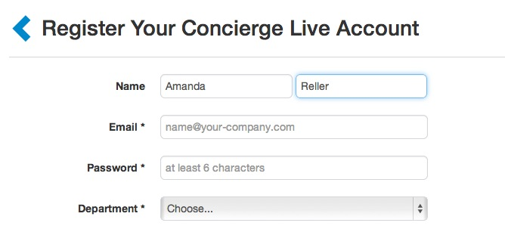
Registration
Complete all the fields on the form, then click “Register my account”.
Once submitted, a user receives an e-mail confirmation prompting them to log into the system.
Companies can have firewall issues which prevents user from receiving the confirmation email. If you don’t receive the confirmation email, submit a support ticket and Concierge Live or your company can confirm your account. Please do not create another account with a different email, it will create problems down the road.

Slide 3
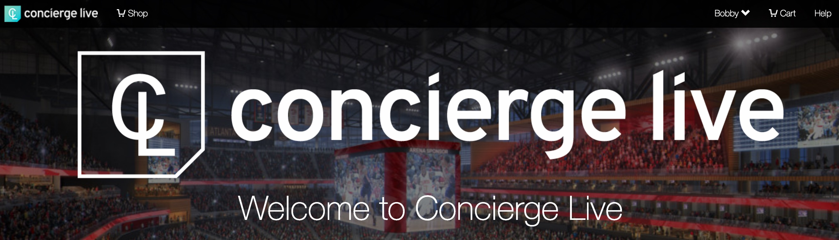
Support
If you need any help or have any questions, please access the Support Center on the top right beside your name labeled “Help”.
Please contact your ticket admin or support@conciergelive.com if you have any questions.

