Slide 1
Mobile Attendee Confirmation
Depending on ticket settings, ticket requestors may have the option to transfer tickets directly to their attendees for Ticketmaster Mobile tickets.
Not all mobile tickets will offer the attendee confirmation process. There are several factors that impact whether a ticket requestor can confirm their attendees including delivery option settings and the timing of the ticket assignment/approval.
When tickets are enabled to allow ticket transfers directly to attendees, the ticket requestor will complete an attendee confirmation process.
The attendee confirmation process is how ticket requestors confirm their attendees.
The attendee confirmation process only applies to business ticket requests (for personal use tickets requests, all tickets will be transferred to the ticket requestor).
Ticket requestors are not required to complete the attendee confirmation process in order to receive their tickets. If a ticket requestor does not confirm their attendees, all tickets for the request will be sent to the ticket requestor.

Slide 2
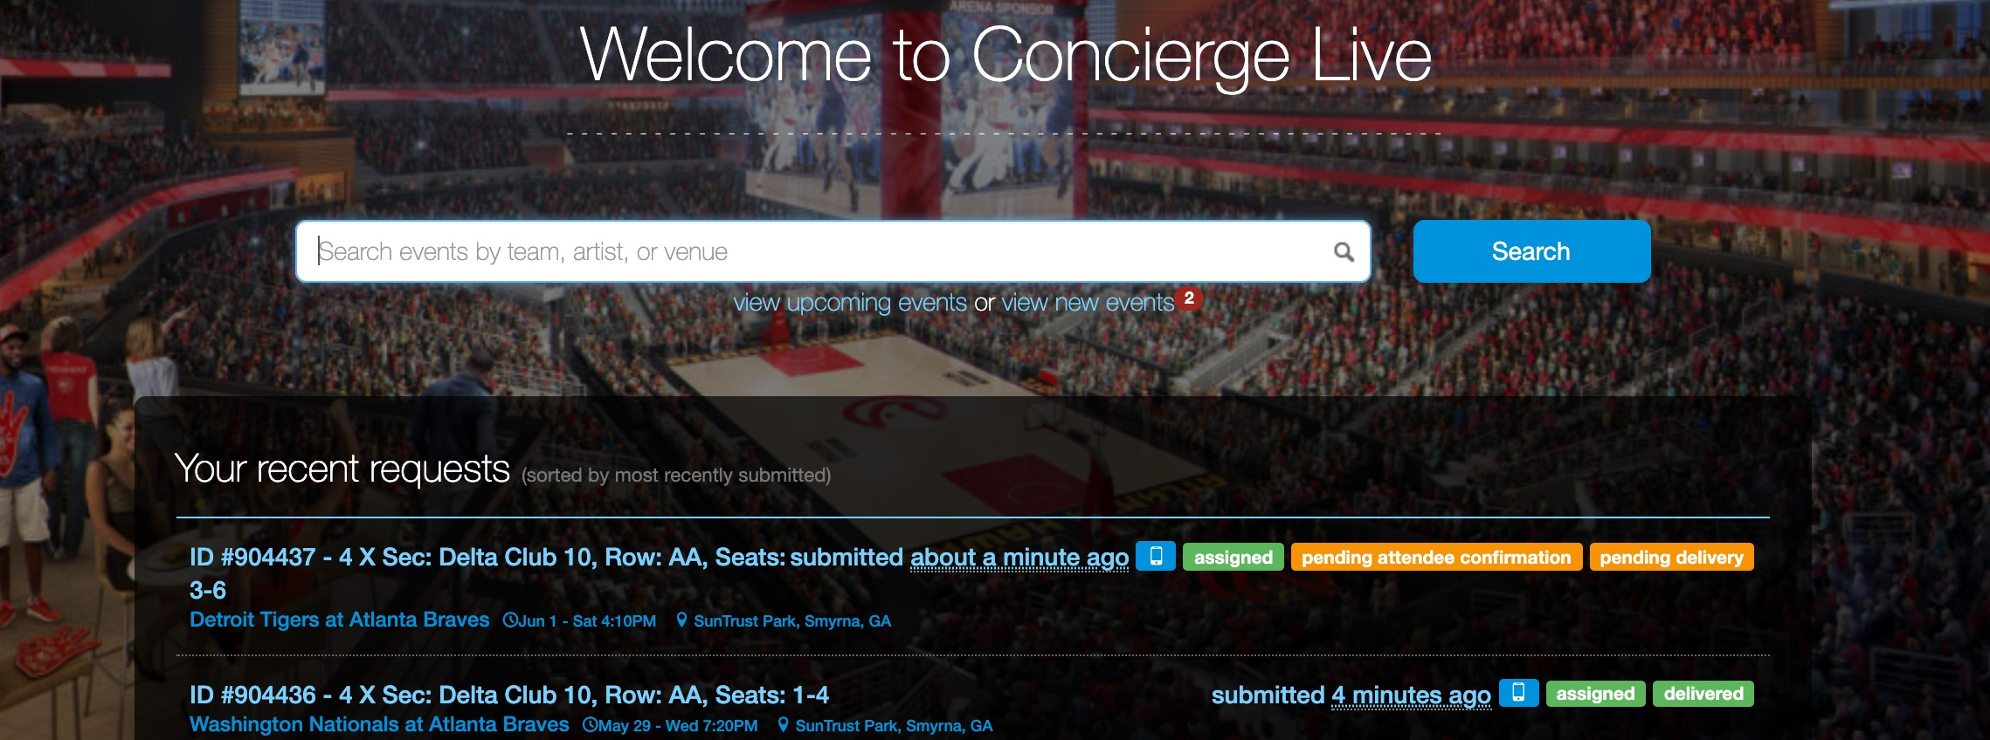
Mobile Attendee Confirmation
Users will be notified about confirming attendees by email 3 days before a mobile delivery is scheduled to transfer (specific transfer timing may vary but that information is usually available in the Delivery section of your request).
Ticket requestors confirm attendees through a link in the attendee confirmation email or through the request, by clicking “pending attendee confirmation” on their Home Page or in the “My request history” section (click your name [top of the page], then “My request history”).

Slide 3
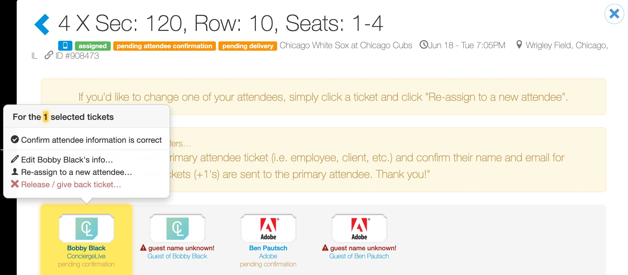
Mobile Attendee Confirmation
To confirm, edit or re-assign an attendee ticket, click on an attendee ticket. From the pop-up select:
  “Confirm attendee information is correct” (select if this attendee will use the ticket)
  “Edit Bobby Black’s info…” (employee email is the email in their profile)
  “Re-assign to a new attendee” (give tickets to a new attendee)
  “Release / give back ticket” (contact the ticket admin to release the ticket)
An attendee’s confirmation status is located under the ticket (i.e. pending confirmation).

Slide 4
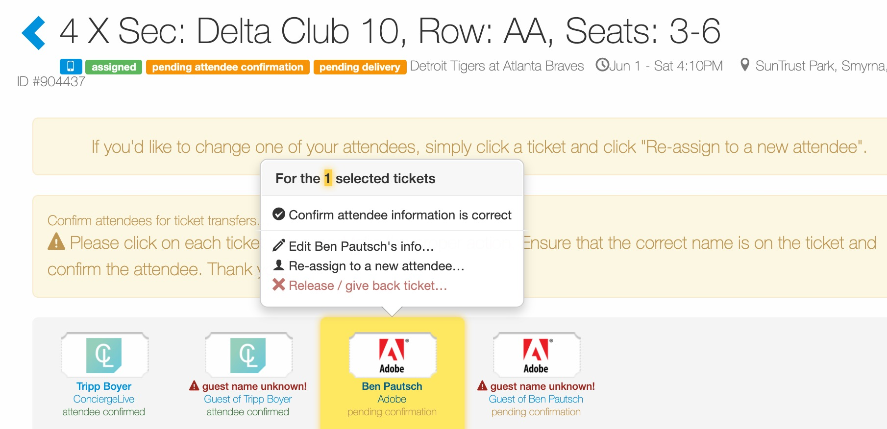
Mobile Attendee Confirmation
Once an attendee is confirmed, their confirmation status is updated below the ticket (i.e. attendee confirmed).
The attendee confirmation process is for primary attendees. Notice confirming Tripp Boyer’s ticket also confirmed his +1. All primary guest tickets are sent to the primary attendee.
Repeat the attendee confirmation process for all assigned primary tickets (i.e. Ben Pautsch) where their confirmation status is pending.

Slide 5
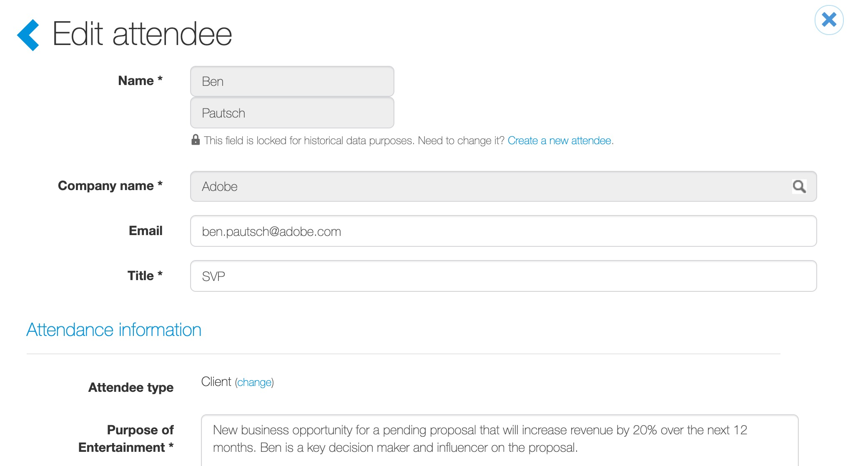
Mobile Attendee Confirmation
For external attendees, confirm the attendee’s email address to ensure mobile tickets are transferred to the proper person.
If you don’t know an attendee’s email, don’t confirm the attendee. Any tickets not confirmed will be sent to the ticket requestor.
If email is not an available data field, contact your ticket admin.

Slide 6
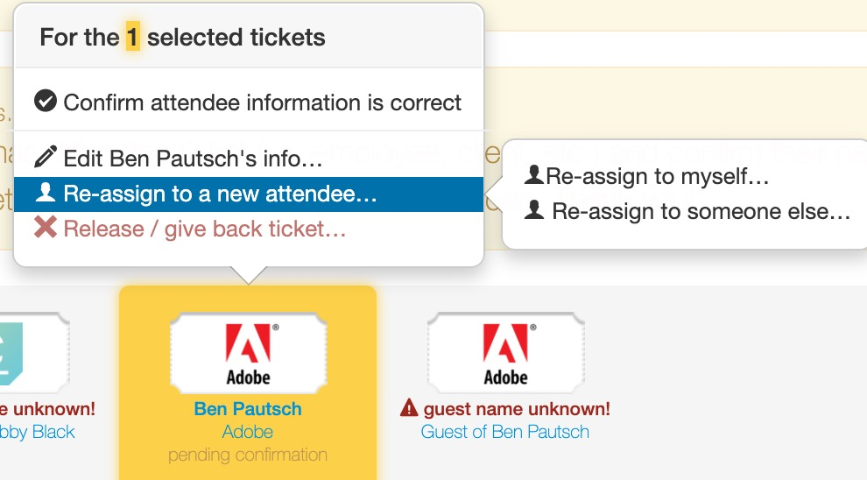
Mobile Attendee Confirmation
If an initial attendee is no longer using a ticket, ticket requestors can re-assign tickets to another attendee.
Click on the primary attendee (i.e. Ben Pautsch) and any +1’s if Ben is not going to use any of the originally assigned tickets, then “Re-assign to someone else…”.
When a ticket is re-assigned to another attendee, the ticket requestor must still confirm the attendee.

Slide 7
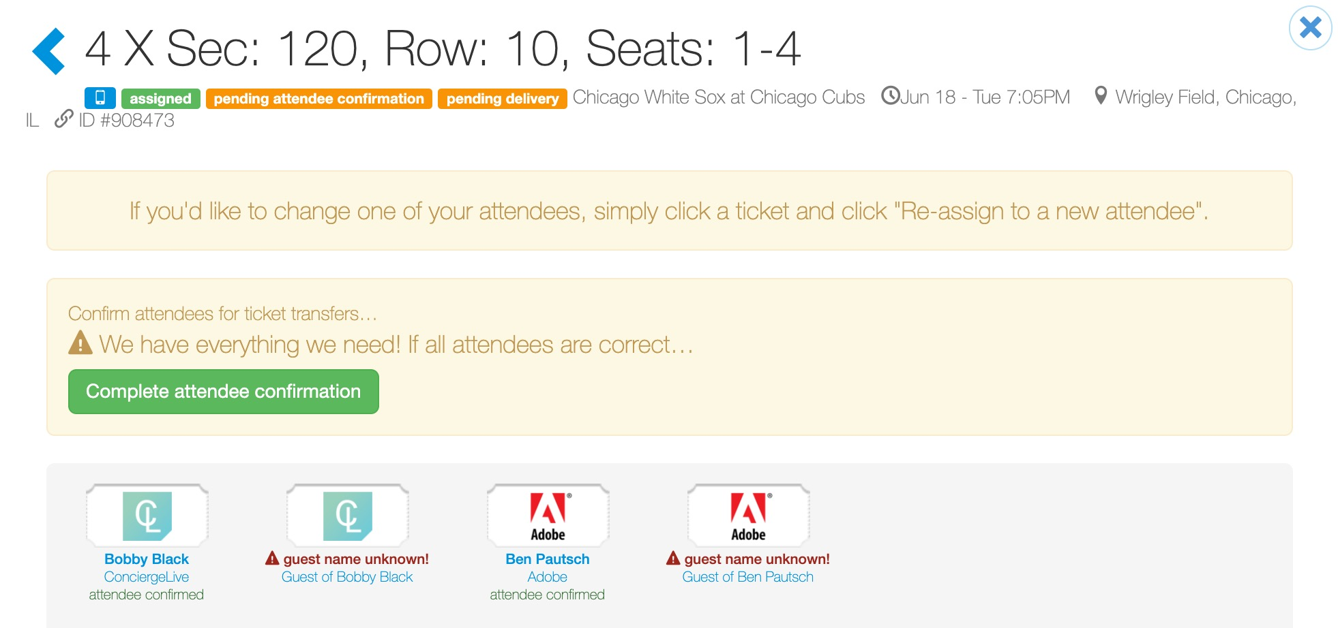
Mobile Attendee Confirmation
Once all attendees are confirmed, click “Complete attendee confirmation” to finalize the process.
If you are unable to confirm all the attendees, ticket requestors can return to edit, update or confirm attendee until the mobile tickets have been transferred.

Slide 8
Mobile Attendee Confirmation
Once all attendees are confirmed, the ticket request is updated and shows “attendees confirmed”.
Attendee Confirmation Tips:
The attendee confirmation process is only applicable to business ticket requests.
If tickets are assigned inside the tickets auto-deliver timeframe (i.e. inside 3 days before the event), all tickets are sent to the ticket requestor. The ticket requestor is then responsible for transferring tickets to their attendees.
If an attendee is not confirmed, their tickets will be sent to the ticket requestor.
Once tickets are transferred, ticket requestors can still edit attendees, but the ticket requestor is responsible for securing the mobile tickets from the original attendee and transferring tickets to the new attendee.

