Slide 1
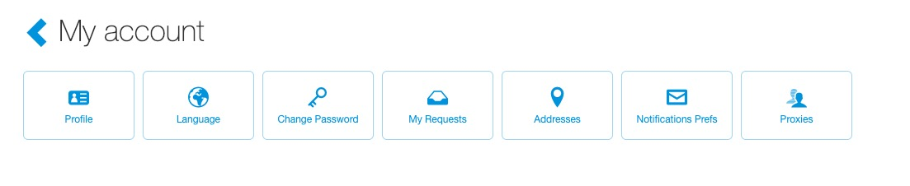
My Profile
To access your profile, click your name (top right of the page), then select “My Account”.
Click the “Profile” button.

Slide 2
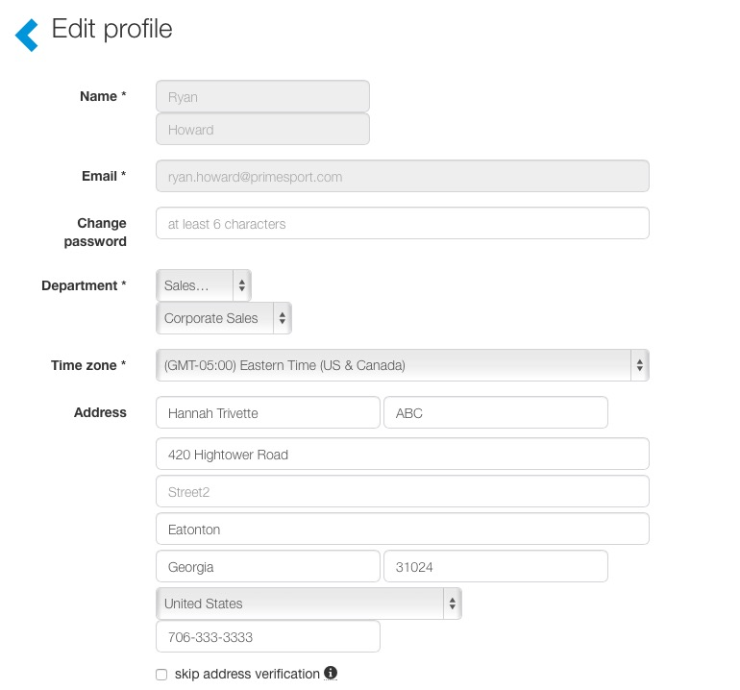
My Profile
From here, users can edit their profile.
Once edits have been made, select the “Save” button.
Users cannot edit their name or email. To make changes to those fields contact your company’s ticket admin.
If your company uses a directory feed, users may only be able to view their profile, not edit. Please contact your company’s ticket admin if your company uses a directory feed.

