Slide 1

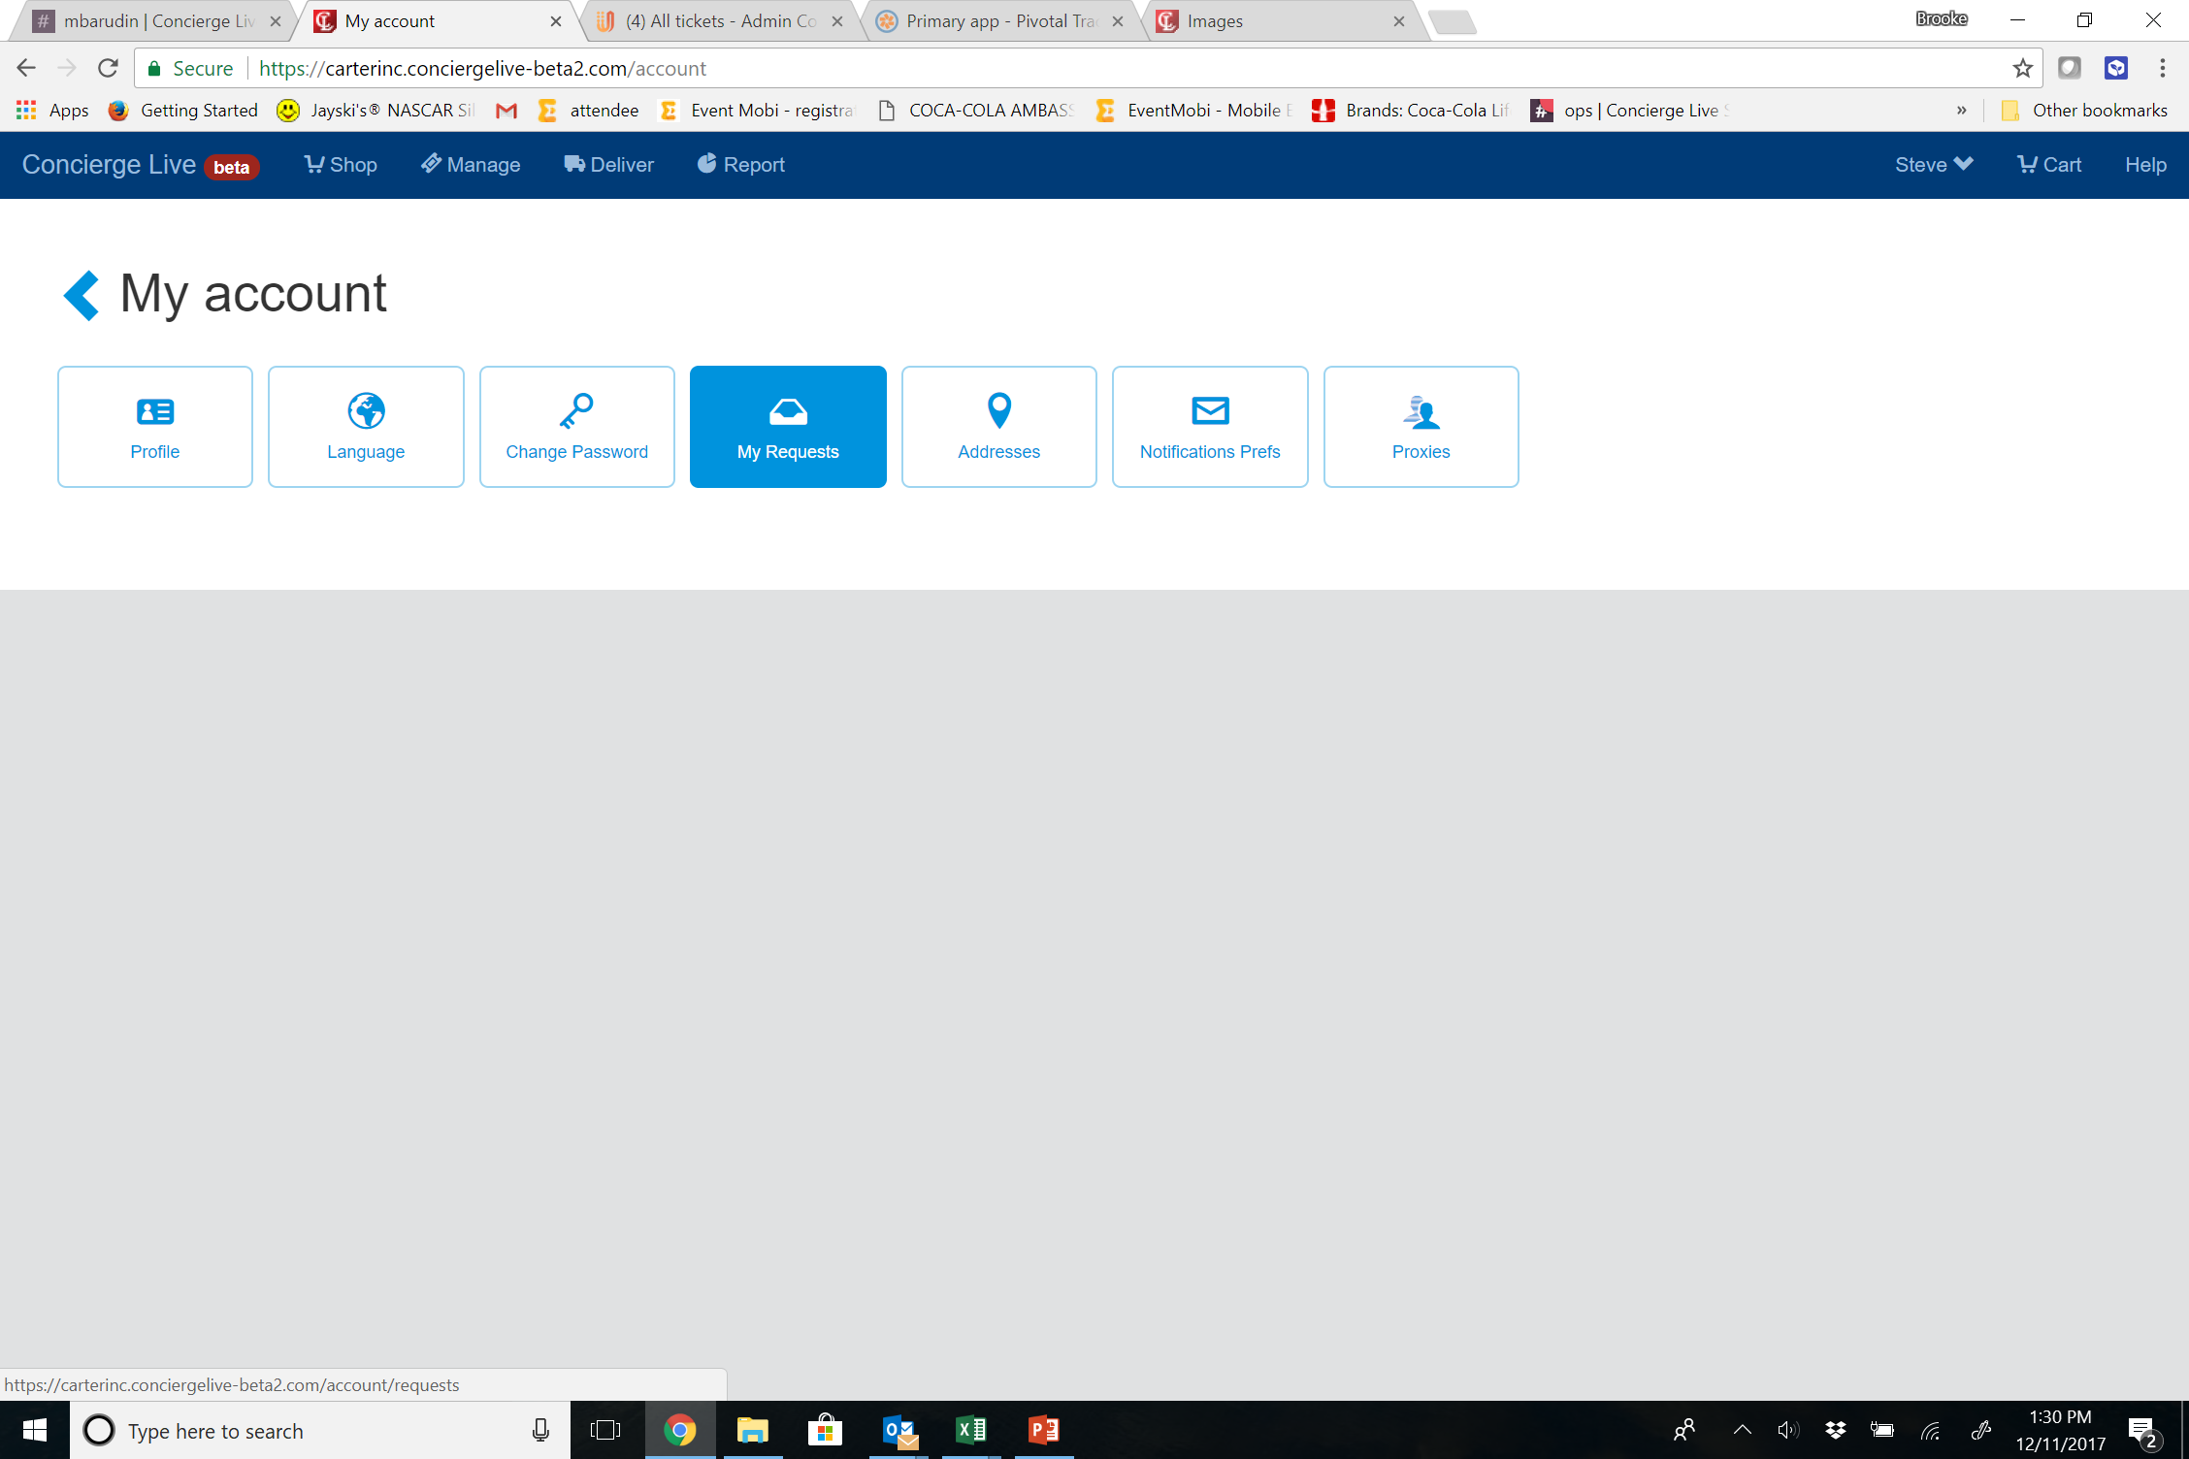
Request History
To access your request history, click your name (top right of the page), then select “My request history”.
In your request history, you can see the request status, make changes, or possibly cancel a request.
Generally, an email is sent to users when the status of a request changes (i.e. a request is approved, tickets are shipped).
Users can also access their request history from the My Account section (click your name (top right of the page), then select “My account”. From there click “My Requests”.

Slide 2
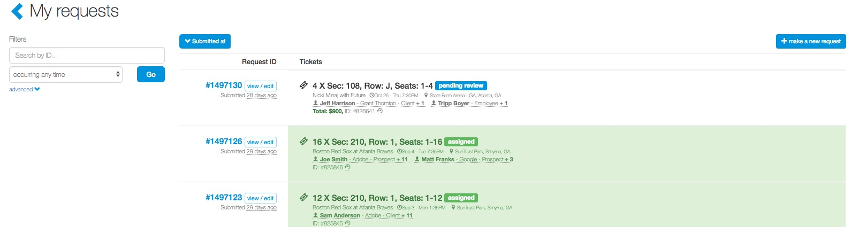
Request History
In their request history, users can view their current and previous requests.

Slide 3
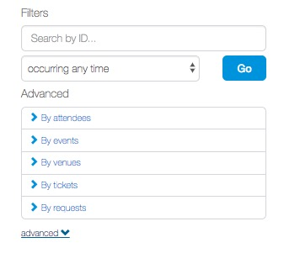
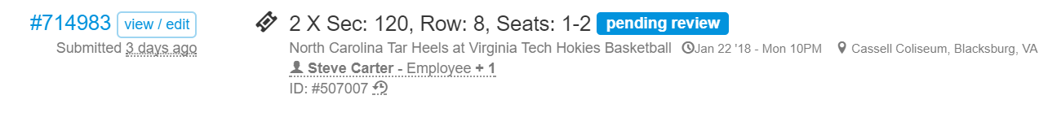
Request History
Users can use the filters on the left-hand side to locate a specific request.
Click on ”advanced” to see additional filter options.
Once a request has been located, click the “view/edit” icon located beside the ticket request ID information.

Slide 4
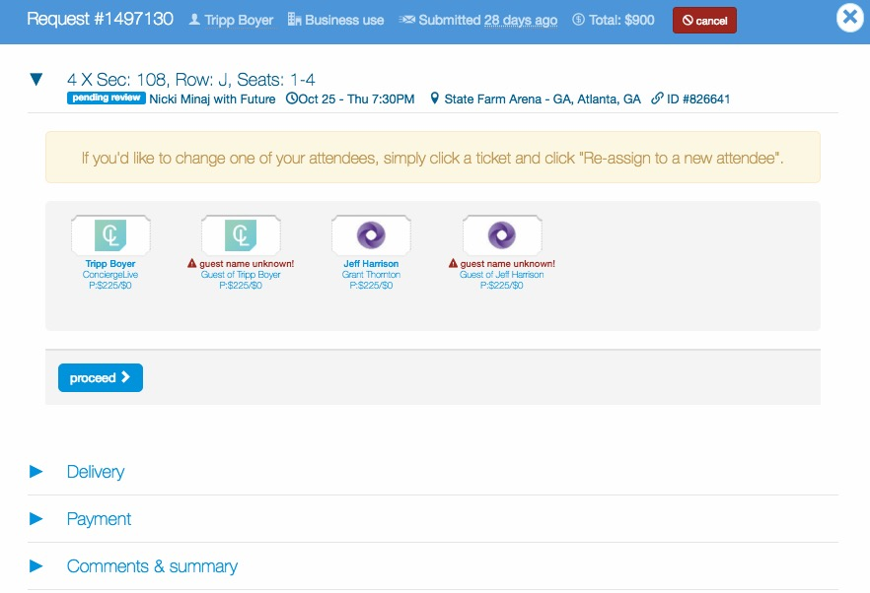
Request History
When viewing the request, users can view the request summary including the following:
  Ticket request ID
  Request status
  Event details
  Attendee details
To edit a request, select the section you want to edit, then re-submit the request.

