Slide 1
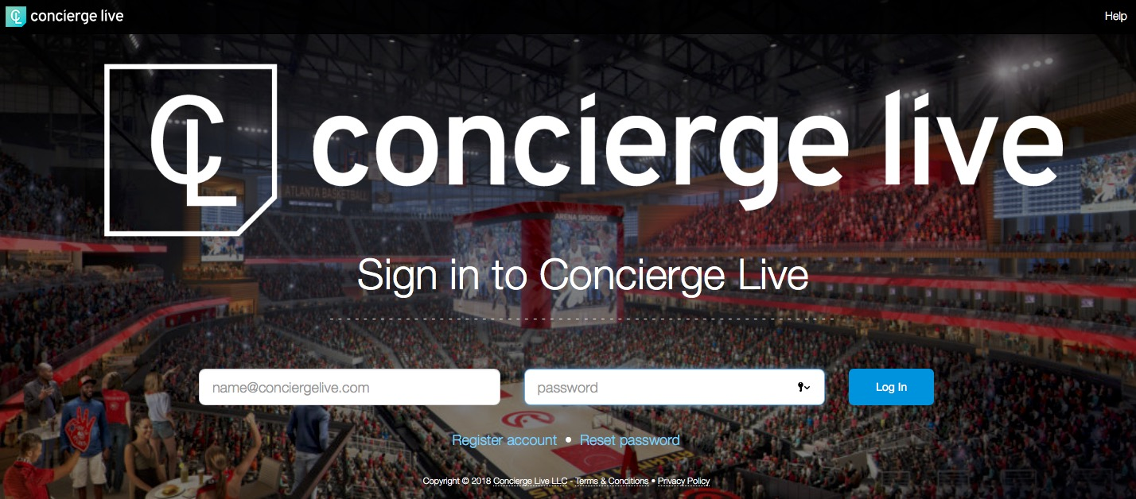
Login
Go to your site’s private web address.
Log in using your email and password.
If you forgot your password, click the link “Reset password”.
To register for an account, click “Register account” (left-hand side under the email address field.

Slide 2
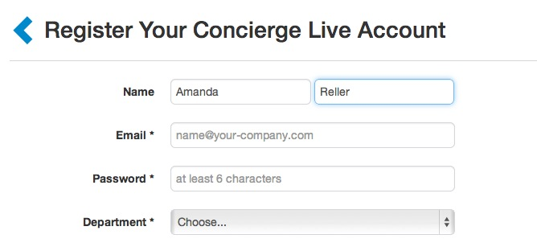
Registration
Complete all the fields on the form, then click “Register my account”.
Once submitted, a user receives an e-mail confirmation prompting them to log into the system.
Companies can have firewall issues which prevents user from receiving the confirmation email. If you don’t receive the confirmation email, submit a support ticket and Concierge Live or your company can confirm your account. Please do not create another account with a different email, it will create problems down the road.

Slide 3
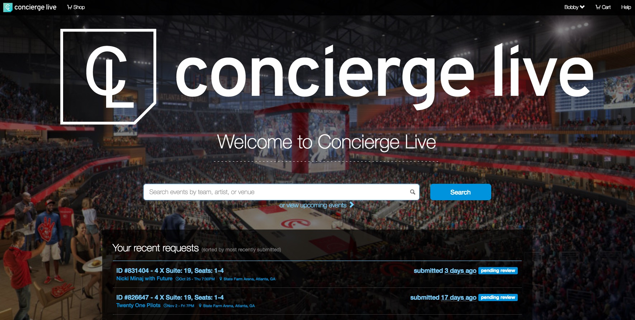
Home Page
The home page outlines key information including announcements and recent requests.
Users search for events from the home page.

Slide 4
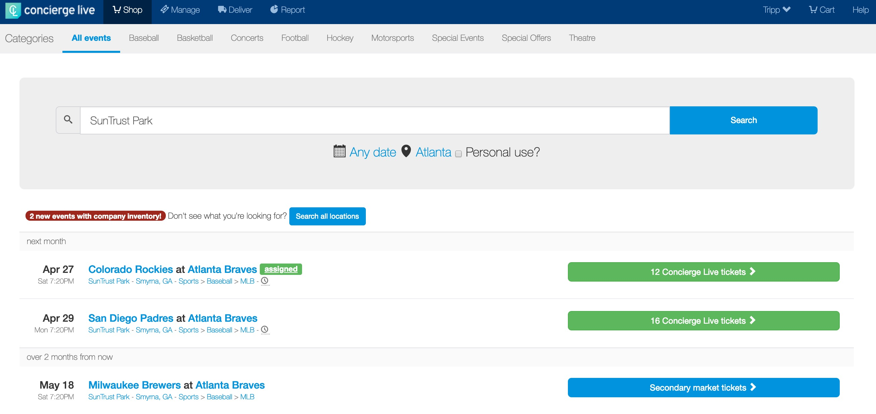
Requesting Tickets
On the shop page users can see upcoming events they can request.

Slide 5
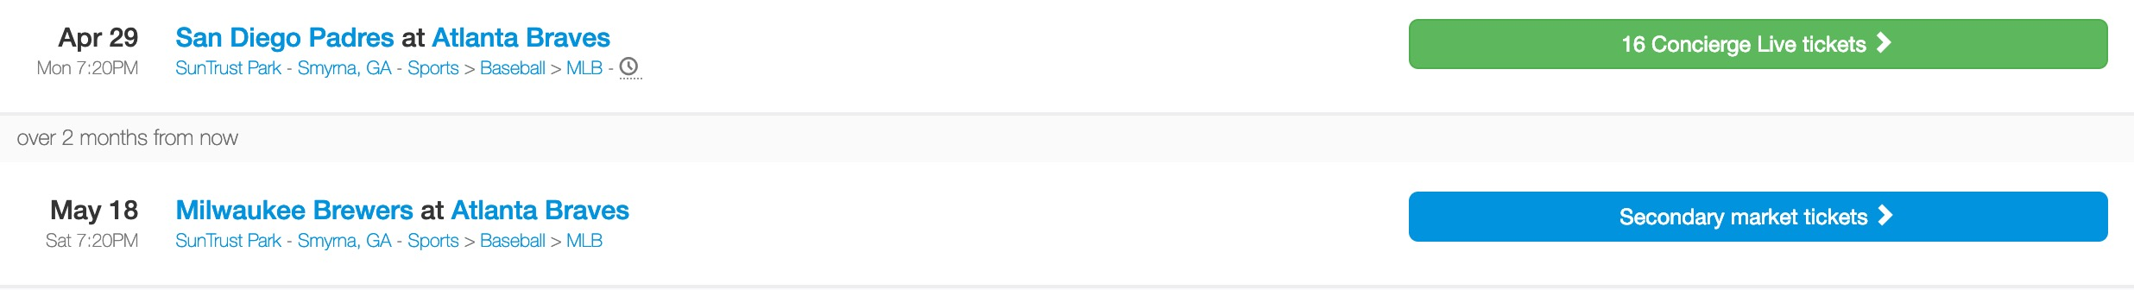
Requesting Tickets
On the Shop page, users see company inventory (green button) and Concierge Live Marketplace inventory (blue button).
If company inventory is available for an event, it will always show first (before Concierge Live Marketplace inventory).
Once you locate an event of interest, click the green (company tickets) button or the blue (Concierge Live Marketplace inventory).

Slide 6
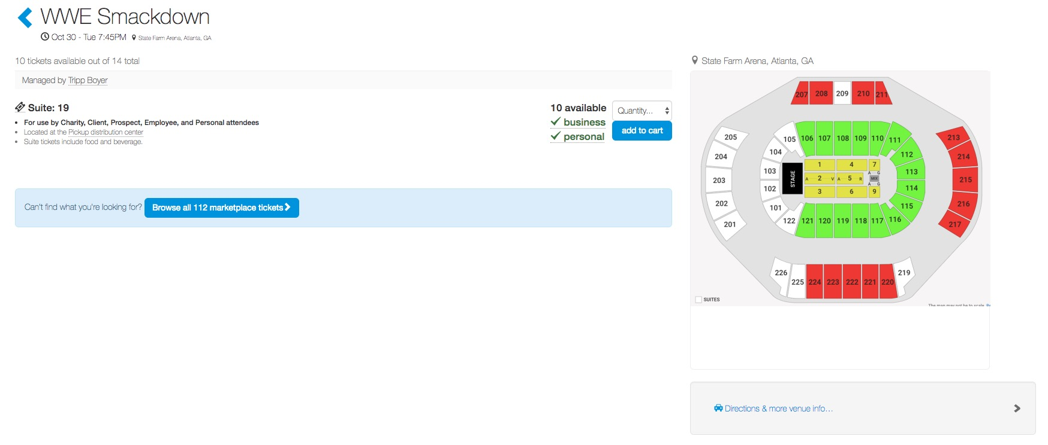
Requesting Tickets
Once an event of interest is selected users see a ticket overview including available tickets, their location, if they are accepting business or personal requests and who manages the tickets.

Slide 7
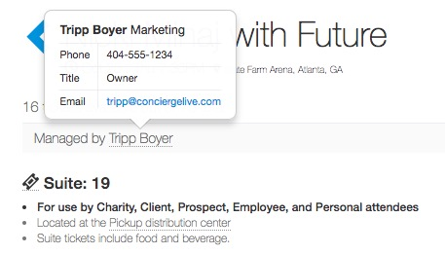

Requesting Tickets
In addition to ticket details, users can see the ticket admin who manages the tickets.
Ticket admin determine which requesters gets tickets.
User can see if tickets are available for business and/or personal use.
Once tickets are identified, select a ticket quantity, then click “add to cart”.

Slide 8
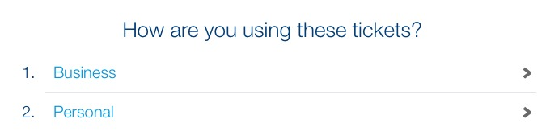
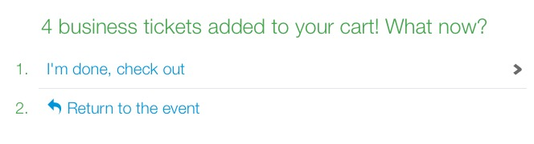
Requesting Tickets
If tickets are available for “Business” and “Personal” requests, users select how the tickets will be used.
If tickets are only available for either business or personal requests, this step will not appear.
In this case, the user will be using the tickets for business use, so select “Business”.
Once tickets are selected, they are added to the user’s cart.
Users can continue shopping or check out. In this example, click “I’m done, check out”.

Slide 9
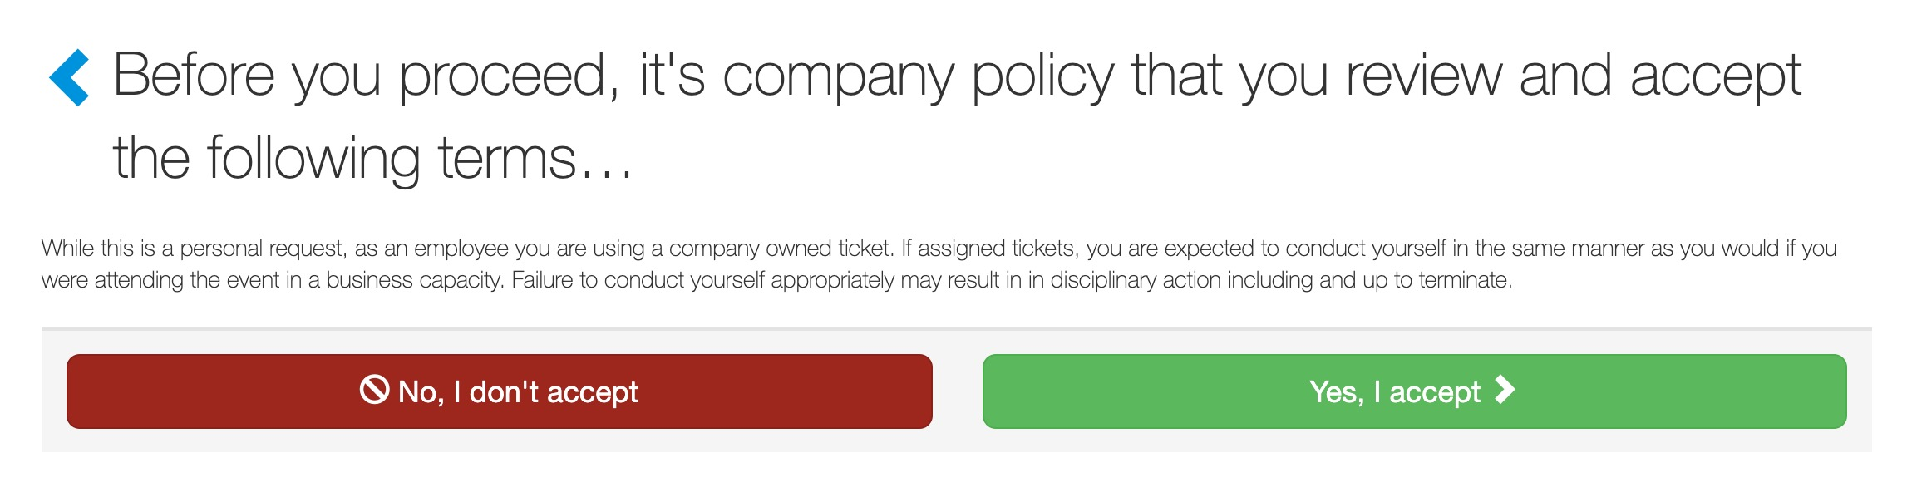
Requesting Tickets
Depending on company settings, users can be required to accept policies before they can check out.

Slide 10
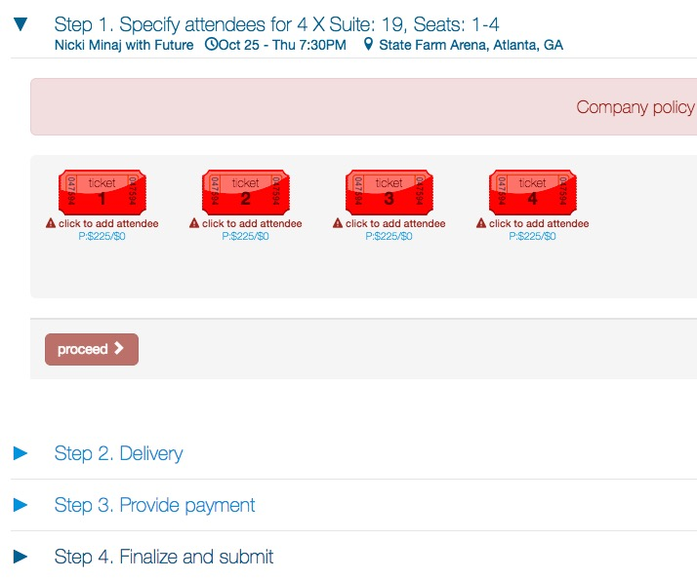
Requesting Tickets
The business checkout process is defined by the ticket admin who manages the tickets requested.
For business requests, users are required to identify attendees and complete any other check out steps (i.e. delivery, billing, etc.).
The first step is identifying attendees who will be using the tickets.

Slide 11
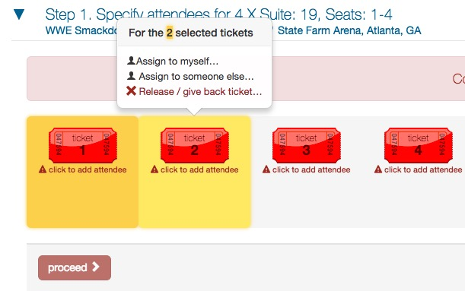
Requesting Tickets
Click the specific tickets you would like to give the first primary attendee (this would include any tickets the attendee’s non-business guests will be using [i.e. spouse, child, friend]).
If the requestor will be attending the event, select “Assign to myself…” from the pop-up.
If the requestor is not attending the event, select “Assign to someone else…” to give these tickets to another attendee.
In this example, Bobby (the user) will be attending with his client, so select “Assign to myself…”.

Slide 12
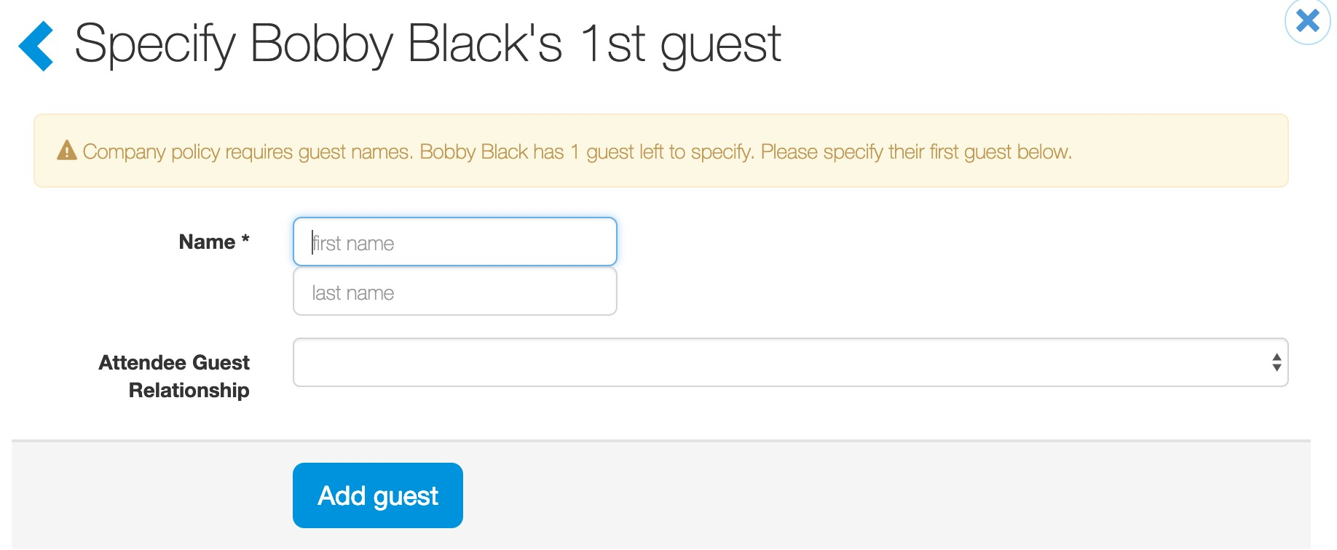
Requesting Tickets
Depending on company settings, requestors may be required to provide primary attendee guest information.
When required, requestors will be prompted to complete guest information (i.e. spouse, significant other, child, etc.) for the primary attendee.
Attendee guest information can be required for users/employees and/or external contacts.
This step will be omitted if attendee guest information is not required.

Slide 13
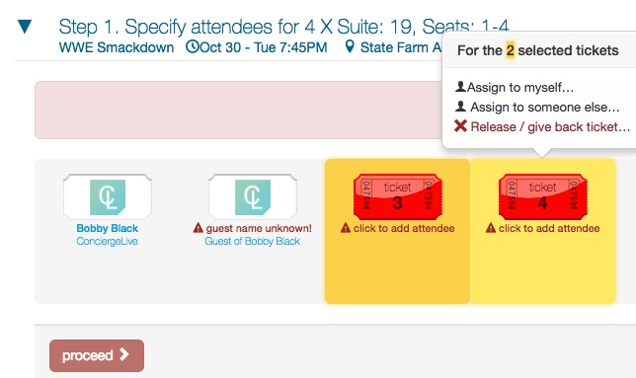
Requesting Tickets
All requested tickets must be assigned to an attendee in order to proceed to the next step.
You will continue to select tickets and add attendees until all the tickets are assigned.
Ticket can be released, by clicking “Release/give back ticket…”.
In this example, Bobby is bringing a client. Select the remaining tickets, then from the pop-up, select “Assign to someone else…”

Slide 14
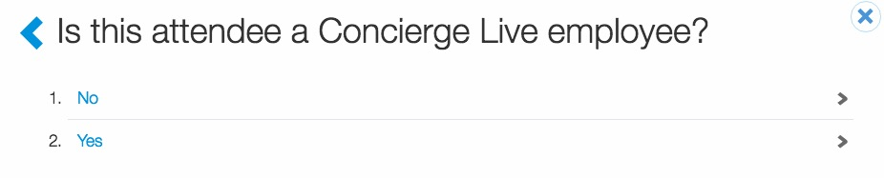
Requesting Tickets
Based on the type of attendee the requestor plans to entertain, select whether they are an employee of your company or an external attendee (i.e. client, prospect, etc.).
In this example, Bobby is bringing a client, so select “No”.

Slide 15
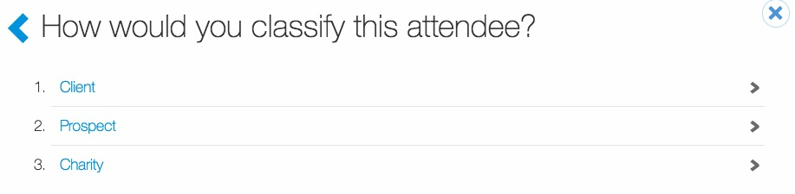
Requesting Tickets
Based on the type of attendee Bobby plans to entertain, select an attendee type.
Attendee type options will vary from company to company and different events may have different attendee types.
In this example, select “Client”.

Slide 16
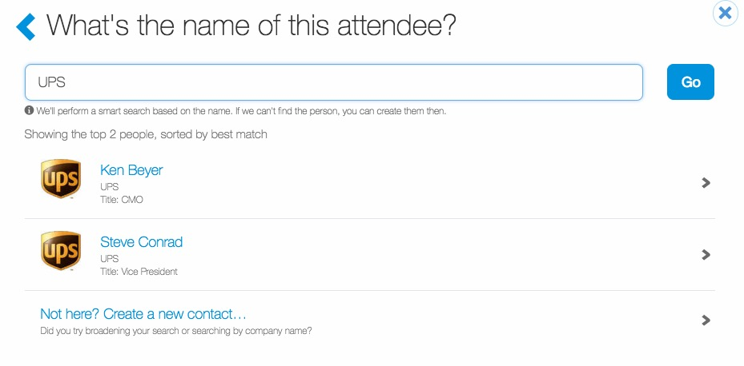
Requesting Tickets
Enter the attendee’s name or company and click “Go”.
If the attendee has previously been entertained, their name will appear. If the attendee does not appear, you will need to create a new contact ”Not here? Create a new contact…”.
Once a contact has been created, requestors are not required to re-create them for future entertainment opportunities.
In this example, Bobby is bringing “Ken Beyer” with UPS, click his name.

Slide 17
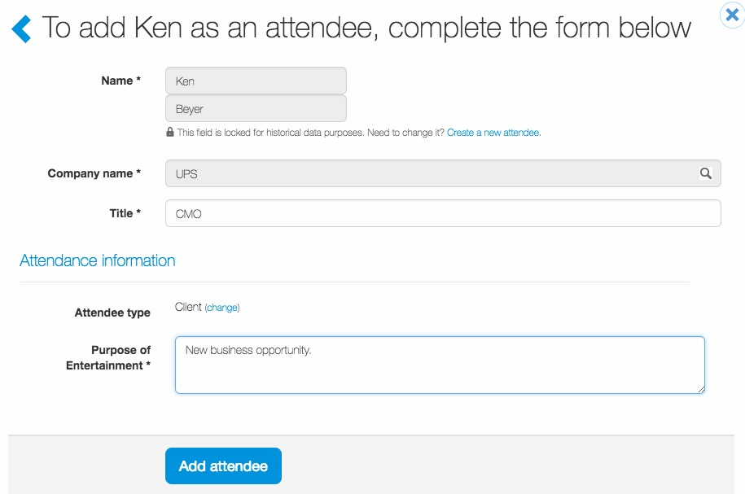
Requesting Tickets
For Ken’s profile, requestors may be required to complete fields before adding the attendee to tickets.
Once all required fields have been completed, click “Add attendee”.

Slide 18
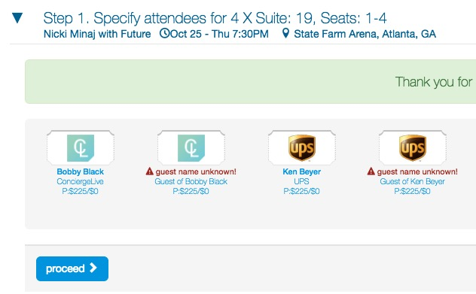
Requesting Tickets
Depending on company settings, like the previous attendee, requestors may be required to provide primary attendee guest information.
Users cannot proceed to the next step until all requested tickets are assigned to an attendee.
Once all tickets are assigned, the “proceed” button turns blue and users can proceed to the next step.

Slide 19
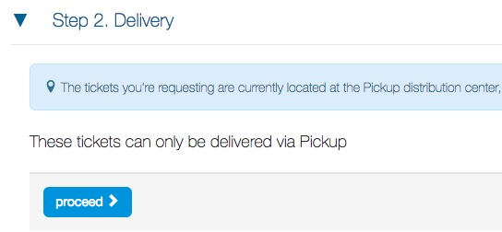
Requesting Tickets
Depending on a ticket’s configuration, users may have to select a delivery method.
Ticket delivery options will vary based on the ticket type and ticket admin. Options may include pick-up, interoffice, UPS, mobile, electronic, etc.
If there are no delivery options, the delivery step will be skipped.
For physical tickets deliveries, users can enter and save addresses for future deliveries.

Slide 20
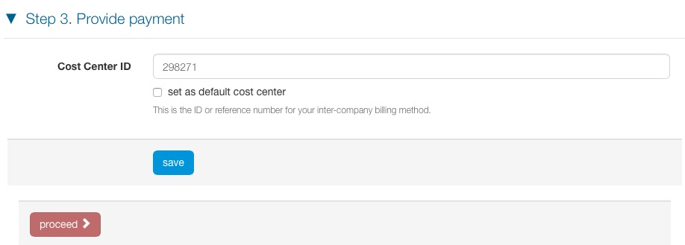
Requesting Tickets
When requestors are charged for tickets, a cost center or a credit card will be required.
If a cost center is used for billing, requestors can enter and set a default cost center.
If a credit card is used for billing, requestors can enter and save credit card data for future purchases.

Slide 21
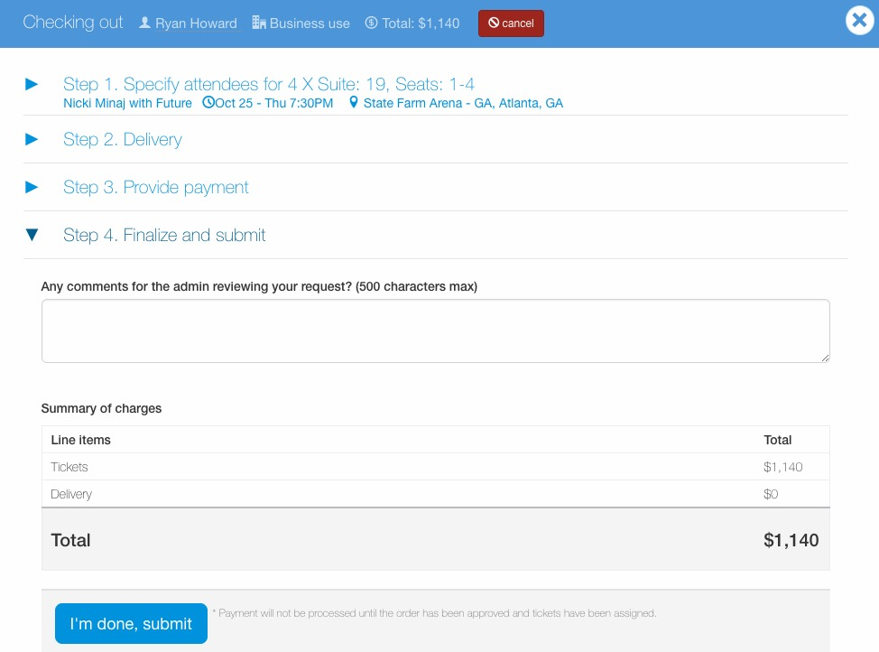
Requesting Tickets
Before a requestor submits a request, it can be reviewed and edited.
Requestors also have the option add comments viewable to the ticket admin.
Once satisfied with the request, click “I’m done, submit”.

Slide 22
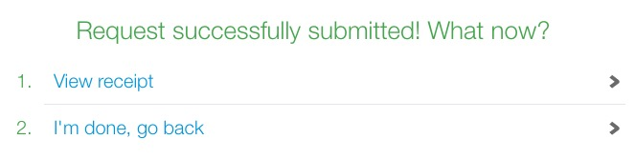
Requesting Tickets
After you submit the request, you have 2 options:
  View receipt: allows you to view the request summary.
  I’m done, go back: takes you back to the Home page .
Submitting a request is not a guarantee of tickets. Users will be notified when their request is approved or declined.
Users can edit attendee and request information through their request history (click your name [top of the page], then “My request history”).

Slide 23

Support
Technical Support
If you need any help or have any questions, please access the Support Center on the top left beside your name labeled Help.
There are additional resources for general questions as well as contact information for additional support on this page.
Please contact your ticket admin or support@conciergelive.com if you have any questions.
Ticketmaster Mobile
If you need any help or have any questions, regarding mobile tickets including claiming/accepting and transferring tickets, please contact Ticketmaster or click the links below:
Accept tickets: https://help.ticketmaster.com/s/article/How-do-I-accept-transferred-tickets?language=en_US&r=4&ui-force-components-controllers-recordGlobalValueProvider.RecordGvp.getRecord=1
Transfer tickets: https://help.ticketmaster.com/s/article/How-do-I-transfer-tickets?language=en_US

