Slide 1
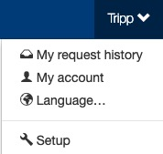
Attendee Types
The Setup section is where setup admin can control account behaviors. From updating attendee types and data fields, to delivery options for tickets, to branding the site; all is done in the Setup section.
To access the Setup section, click on your name (top of the page), then click “Setup”.

Slide 2
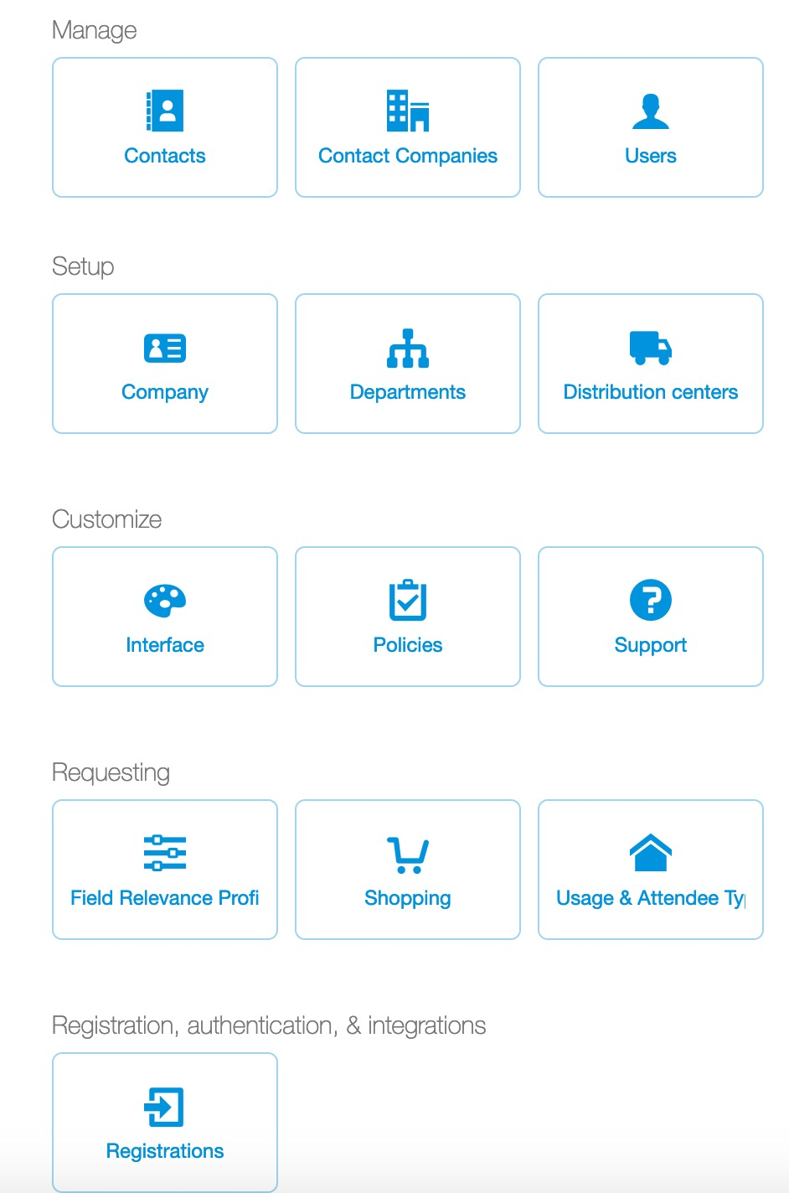
Attendee Types
To review, add, edit attendee types, ticket admin must go to the Setup section (click your name, then Setup).
Attendee types are used to capture information on attendees using tickets.
Common attendee types include: Client, Prospect, Charity, Employee Host and Personal Use.
Setup admin can view, edit and add attendee types, by clicking “Usage & Attendee Types”.

Slide 3
Attendee Types
By default new Concierge Live accounts are created with the following attendee types and field requirements:
  Charity = Name (o); Title (o) Company Name (r); Tax ID (r)
  Client = Name (o); Company Name (r); Title (r); Purpose of Entertainment (r)
  Employee = Name (r); Email (r); Title (r); Phone (r)
  Prospect = Name (o); Company Name (r); Title (r); Purpose of Entertainment (r)
  o = Optional
  r = Required
For mobile tickets, if you allow ticket requestors to transfer tickets directly to their attendees, email must be a required field for your attendee types. See the field relevancy deck to set field requirements.
To modify field setting for an attendee type, please see the Field Relevancy deck for step by step instructions.

Slide 4
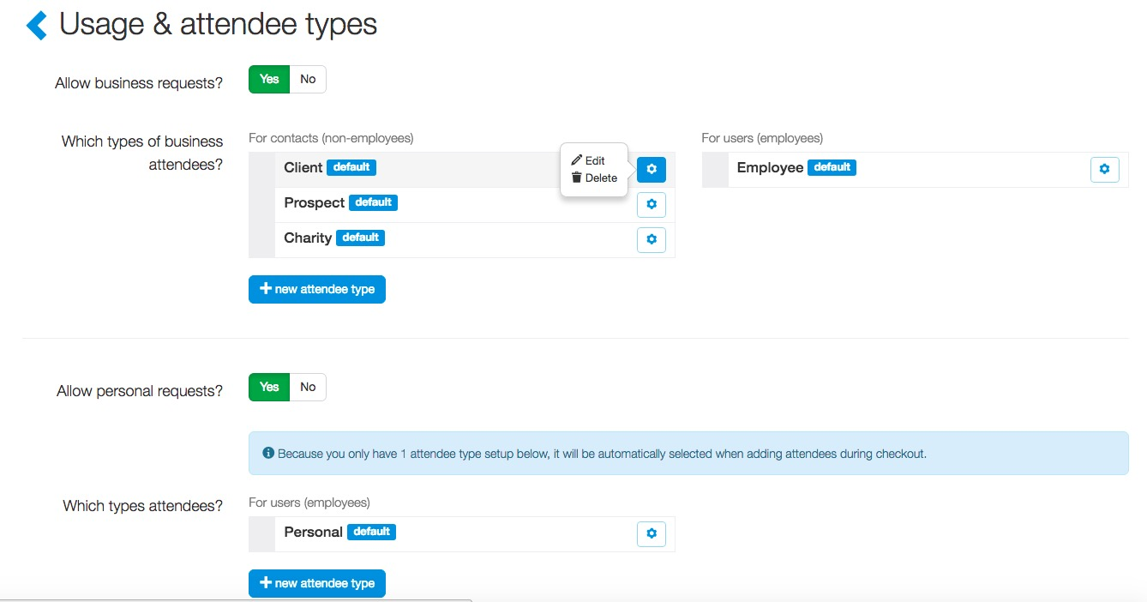
Attendee Types
Concierge Live has created default attendee types which can be modified based on your specific needs.
To view or edit an existing attendee type, click the cog icon for the attendee type of interest, then “Edit”.

Slide 5
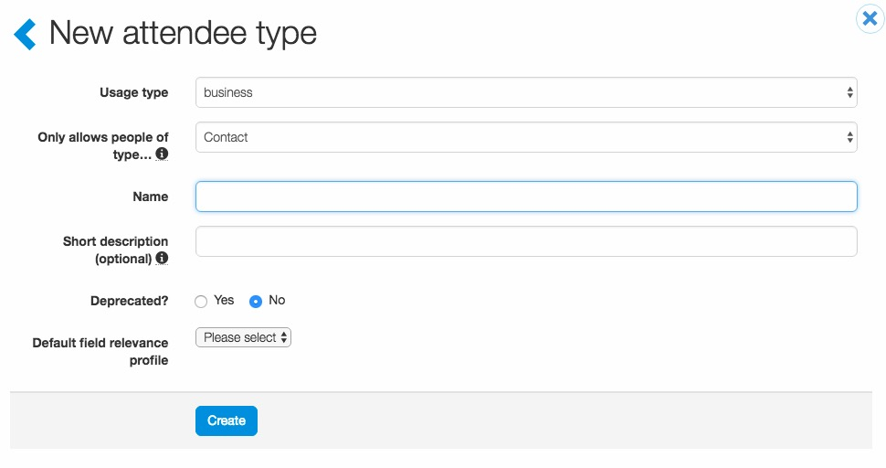
Attendee Types
When viewing and editing:
Usage type: Select business (business use) or personal (employee personal use).
Only allows people of type…: Select contact (this is for external attendees) or user (this is for employee use – like an employee host or personal use).
Name: Name of the attendee type (Client, Prospect, Vendor, Government Official, etc.).
Short Description: Add language which is viewable to users during the request process to clarify information about the attendee.
Deprecated: Removes the attendee type as an option for users to select when entertaining but retains the information for reporting.
Default field relevancy profile: The field relevancy determines the fields a user has to complete when entertaining an attendee.

Slide 6
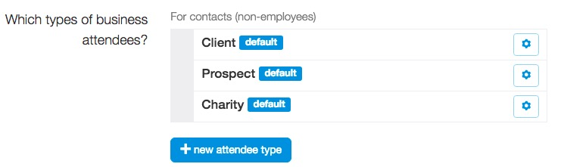
Attendee Types
To add a new attendee type, click “+ new attendee type”.

Slide 7


Attendee Types
By default, business and personal requests are enabled.
If ticket admin do not want to allow business or personal requests, click “No”.
When enabled, ticket admin can determine if an attendee type is enabled by default.

Slide 8
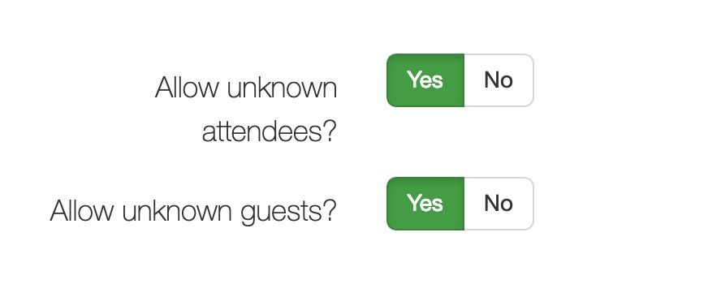
Attendee Types
Unknown Attendees:
Unknown attendee types give users the ability to make a request even if they don’t know the specific attendee that they will be entertaining.
Unknown Guests:
Unless a compliance reason requires your company to capture primary guest information, it’s recommended that “Allow unknown guests” be set to “Yes”.
When unknown guests are not allowed (set to “No”) requestors must provide a name for every ticket assigned to an attendee (employee or contact). For example, a requestor gives Rick Thomas 2 tickets, the system assigns 1 ticket to Rick, the requestor then has complete information on Rick’s guest (Rick’s +1).

