Slide 1
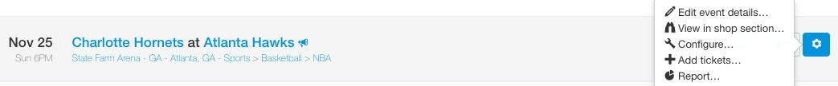
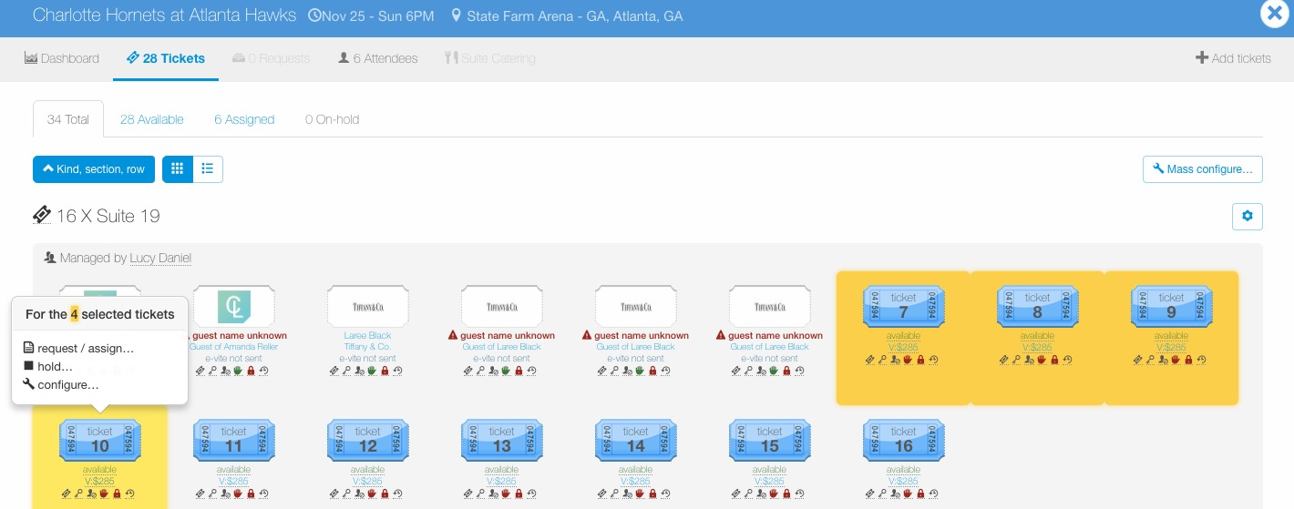
Configure – Billing
To configure tickets for an entire event, go to the Manage page, find the event, click the wheel icon to the right of the event and then click “Configure…”.
To configure a certain ticket group or individual tickets within an event, go to the Manage page, find the event and click the ticket icon to view tickets for the event.
Once in the event, click the “cog” icon next to the ticket group to edit an entire ticket group or click individual tickets to configure, then select “configure…”.

Slide 2
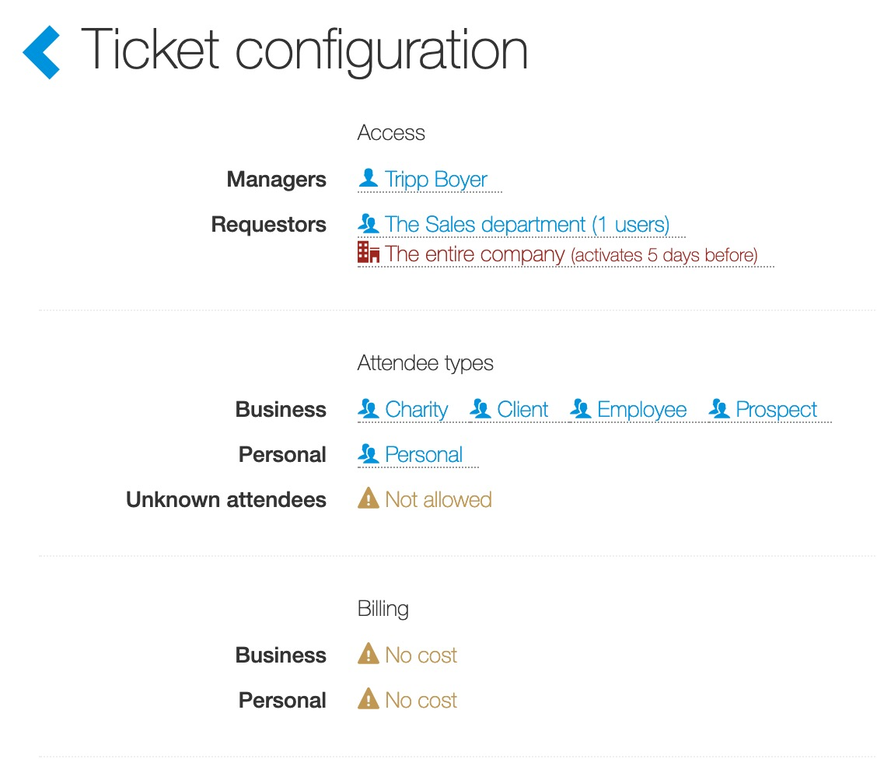
Configure – Billing
When a company charges business units for ticket usage, ticket admin can require users to pay for tickets. Billing options are based on your preferences, but they can be changed for specific tickets.
Please note, business and personal use are different billing options. Ticket admin can update one or both. If a billing configuration is applied for business ticket use and not for personal ticket use, users will not be required to complete a billing step for personal ticket use.
For business use, click on the “! No cost” next to Business.
For personal use, click on the “! No cost” next to Personal.

Slide 3
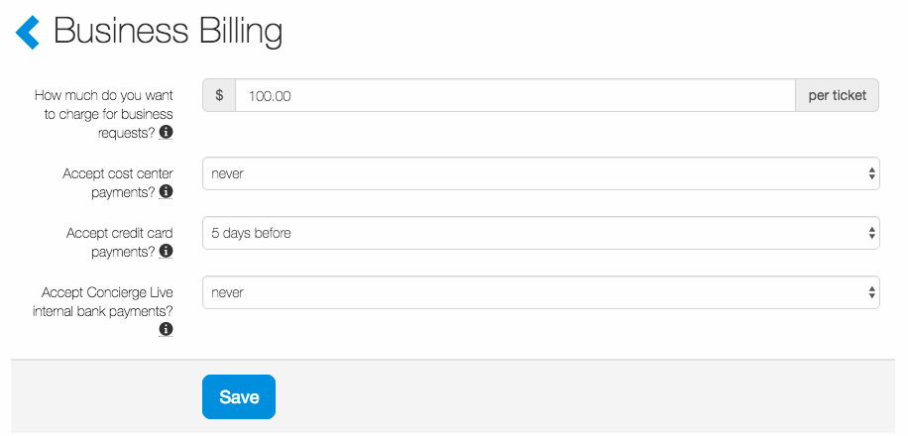
Configure – Billing
For business use, ticket admin will be able to input how much they want to charge per ticket as well as the type of payment method they would like accepted and the timing of when the user will be charged.
Ticket admin can pick whether they want to charge via cost center, credit card and/or Concierge Live’s internal bank payments.
Once done updating the business use billing, click “Save”.

Slide 4
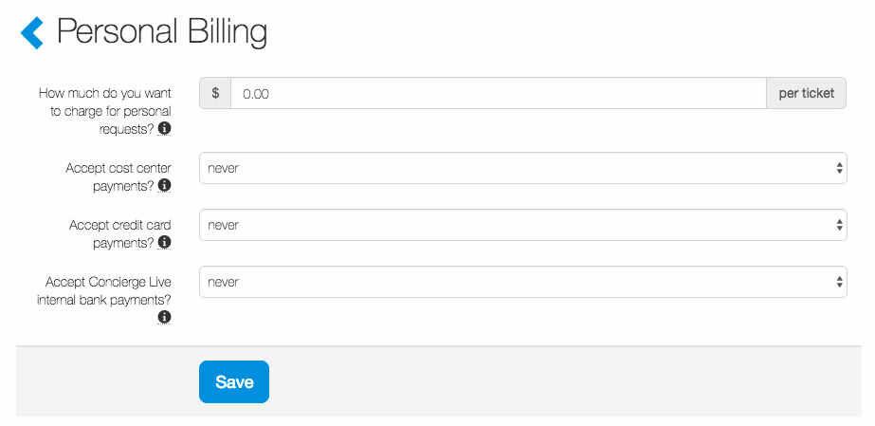
Configure – Billing
For personal use, ticket admin will be able to input how much they want to charge per ticket as well as the type of payment method they would like accepted and the timing of when the user will be charged.
Ticket admin can pick whether they want to charge via cost center, credit card and/or Concierge Live’s internal bank payments.
Once done updating the personal use billing, click “Save”.

