Slide 1
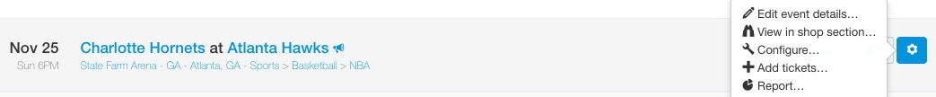
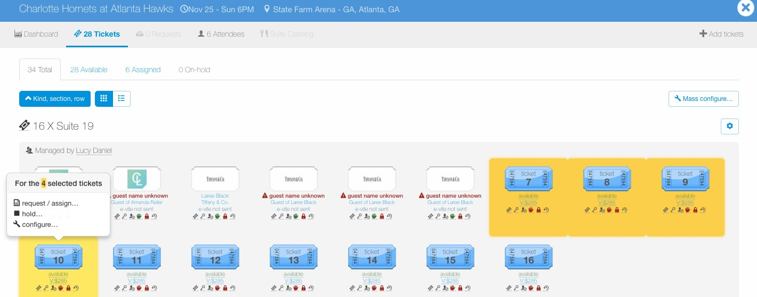
Configure – Delete Tickets
Tickets can also be deleted in bulk, through Mass Configure.
To configure tickets for an entire event, go to the Manage page, find the event, click the wheel icon to the right of the event and then click “Configure…”.
To configure a certain ticket group or individual tickets within an event, go to the Manage page, find the event and click the ticket icon to view tickets for the event.
Once in the event, click the “cog” icon next to the ticket group to edit an entire ticket group or click individual tickets to configure, then select “configure…”.

Slide 2
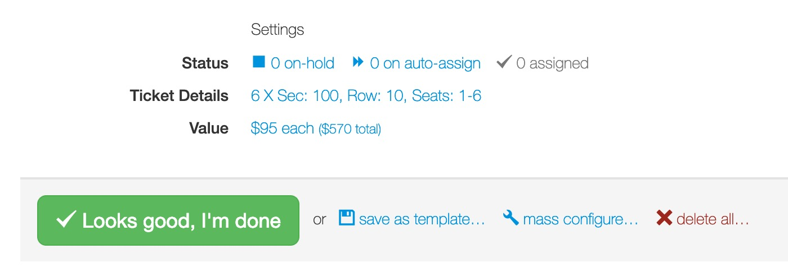
Configure – Delete Tickets
To delete tickets, click “X delete all…” at the bottom of the Configure page.
Once deleted, the action cannot be undone.
Any requests for deleted tickets will be automatically cancelled.

