Slide 1
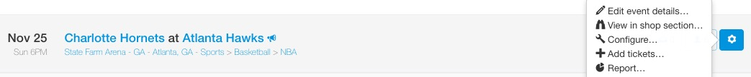
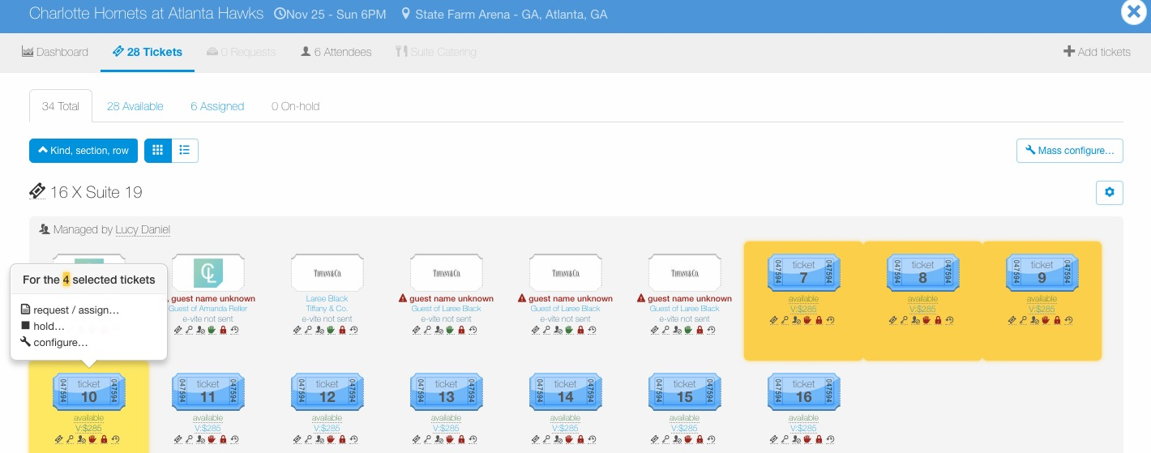
Configure – Request Permissions
To configure tickets for an entire event, go to the Manage page, find the event, click the wheel icon to the right of the event and then click “Configure…”.
To configure a certain ticket group or individual tickets within an event, go to the Manage page, find the event and click the ticket icon to view tickets for the event.
Once in the event, click the “cog” icon next to the ticket group to edit an entire ticket group or click individual tickets to configure, then select “configure…”.

Slide 2
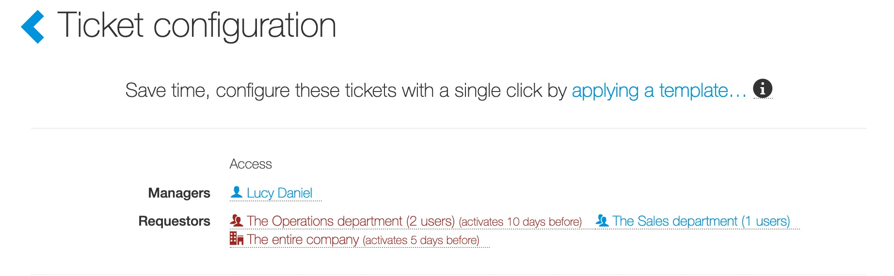
Configure – Request Permissions
Next to Requestors, click a requestor’s name or as seen in the screenshot below “The Operations department”.

Slide 3
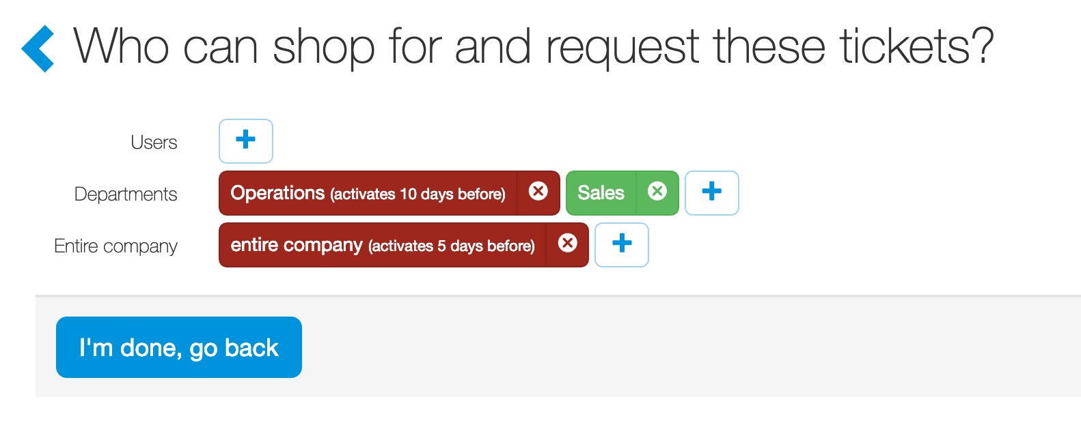
Configure – Request Permissions
Requestors: Ticket admin can control who can access and request tickets and when they can do so. Ticket admin can set access by:
Users: individual users
Department: all users in a department.
Entire Company: all registered users.
To add a shop permission, click the “+” next to the header for Users, Departments and/or Entire Company.
To remove a shop permission, click the white “X”.

Slide 4
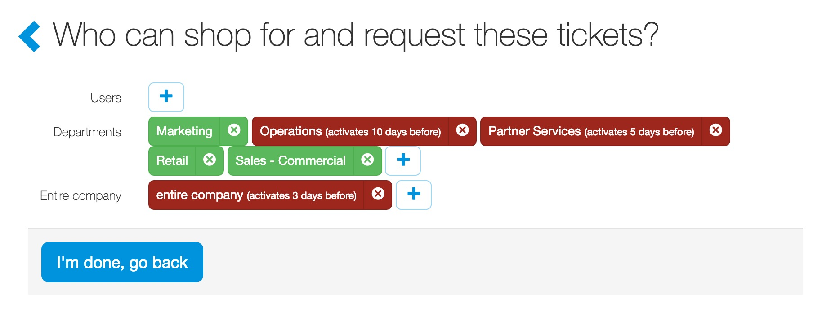
Configure – Request Permissions
The most common way ticket admin limit request access to tickets is by department. Many clients will cascade access of available ticket to other departments or users as the event date gets closer to ensure tickets are used. This approach gives a first right of refusal to departments or a user(s) however, based on ticket availability, automatically broadens request access to other departments or users as the event date approaches. Tickets can have multiple request access triggers. In this example, Marketing, Retail and Commercial Sales can request tickets immediately. If these tickets are still available, in addition to users in Marketing, Retail and Commercial Sales, users in the Partner Services department will gain request access 5 days before the event and users in the Operations department will gain request access 10 days before the event. Three (3) days before the event, if tickets are still available the entire company will have access to request these tickets.

Slide 5
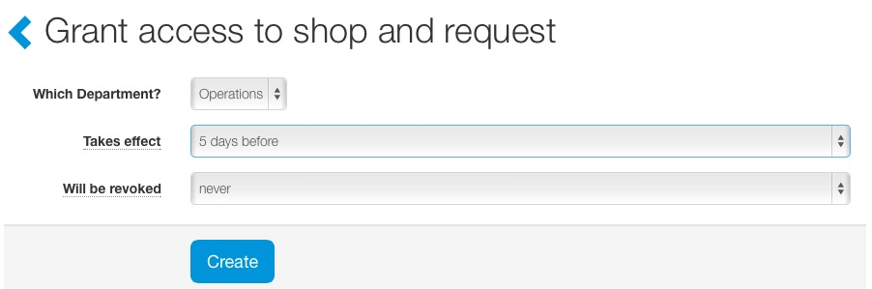
Configure – Request Permissions
Triggers can be set to create tiered access to tickets.
Takes effect: A trigger allows ticket admin to set a timeframe when users have access to tickets.
Will be revoked: A trigger can be set for ticket admin to remove user access to tickets.
Triggers can be applied to individual users, departments, or the entire company.

