Slide 1
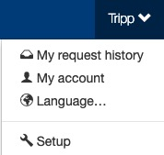
Departments
The Setup section is where setup admin can control account behaviors. From updating attendee types and data fields, to delivery options for tickets, to branding the site; all is done in the Setup section.
To access the Setup section, click on your name (top of the page), then click “Setup”.

Slide 2
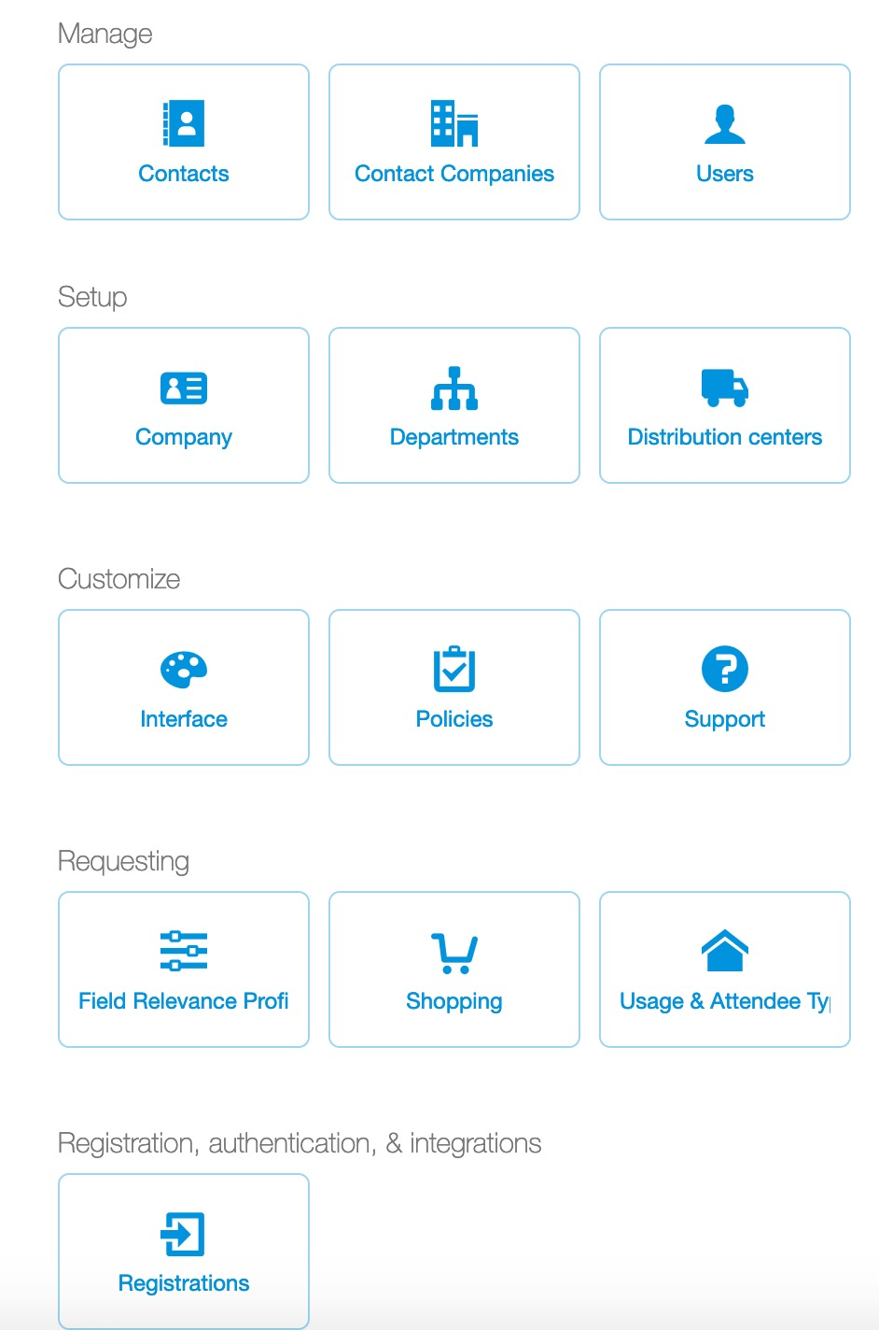
Departments
To review, create or manage departments, in the Setup section, click the “Departments” button.
If a company uses a directory feed, it may not be possible to add/edit department details. If your company uses a directory feed, please contact your ticket Admin for any department changes.

Slide 3
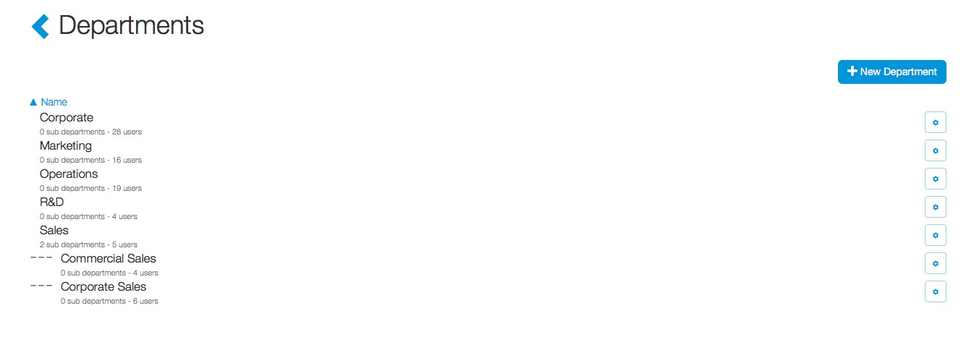
Departments
Ticket admin can create or edit department information. To create a new department, click “+ New Department”.

Slide 4
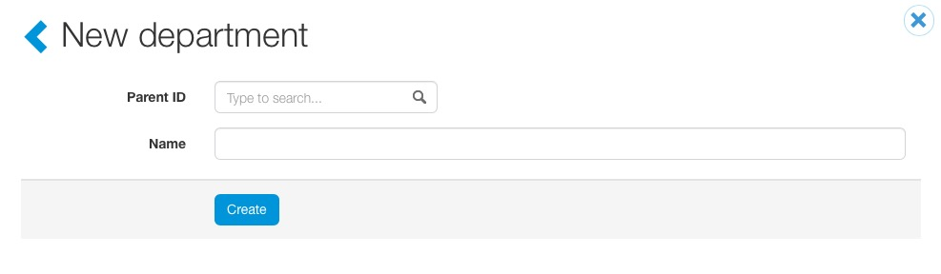
Departments
When creating a new department, ticket admin can create sub departments. To create a sub-department, search for the parent name in the “Parent ID” search box. A quick search will appear with any relevant department matches.

Slide 5
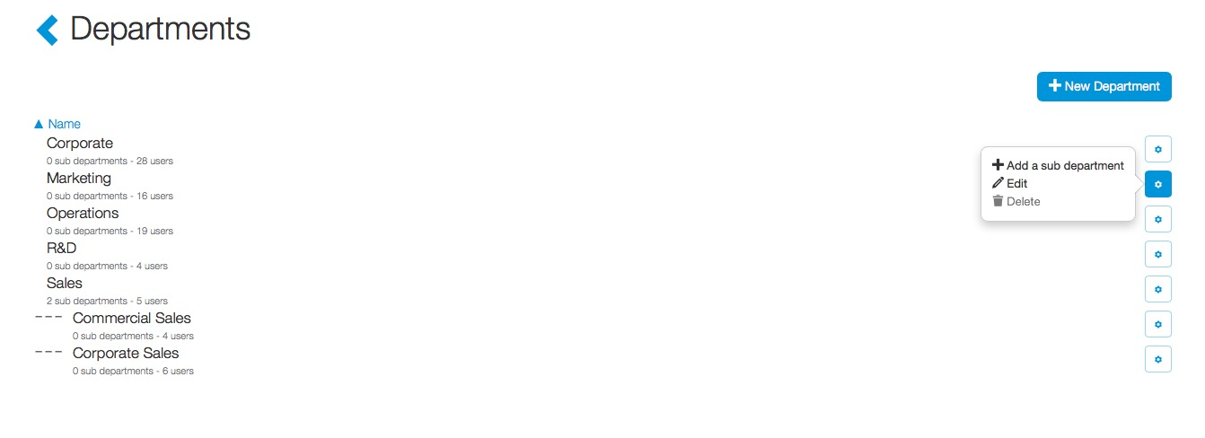
Departments
To edit or delete an existing department, click the “wheel” icon for the department. From here, ticket admin can create a sub department, edit the department name, parent department or delete the department.
Users are added/edited to departments through the User section (on the Setup page) or through a user’s account profile.
If a department contains users, the department cannot be deleted. In order to delete the department, ticket admin must shift the user(s) to a new department, then the option to delete will be available.

