Slide 1
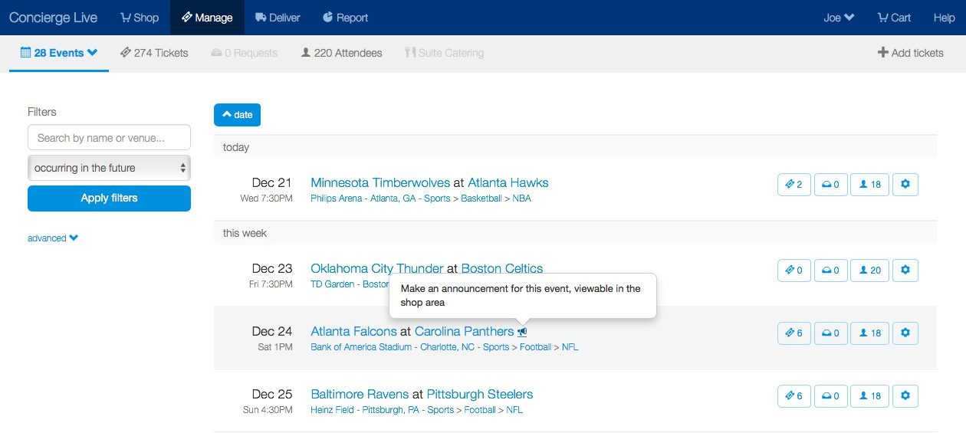
Event Announcement
Ticket admin can create announcements on the Manage Page.
To create an announcement, click on the megaphone icon next to the event title.

Slide 2
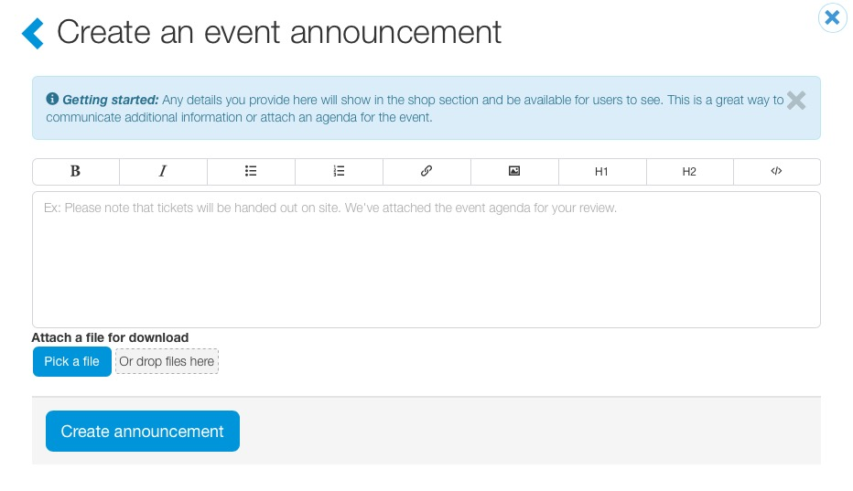
Event Announcement
Ticket admin can style the announcement and include a link or an attachment.
Once a ticket admin has finished, click “Create announcement”.

Slide 3
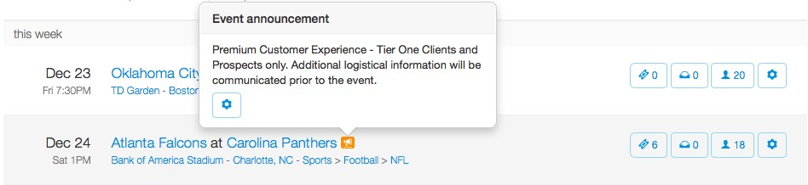
Event Announcement
Once saved, a megaphone icon highlights (in orange) and the announcement is viewable to ticket admin on the manage page.
Ticket admin have the option to edit or delete the announcement from the megaphone by clicking on the wheel icon in the announcement.

Slide 4
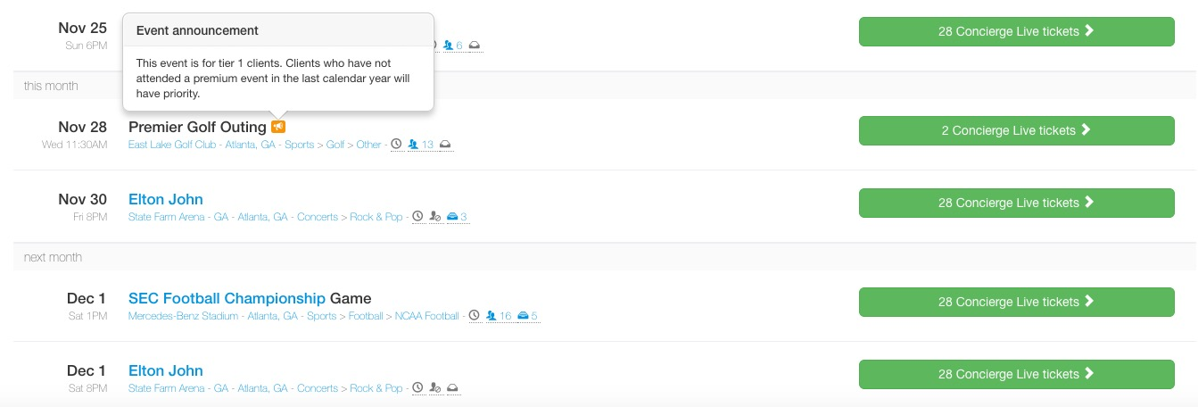
Event Announcement
Once an announcement is saved, users can view the announcement by moving their mouse over the highlighted megaphone icon (in orange next to the event name) on the Shop page.

Slide 5
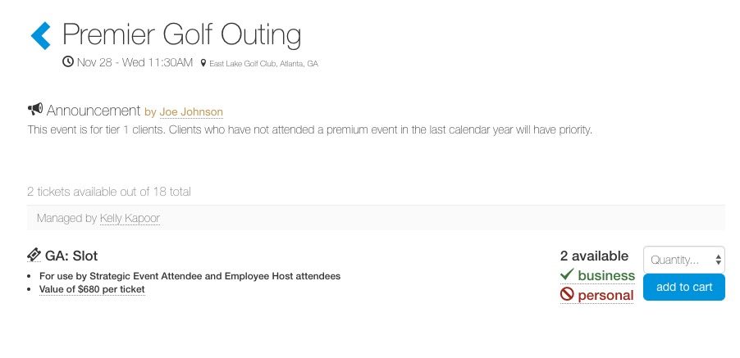
Event Announcement
When a user clicks into an event, they will see the announcement at the top of the page on the tickets view page.

