Slide 1
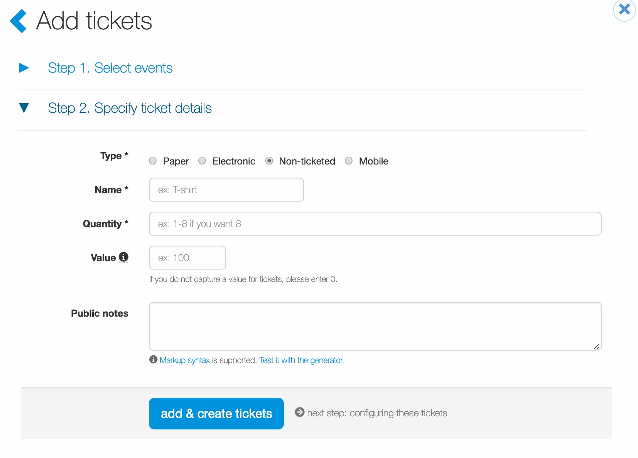
Non-Ticketed Items
Ticket admin can add non-ticketed inventory which follows the same process as creating ticketed inventory.
Once the events have been selected, in “Specify Ticket Details” step, select “non-ticketed”.
Enter the:
  Name of the item (i.e. hat, shirt, etc.)
  Quantity (1-10)
  Value (if there is no value, enter 0 [zero])
  Public notes (if applicable)

Slide 2
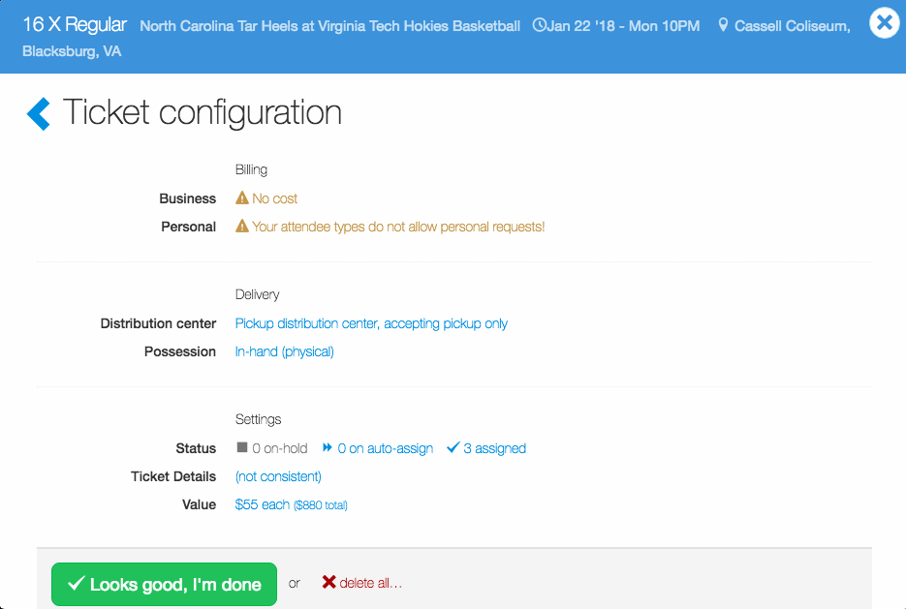
Non-Ticketed Items
Once non-ticketed inventory has been created, ticket admin can configure the items.
The configure process for non-ticketed items is the same as configuring tickets (i.e. billing).

Slide 3
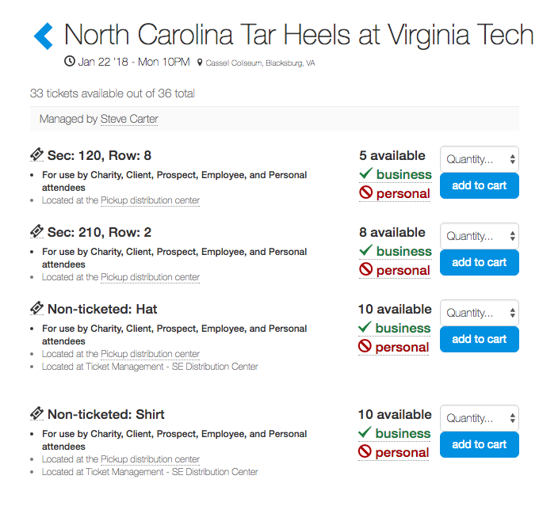
Non-Ticketed Items
Based on a user’s access, they can view and request non-ticketed items.
Like tickets, the request process is based on how the ticket admin configures the non-ticketed items.

Slide 4
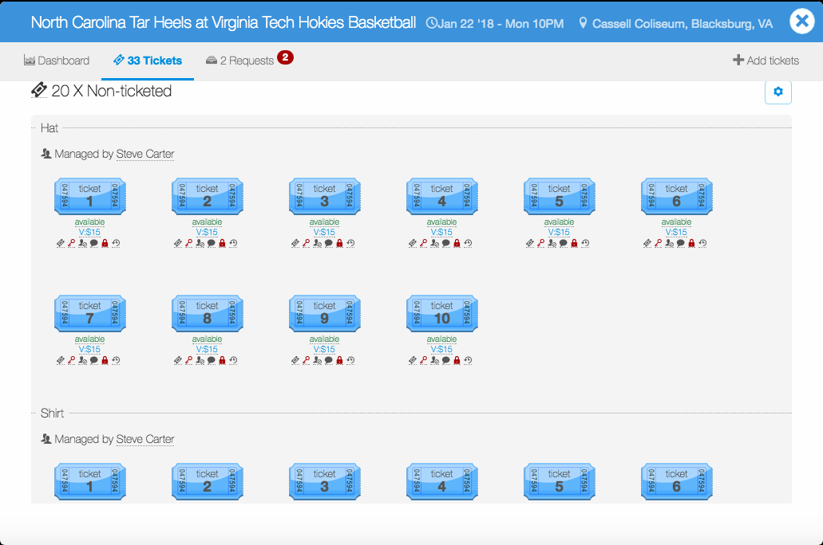
Non-Ticketed Items
Once created and configured, ticket admin with management permissions will see all non-ticketed items on their manage-tickets page.
Ticket admin can make requests on behalf of users for non-ticketed items.

Slide 5
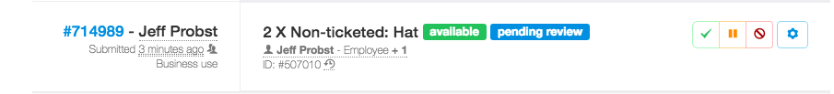
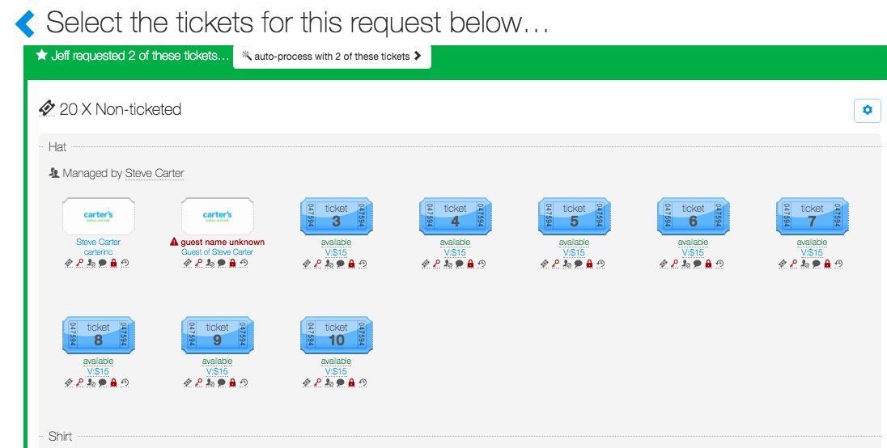
Non-Ticketed Items
When processing non-ticketed requests, if there are multiple non-ticketed items for an event, process non-ticketed requests manually vs. auto-process.
When a ticket admin auto-processes a non-ticketed item request, Concierge Live will approve the first available item which may not be the correct non-ticketed items (i.e. shirt vs. hat).

Slide 6
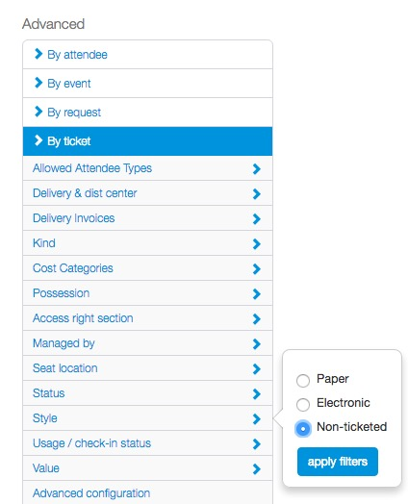
Non-Ticketed Items
Once a report is generated, to limit returns to only non-ticketed items, apply the “non-ticketed” filter under “By ticket” in the “Style” section of advanced filters.

Slide 7
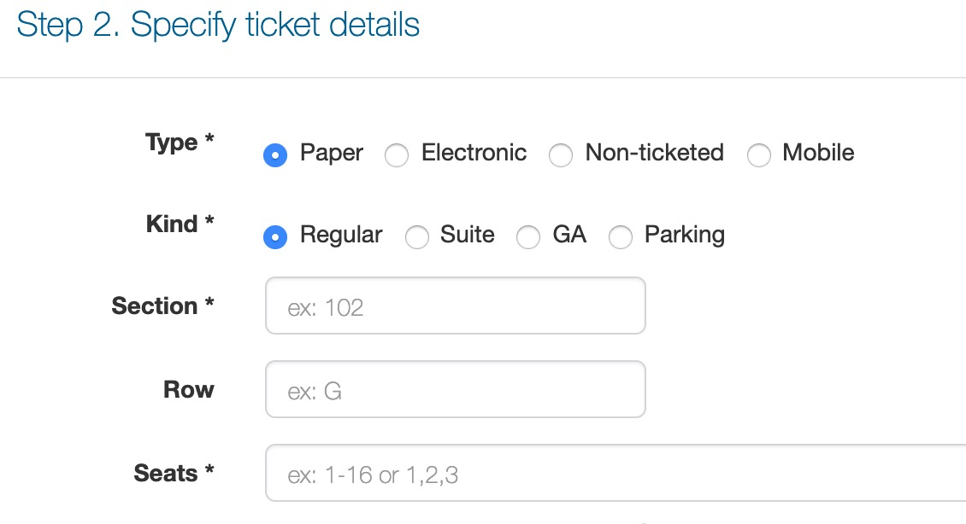
Non-Ticketed Items
Non-ticketed inventory does not appear as a quantity on the tickets page. In this example, there are 13 tickets and 10 non-ticketed items. Notice that only 13 tickets appear, though there may be non-ticketed inventory available for the event.
If a request is made for non-ticketed inventory, the request will appear in the request tab section and if enabled the admin will receive an email notification regarding the request.
If ticket admin want to see quantities for non-ticketed inventory, they will need to select “Paper” as the kind of inventory.
The primary drawback to using paper as the kind of inventory is users will see “section” and “seats” for the name and quantity for the non-ticketed inventory. When you select ”Non-ticketed” for the kind, admin enter the name of the item and the quantity.

Slide 8
Non-Ticketed Items
Non-ticketed Item Tips
Depending on your needs, it may make sense to create an ”any day” event for your non-ticket inventory. Based on access, “any day” events appear at the top of the shop page.
Like ticket requests, if non-ticketed items are in a different distribution center than the other tickets in a user’s cart, the user will have to place 2 separate requests. All tickets and non-ticketed items in a request must belong to the same distribution center to keep delivery during checkout consistent. For example, you cannot request electronic tickets and a non-ticketed item (i.e. a hat) on the same request.

