Slide 1
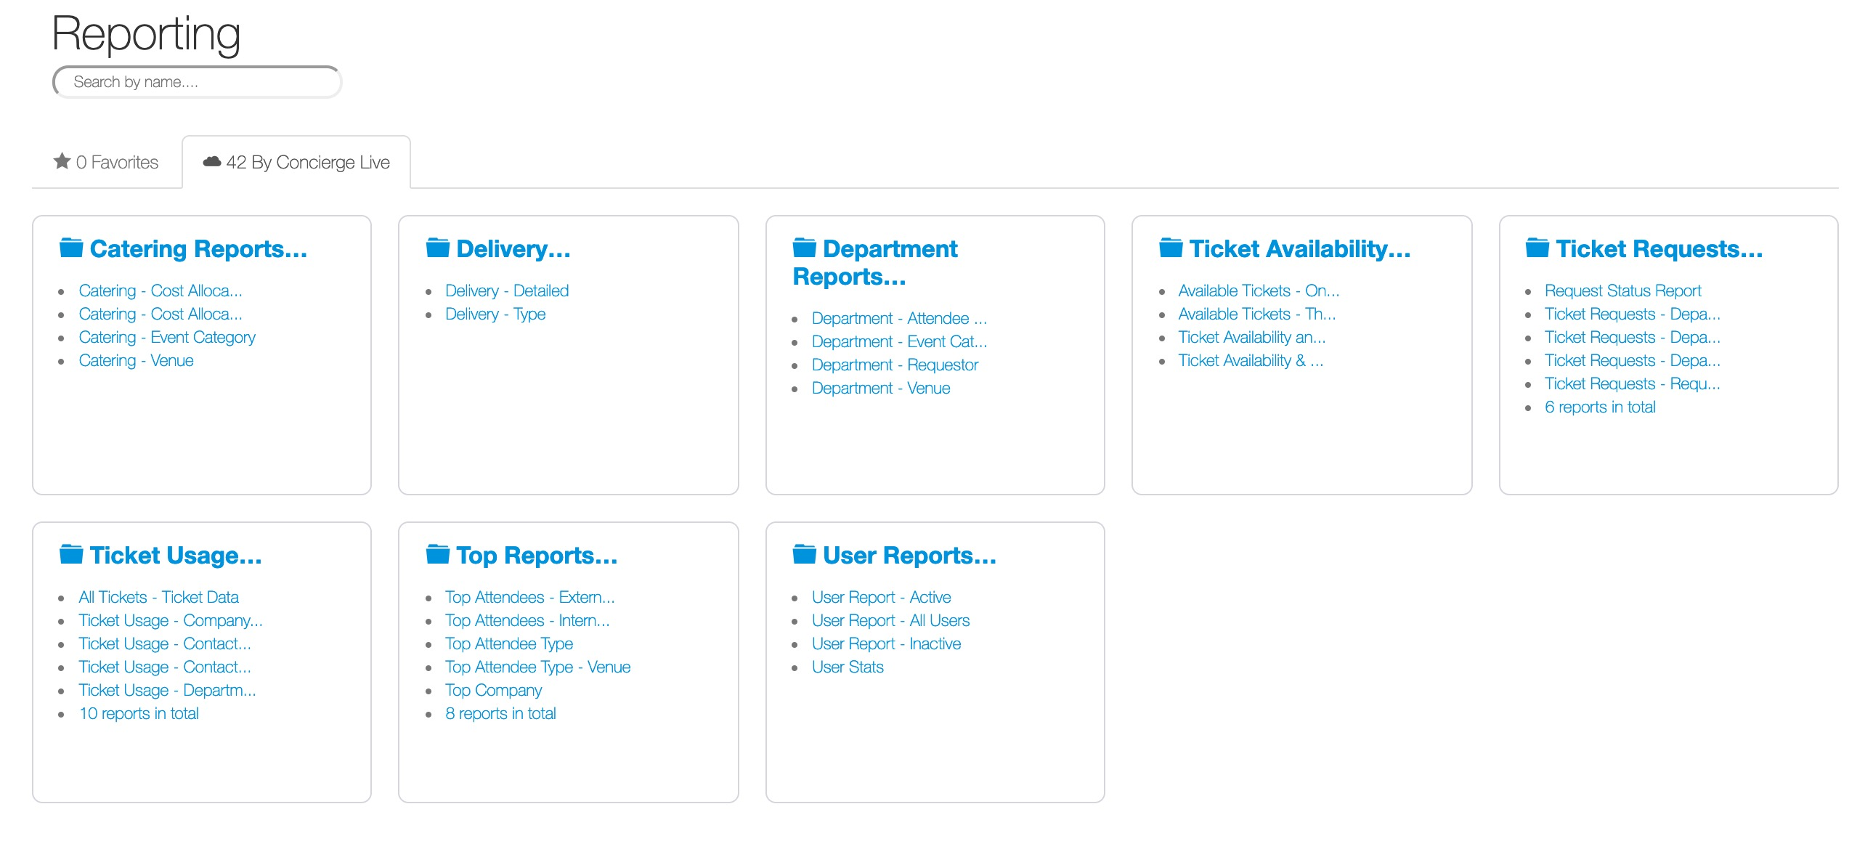
Reports
Concierge Live provides a variety of reports for ticket admin to view and evaluate their ticket assets.
To drill into a report group, click on a report header (i.e. Top Reports).

Slide 2
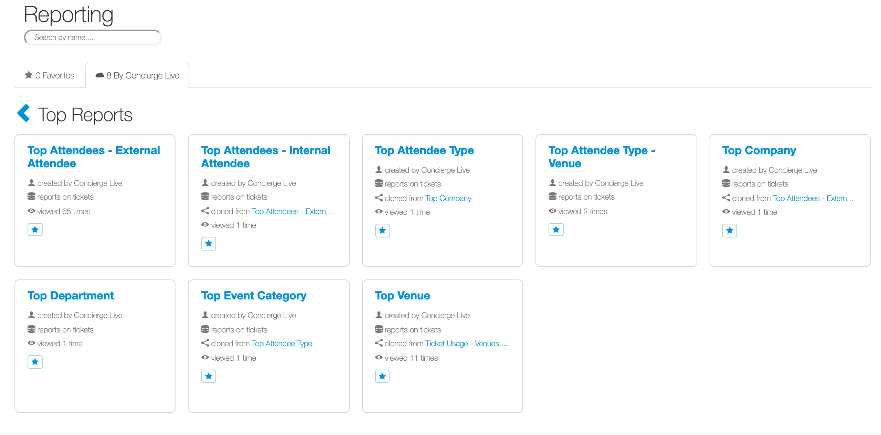
Reports
Once in a report group, to view a report, click on the report name (i.e. Top Attendees – External Attendees).

Slide 3
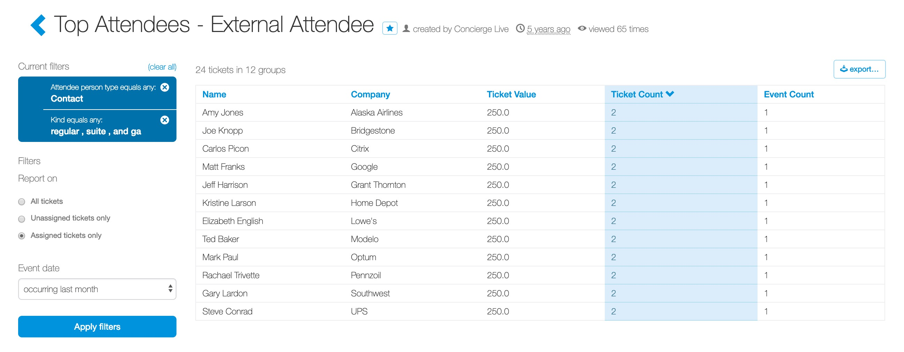
Reports
Ticket admin can view and filter data using the filters on the left-hand side.
Ticket admin can also export report data to Excel or CSV.

Slide 4
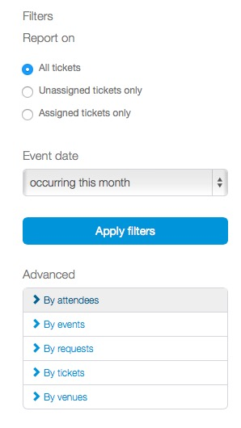
Reports
The filters on this page follow the same pattern as other filters throughout Concierge Live.
Use the filters to narrow the scope of your reporting (i.e. date range, venue, performers, attendee types, etc.).

Slide 5
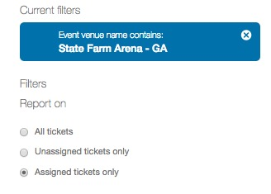
Reports
Once applied, filters appear in a blue box.
To remove an applied filter, click the “x” located beside the filter name.

Slide 6
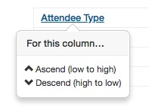
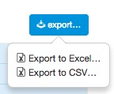
Reports
In the report itself, ticket admin can click on a column name to:
  Sort (ascend or descend)
  Group (vertically or horizontally)
To export the report, click the export button on the far right of the report. From here, ticket admin can export to Excel or CSV.

