Slide 1
Configuration Templates
Configuration templates are a simple and efficient way for ticket admin to create, save and apply configuration settings to tickets.
Configuration templates can be created for venue, a ticket type, an event category, a department, or any configuration settings a ticket admin needs (i.e. Premium Concerts, NFL suite tickets, NBA tickets, etc.).
Ticket admin can have as many templates as they need and can revise, edit or add new templates as needs change.
Only Setup Admin can share their saved templates with other ticket admin.
Applying a configuration template isn’t finalizing the tickets. The ticket admin will return to the configuration overview to update or modify any configuration settings.

Slide 2
Configuration Templates
Creating a configuration template:
When configuring tickets, ticket admin can create and save a configuration template.
To create a template, apply preferred configure settings to all relevant categories (i.e. managers, requestors, distribution centers, etc.).
To save a template after creating, click “save as template…” at the bottom of the page.
The following configuration settings that are NOT included when saving or applying a template:
Delivery - Possession
Billing Costs
Value

Slide 3
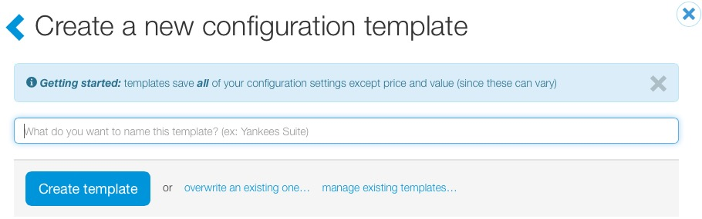
Configuration Templates
When saving a template, ticket admin have two options:
  Create a new configuration template.
    Enter a template name and click “Create template”.
  Or overwrite an existing configuration template.
    Click “overwrite an existing one…”.

Slide 4
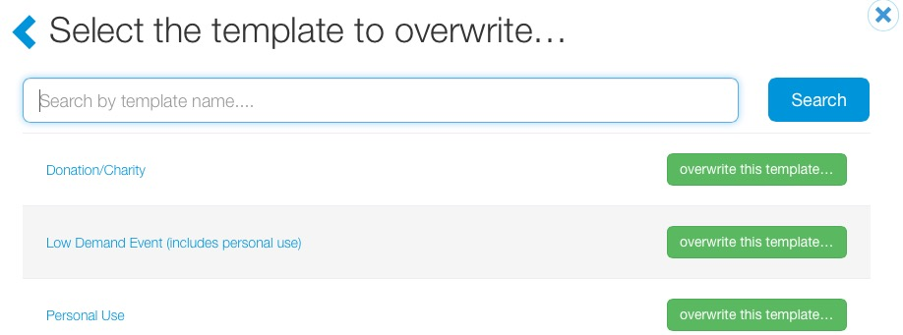
Configuration Templates
Select the template in order to overwrite it. When a template is overwritten, changes will not be retroactively applied to previous events that had the original template applied.

Slide 5
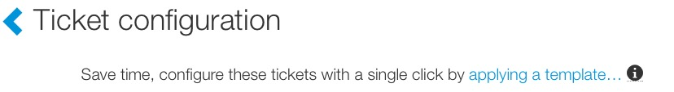
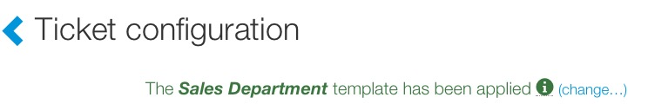
Configuration Templates
Applying a saved template:
Ticket admin also can configure tickets by applying a saved template. To apply a template, click “applying a template…” at the top of the page.
If a template is applied to tickets, the name of the template will be viewable at the top of the configure window.

Slide 6
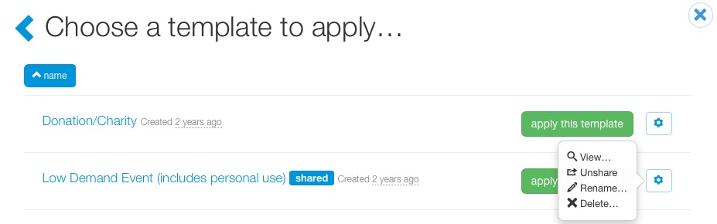
Configuration Templates
Templates are private to the ticket admin who created them. Setup admin are the only ticket admin who can share templates:
For Setup Admin, to share a template, click the wheel icon and select share.
After a template has been shared, the word shared will appear next to the template name.
If you no longer want company ticket admin to see the template, click the wheel icon again, and click “Unshare”.
From the same screen, ticket admin have the option to view, rename a template or delete entirely.

