Slide 1
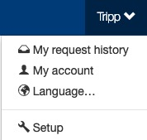
Users
The Setup section is where setup admin can control account behaviors. From updating attendee types and data fields, to delivery options for tickets, to branding the site; all is done in the Setup section.
To access the Setup section, click on your name (top of the page), then click “Setup”.

Slide 2
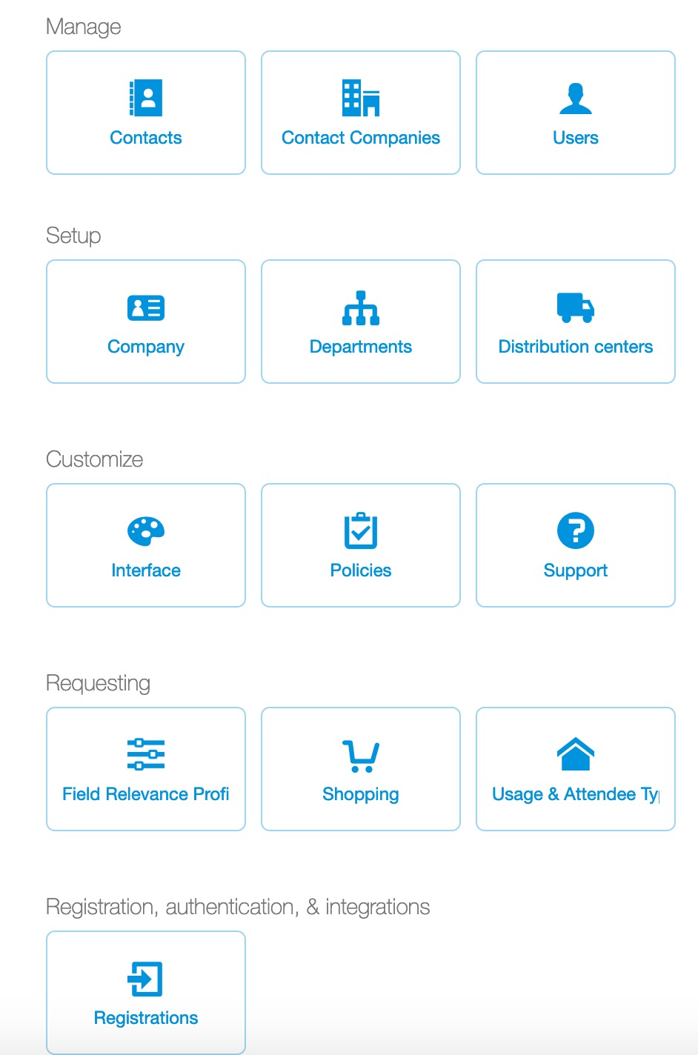
Users
To create, review or edit a user click “Users”.
If a company uses a directory feed, it may not be possible to add/edit user details. If your company uses a directory feed, please contact your company ticket admin for user related changes.

Slide 3
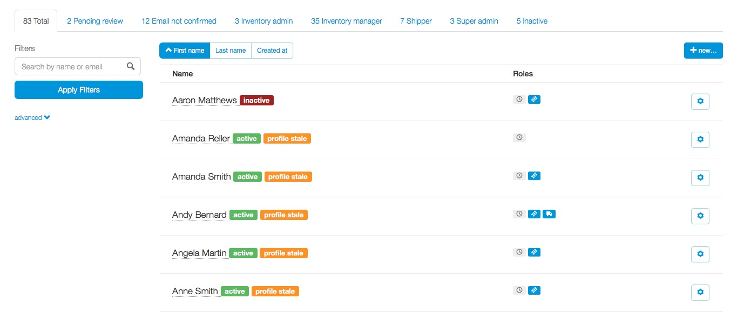
Users
Ticket admin can use the filters to search for a user.
Ticket admin can create or edit a user’s information.
To create a new user, click the “+ new…” icon in the upper right-hand corner.

Slide 4
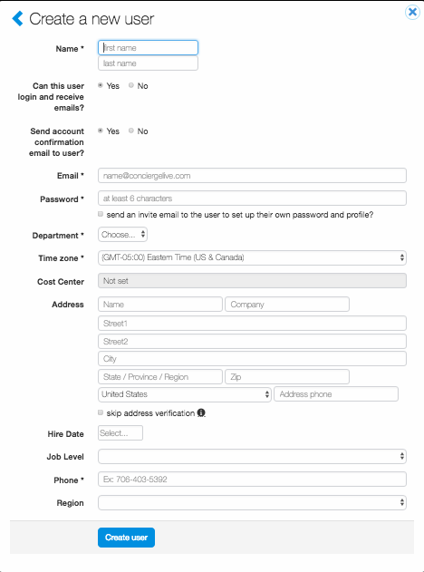
Users
User fields will vary from company to company. Any fields with an “*” are required.
Once the user profile has been completed, click “Create user”.

Slide 5
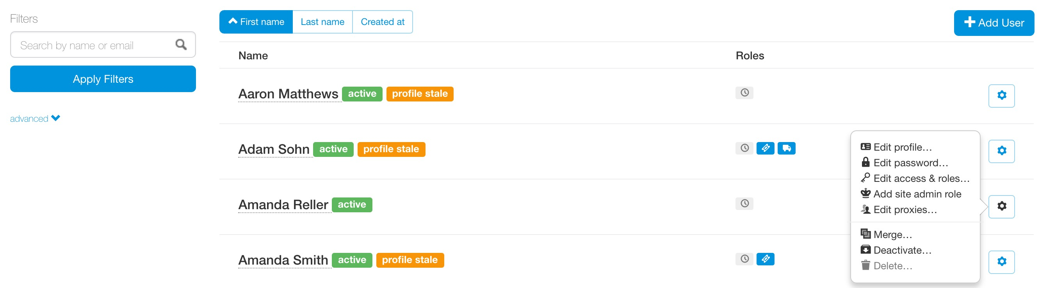
Users
To edit a user, click the “cog” icon to the right of the user. Ticket admin can edit by clicking:
Edit profile
Edit password
Edit access & roles
Add site admin role
Edit proxies
Merge
Deactivate
Delete

Slide 6
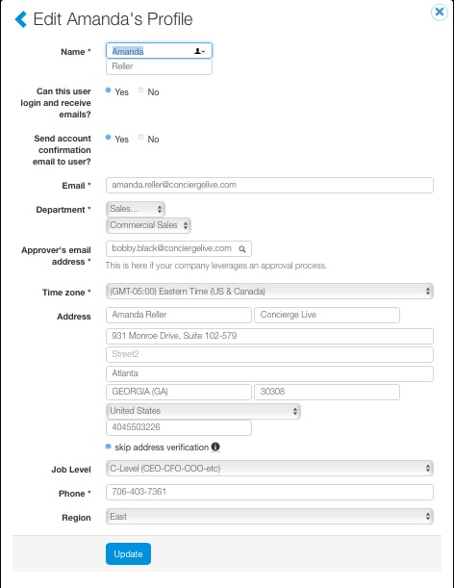
Users
Once edits are made to a user’s profile, click “Update”.

Slide 7
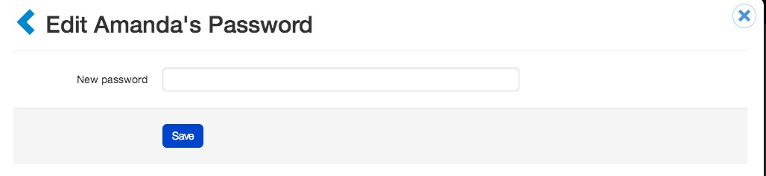
Users
To edit a user’s password, enter a new password and click “Save”.

Slide 8
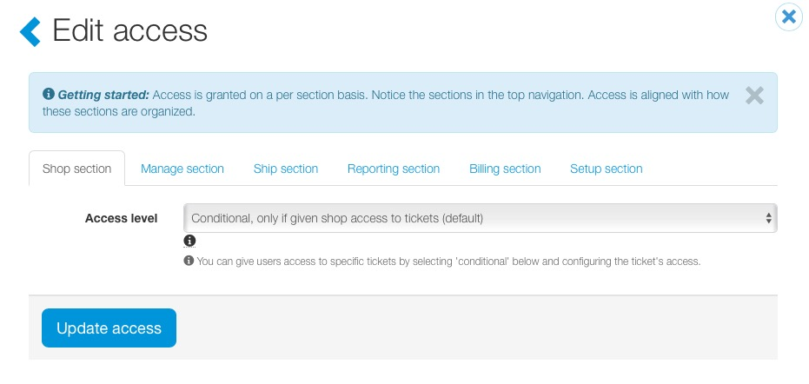
Users
Broader permissions can be granted in this section.
Shop: as a general rule, when a user registers, they only have shop permissions (i.e. ability to request tickets based on what ticket admin allow them to shop for).
Manage: ticket admin are conditional admin which means they have management permissions to any tickets they create or been allocated by another ticket admin. A few designated ticket admin are “full admin” which means they have manage rights to every ticket.
Reporting: as a general rule, ticket admin can report on tickets under management. Full report permissions allow a user to report on all tickets.
Billing: like full inventory admin, Billing is typically limited to a couple of ticket admin. Billing admin receive system invoices.
Setup: like full inventory admin, Setup is typically limited to a couple ticket admin. These ticket admin can make system changes (custom fields, attendee types, visibility settings, etc.).

Slide 9
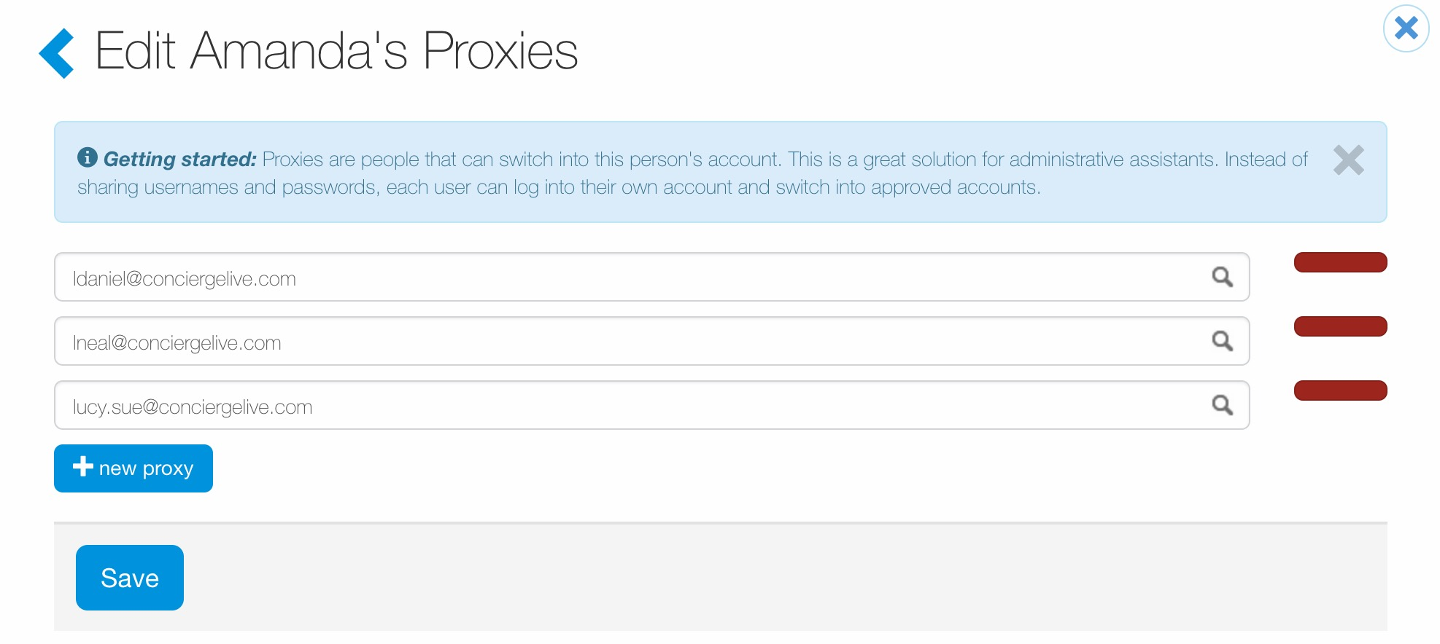
Users
Ticket admin can add or edit a proxy to a user’s account.
To delete a proxy, click the red button next to the proxy’s name.
To add a new proxy, click ”new proxy”, and enter the user’s name. A quick search will appear where ticket admin can search for users.
Select the user to make a proxy, then click “Update”.

Slide 10
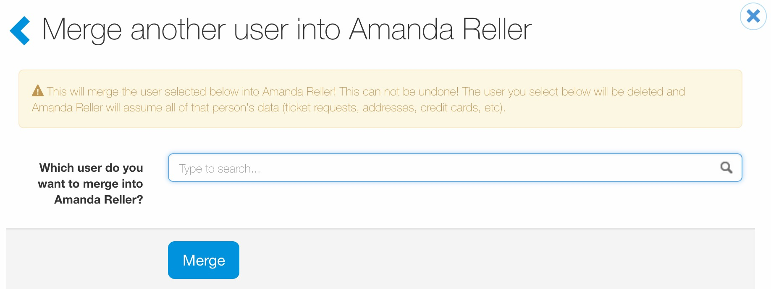
Users
To merge users, search for and select the user, then click “Merge”.
This action cannot be undone.

Slide 11
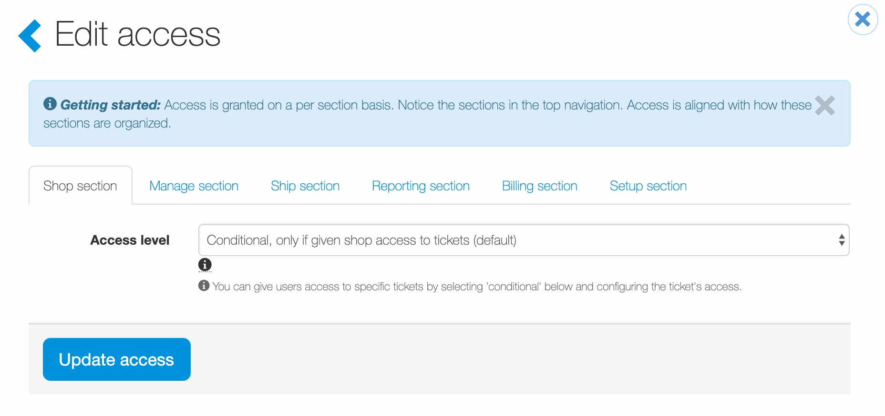
Users
In general when a user registers for a Concierge Live account, they are a ”user”. If a user is given “management rights” to tickets through the configure section, they become a conditional admin for the tickets someone created and added them as a manager to and any tickets they create.
Changing user access should be an edge case not the norm.
If a user has “full” access level for a section, they have full permissions to the section regardless of how tickets are configured. For example, if someone has “full” manage section permissions, the user has full inventory permissions to every ticket in Concierge Live, not just what they have “configure” management permissions for.

Slide 12
Users
Ticket admin can deactivate and delete accounts.
If a user has requests or is listed as an attendee on another user’s request, they cannot be deleted, but the account can be deactivated. This is for data integrity purposes.
If a user hasn’t made any requests and isn’t listed as an attendee on another user’s request, their account can be deleted. Once deleted, the action cannot be undone.

