Slide 1
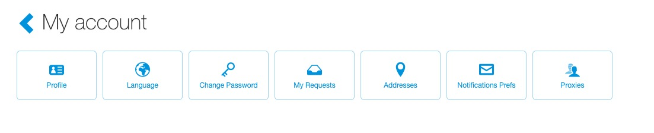
Notification Preferences
To access your notification preferences, click your name (top right of the page), then select “My Account”.
Click the “Notification Prefs” button.

Slide 2
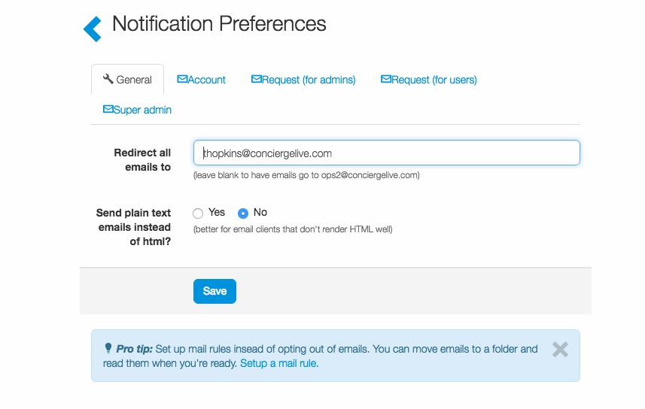
Notification Preferences
Users can review their general and account information.
To re-direct all emails to another user, enter their email address and click “Save”.

Slide 3
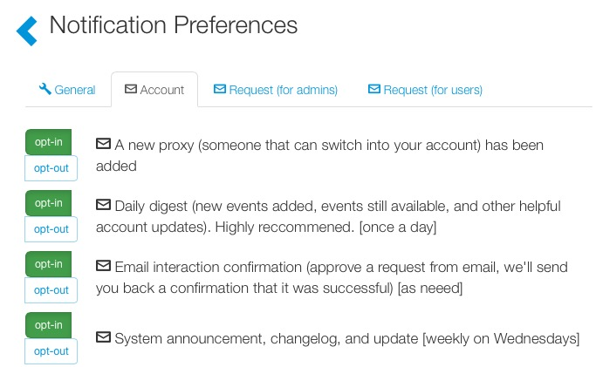
Notification Preferences
Users can determine which emails they would like to receive and can enable or disable them at anytime.
To opt-in or out of a notification, click the button next to the notification.

