Slide 1
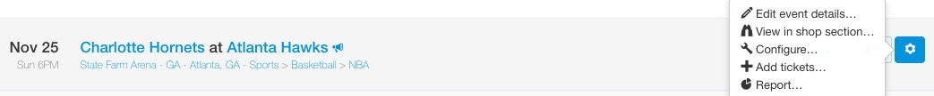
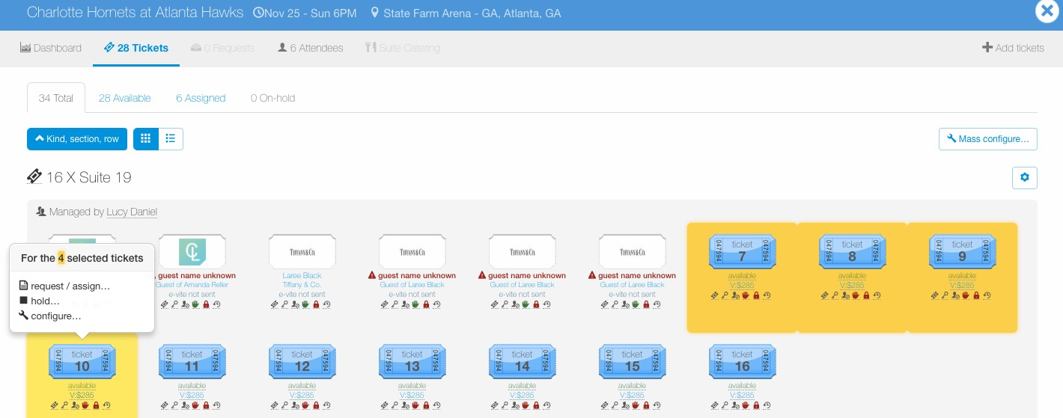
Configure – Ticket Details
To configure tickets for an entire event, go to the Manage page, find the event, click the wheel icon to the right of the event and then click “Configure…”.
To configure a certain ticket group or individual tickets within an event, go to the Manage page, find the event and click the ticket icon to view tickets for the event.
Once in the event, click the “cog” icon next to the ticket group to edit an entire ticket group or click individual tickets to configure, then select “configure…”.

Slide 2
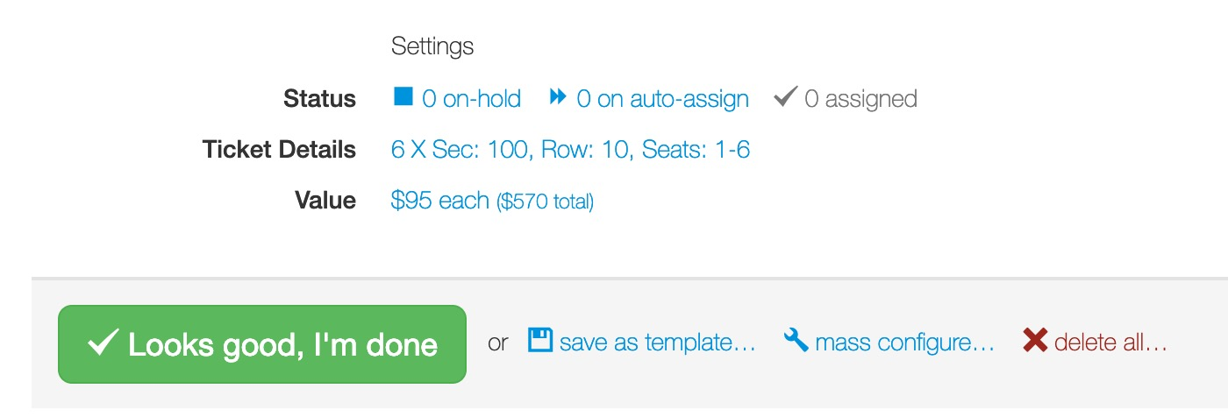
Configure – Ticket Details
To edit ticket details (row, section, ticket kind, value), next ticket details, click on “6 X Sec: 100, Row 10, Seats 1-6”.

Slide 3
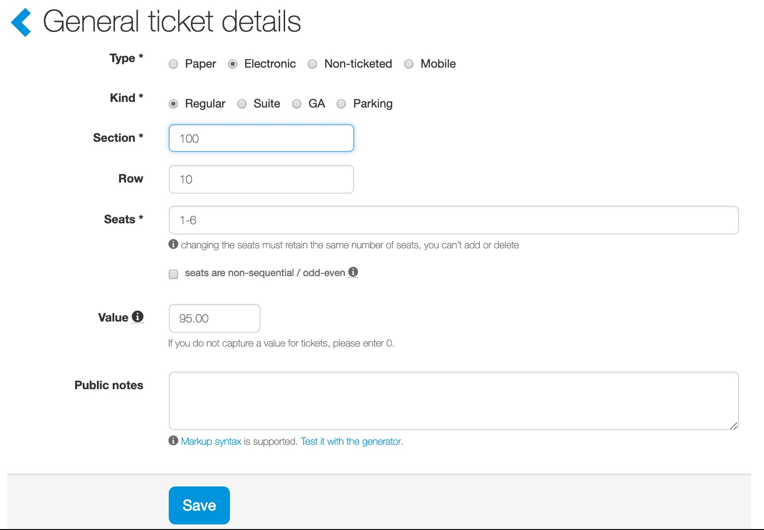
Configure – Ticket Details
Ticket Details:
These are the ticket details (entered when you added tickets).
Edit/update any details (Type, Kind, Section, Row, Value etc.) and click “Save”.

