Slide 1
Lottery Events
Ticket admin can create a ”lottery” for events.
The ”lottery” feature is an extension of auto-process which allows users to make requests at a designated time (i.e. 10 days before the event) and Concierge Live to automatically process ticket requests at a designated time (i.e. 5 days before the event).
Lotteries are mostly set for personal requests. However, a lottery can be set for personal requests and/or business requests.
When a lottery is enabled for business and personal requests, priority is given to business requests.
Lottery ticket assignments are based:
  Recent attendance for lottery events
  Frequency of attendance for lottery events
If no user has been assigned tickets for a previous lottery request, Concierge Live will randomly assign tickets.
If tickets are still available after the lottery run date, any requests placed after will be automatically assigned on a "first come, first serve" basis (auto-assigned).
When the lottery assigns/declines requests, requestors are notified through email.

Slide 2
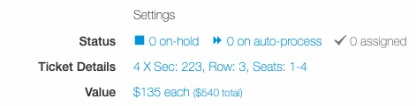
Lottery Events
To enable a lottery, in the configure section select ”auto-process” under “Settings” in the configure section.

Slide 3
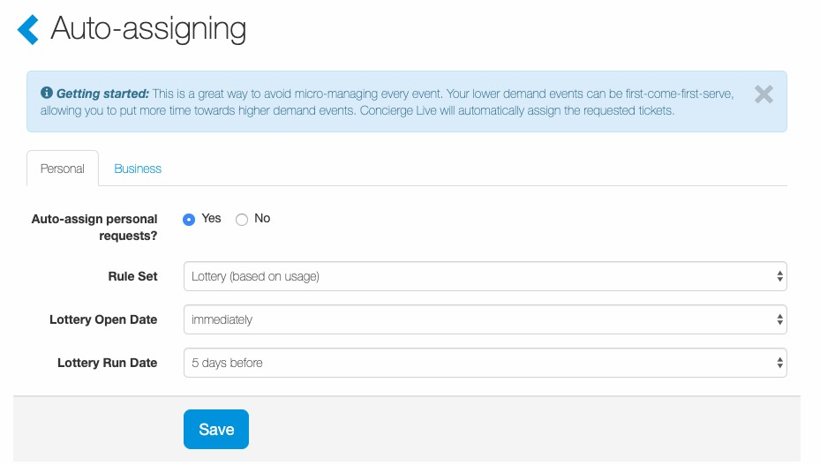
Lottery Events
A lottery can be set for personal requests and/or business requests. The page defaults to “Personal”. To set a business lottery, click the “Business” tab.
To set a lottery, select “Yes” next to “Auto-assign personal requests”.
In the “Rule Set” dropdown, select “Lottery (based on usage).
  Select a timeframe for the Lottery Open Date (i.e. immediately, 7 days before the event). This is the date/timeframe when users can begin making lottery requests.
  Select a timeframe for the Lottery Run Date (i.e. 5 days before the event). This is the date/timeframe when the lottery algorithm will assign or decline lottery requests.
Once the Lottery Open Date and Run Dates have been selected, click “Save”.

Slide 4
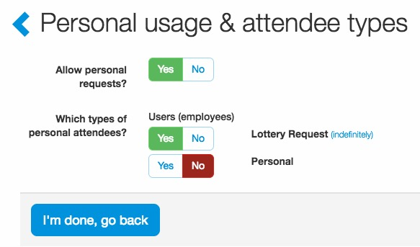
Lottery Events
If a ticket admin wants to report on lottery requests vs personal requests, we recommend creating a personal use attendee type called “Lottery” and if allowed a separate “Personal” attendee type. If reporting on personal vs. lottery requests isn’t important, there is no negative to using a single personal use attendee type and enabling a lottery when it makes sense.

Slide 5
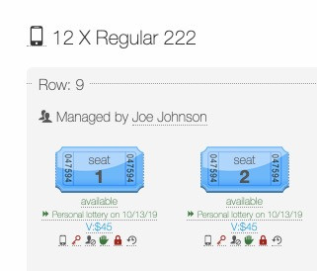
Lottery Events
Once a lottery is enabled, ticket admin on their Manage Tickets Page will see when the lottery will auto-process tickets.

Slide 6
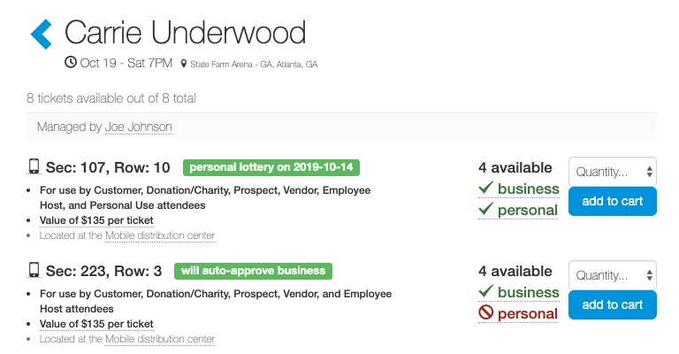
Lottery Events
When tickets are enabled for lottery requests, on the ticket view page, users can see which tickets are part of the lottery and when the lottery will auto-process tickets (i.e. 5 days before the event).
Users can also determine if the lottery is for personal and/or business requests.

Slide 7
Lottery Events
Lottery Event Tips
Ticket admin can create a ”lottery” for events.
The ”lottery” feature is an extension of auto-assign which allows users to make requests at a designated time (i.e. 10 days before the event) and Concierge Live to automatically process ticket requests at a designated time (i.e. 5 days before the event).
The lottery feature applies to both personal and business requests.
When a lottery is enabled for both business and personal requests, priority is given to business requests.
Users are limited to one request per ticket group for a lottery.
Lottery assignments are for the “kind’ of ticket (i.e. suite, regular, GA) requested. The lottery will not assign a suite ticket requestor, regular tickets or a regular ticket requestor, suite tickets.
If you have multiple “regular” ticket sections in the lottery (i.e. section 100, section 105) the lottery will assign regular ticket requests regardless of section requested.
The lottery factors (i.e. recent attendance) are only applicable for lottery requests. A user’s non-lottery personal ticket requests do not factor into lottery ticket assignments.
If tickets are set for a lottery and a ticket admin manually processes a user’s request prior to the lottery run date, the assigned tickets count against the user for future lottery requests (frequency of attendance and recent attendance).
Use ticket quantity restrictions to limit the number of tickets a user can request.

Slide 8
Lottery Events
Lottery Event Item Tips
Parking Passes
  For lottery assigned ticket requests, if the request has parking and parking passes are part of the lottery, parking requests will be assigned on a first come, first served basis. Basically if a requestor is assigned tickets through a lottery, they get the requested parking passes if the parking pass is available.
  The lottery will not assign a parking pass without assigning tickets to a requestor.
  If a ticket request includes a parking pass and during lottery assignments a requestor is assigned tickets, but parking passes are no longer available, the lottery will still assign the ticket portion of the request, but the parking pass request will be declined.
  Parking passes do not factor into prioritization for ticket usage.
Non-Ticketed Items
  Non-ticketed items are not supported by the lottery feature. The lottery feature is designed for tickets and parking passes. A separate request must be made for non-ticketed items.

