Slide 1
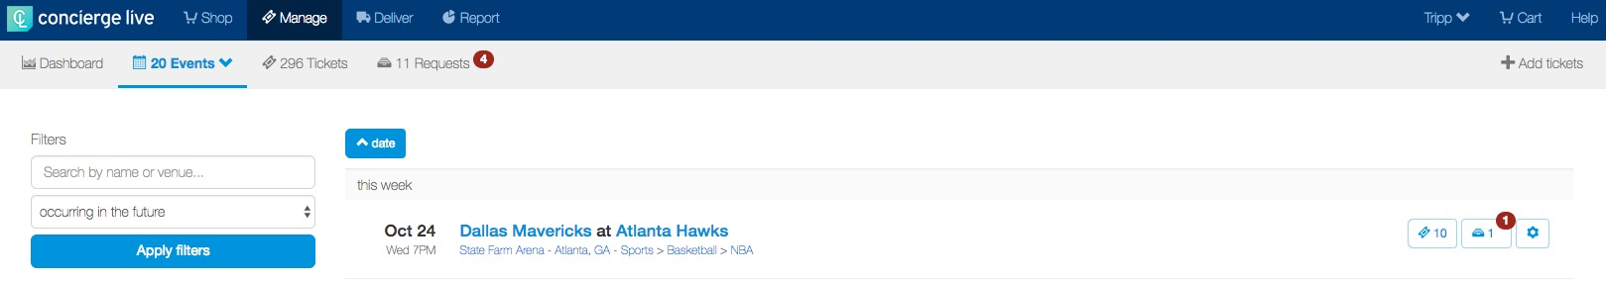
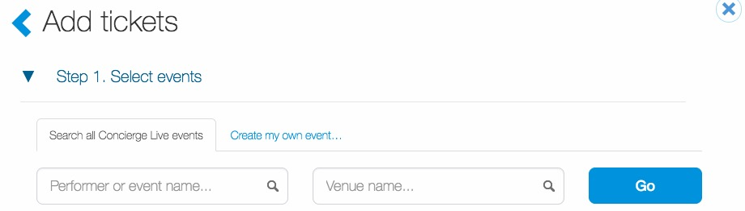
Adding a Private Event
When a ticket admin wants to create and manage an event that is private to your company, click “+ Add tickets” in the upper right-hand corner of the Manage Page.
On the “Add tickets” page, click “Create my own event…”

Slide 2
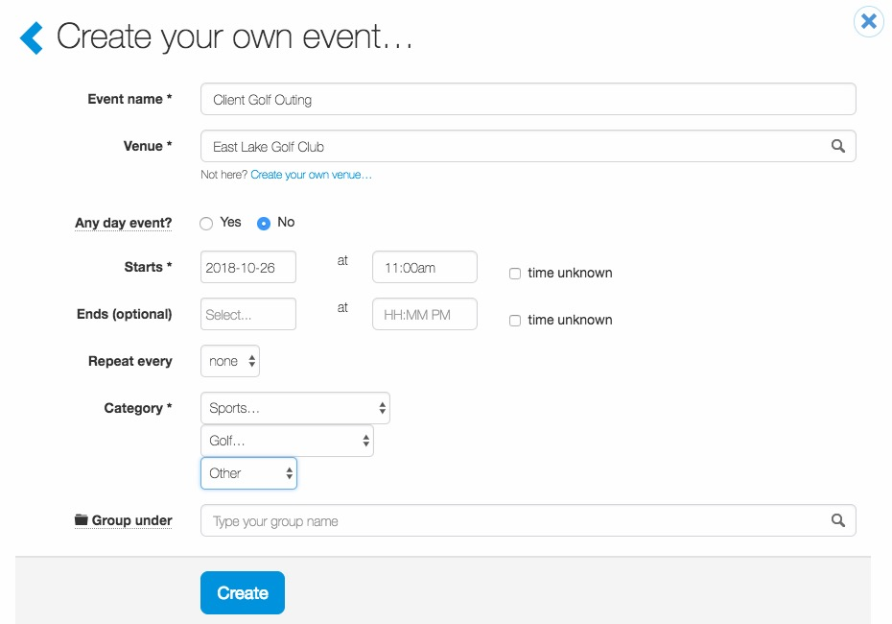
Adding a Private Event
Complete the fields required to create the event (i.e. a golf outing, a customer hospitality event or reception, etc.) and click ”Create”.
The next slide has definitions for the fields on this slide.

Slide 3
Adding a Private Event
Event Name: This is what will show up for everyone in the system. You can change the name later if you need to.
Venue: If you do not see the venue in the system, you can create your own venue as well. Please note if it is a private event at a hotel or meeting space, you more than likely will need to fill out the information for a new venue.
Any day event: This is what would be utilized for tickets or passes that are good any day. For example passes to Six Flags, Disney World, etc. If you select “yes,” it will delete out fields for start and end dates.
Start Date and Time: This is required in our system. If you do not know the time, then select “unknown.” You can modify this later if you need to. This defaults in our system as midnight.
End Date and Time: This is not necessary to fill out. If you have a meeting that requires one registration, not registration per day, then you could fill out an end date and time. Otherwise, please skip this field.
Repeat: If you have an event that happens every day, month, etc. You can create a repeat like you can on your calendar.
Category: Categories are determined by our event feed company. These select the most popular events categories. For more details, please contact your account services manager on recommended selections if you do not see your preferred option listed for a category.
Group Under: Grouping allows for those requesting or managing to see the events all in one click. We recommend grouping for multiple day events. For more details, please contact your account services manager.

Slide 4
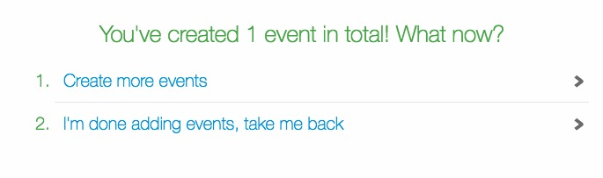
Adding a Private Event
Once the ticket admin creates the event, they have the option to “Create more events” or “I’m done adding events, take me back”.
Selecting “Create more events”, allows the ticket admin to add more private events. If the ticket admin selects “I’m done adding events, take me back”.

Slide 5
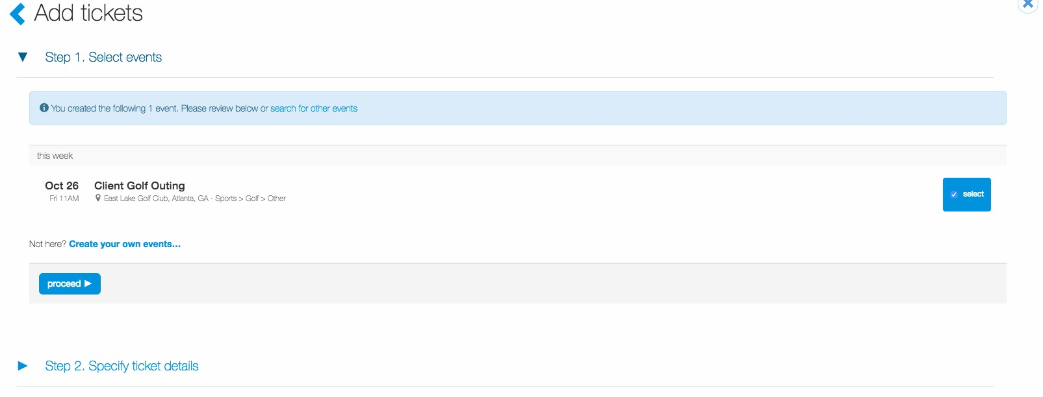
Adding a Private Event
Once the ticket admin finishes adding events and selects “I’m done adding events, take me back”, the added events will appear and selected.
The process for adding tickets is the same as Concierge Live events. (i.e. specify ticket details, configure).

