Slide 1
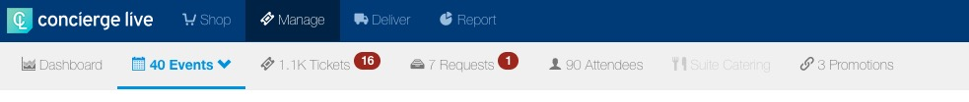
Attendee Management: Briefing Book
Ticket admin have two options for viewing event attendees:
View attendees for a specific event: on the Manage page, use the filters to locate the event and click the “attendee” icon for the event.
View all attendees, across all events: on the Manage page, click “Attendees” in the navigation bar.

Slide 2
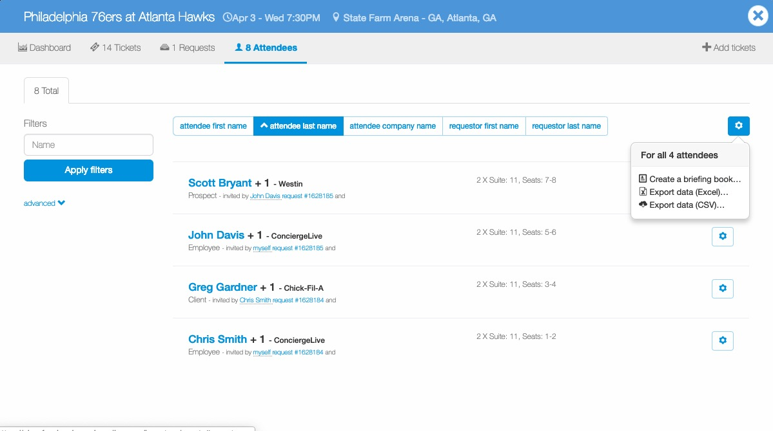
Attendee Management: Briefing Book
A briefing book is a collection of attendee cards, which contain the fields completed for each attendee. Briefing books serve as a great executive tool providing employee hosts insight to the projected attendees for an event.
Ticket admin can use the filters on the left to narrow the attendees list. Any filters applied dictates what is included in the briefing book (i.e. attendee type).
Click the “cog” icon at the top of the page and select “Create a briefing book…”.

Slide 3
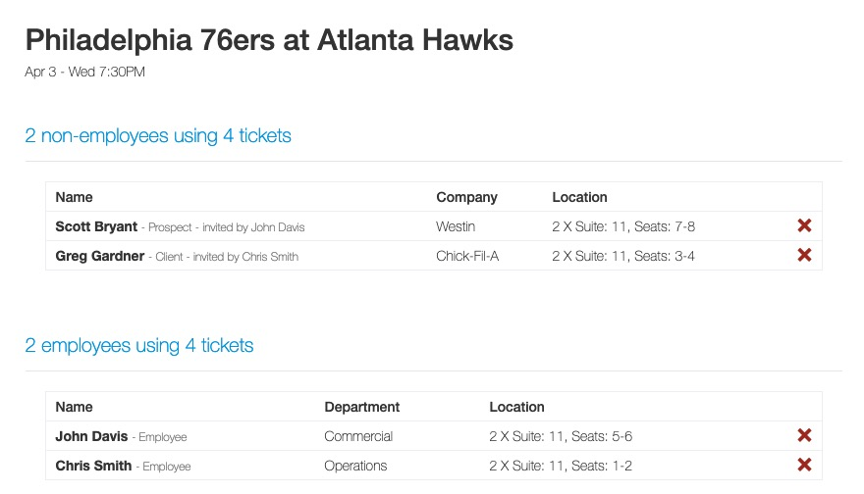
Attendee Management: Briefing Book
The briefing book includes two parts. The first part is a summary of the non-employee and employee projected attendees.

Slide 4
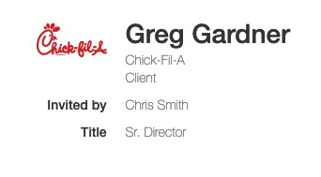
Attendee Management: Briefing Book
The second part of the briefing book is an attendee's full attendee card.
The attendee card highlights all the information captured as part of the ticket request process.
Depending on the attendee type, the information provided during the request process may be high level information or more detailed.

Slide 5
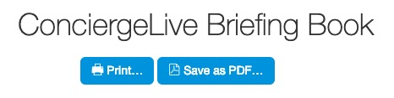
Attendee Management: Briefing Book
Ticket admin can print or save a briefing books as a PDF (located at the top of the briefing book)

