Slide 1
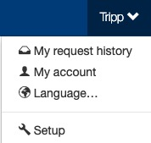
Company Profile Information
The Setup section is where setup admin can control account behaviors. From updating attendee types and data fields, to delivery options for tickets, to branding the site; all is done in the Setup section.
To access the Setup section, click on your name (top of the page), then click “Setup”.

Slide 2
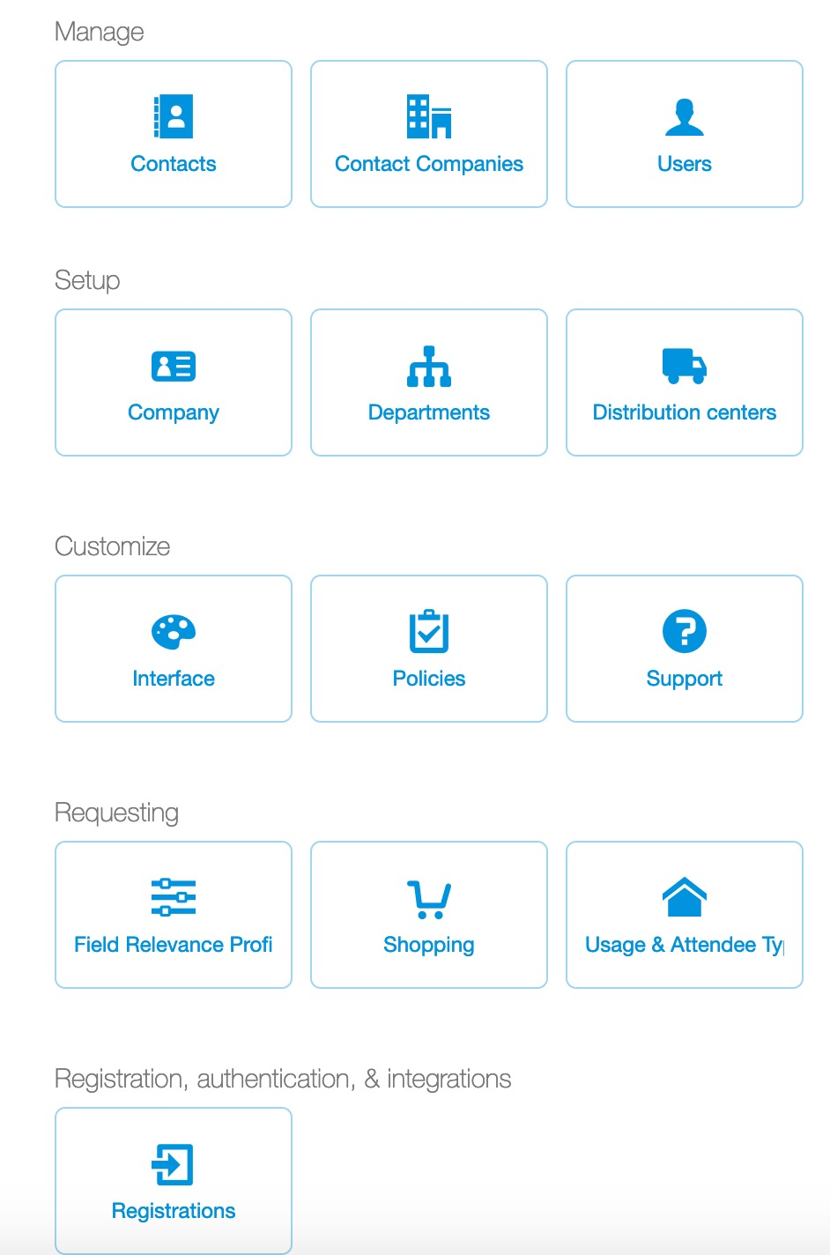
Company Profile Information
Once in Setup, click “Company”.

Slide 3
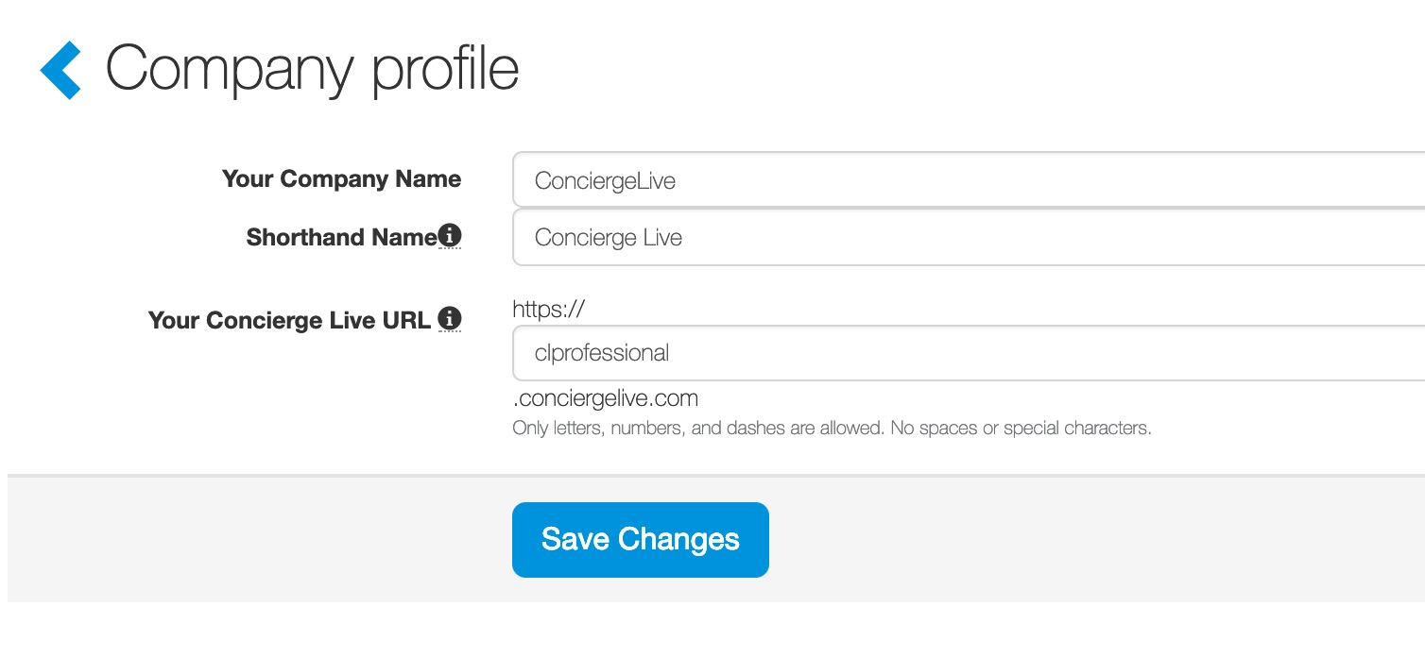
Company Profile Information
The company profile section includes high level information about your company including:
Your Company Name
Shorthand name: this is the name next to tickets on the Shop page.
Your Concierge Live URL: the URL address for your company’s site.

