Slide 1
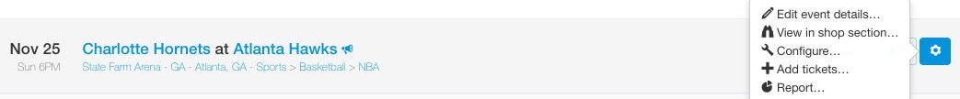
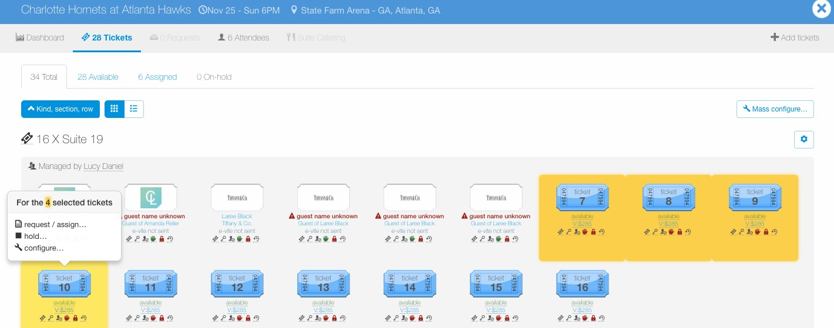
Configure – Attendee Types
To configure tickets for an entire event, go to the Manage page, find the event, click the wheel icon to the right of the event and then click “Configure…”.
To configure a certain ticket group or individual tickets within an event, go to the Manage page, find the event and click the ticket icon to view tickets for the event.
Once in the event, click the “cog” icon next to the ticket group to edit an entire ticket group or click individual tickets to configure, then select “configure…”.

Slide 2
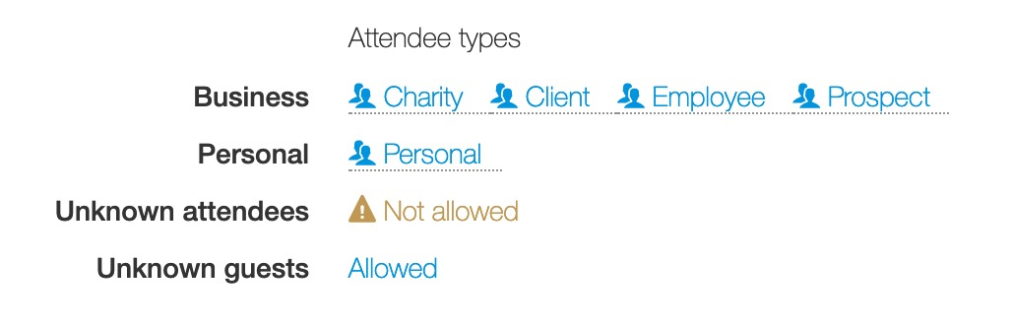
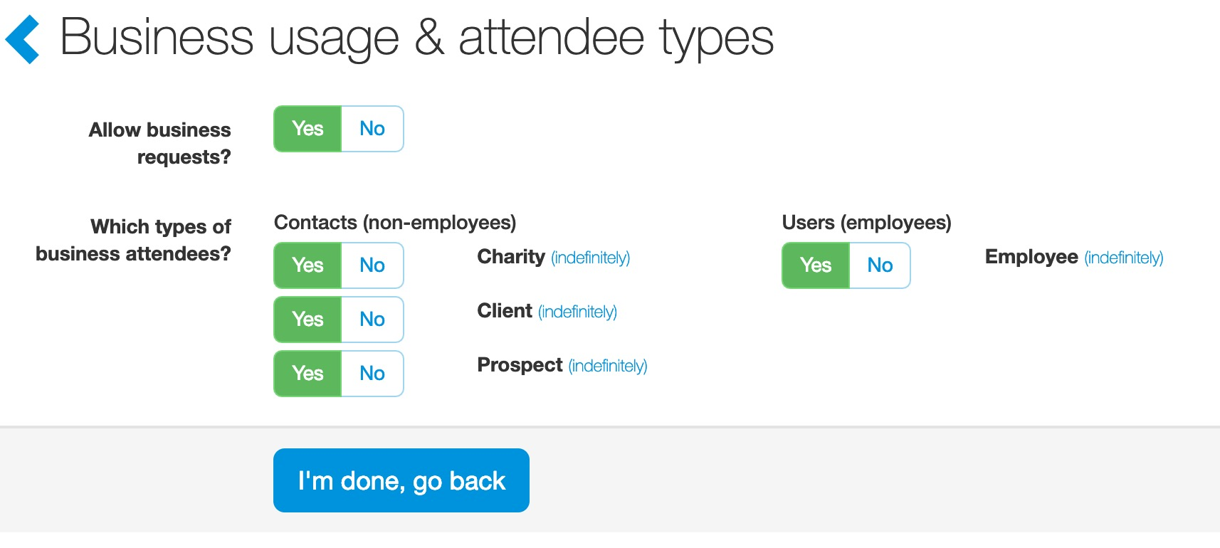
Configure – Attendee Types
Attendee Types:
Attendee types capture information on the people being entertained. Examples of attendee types might include client, prospect, donation, employee host, employee R&R, etc.
Next to “Business” click on an attendee type name.
When an attendee type is allowed, it is available to all users when requesting tickets.

Slide 3
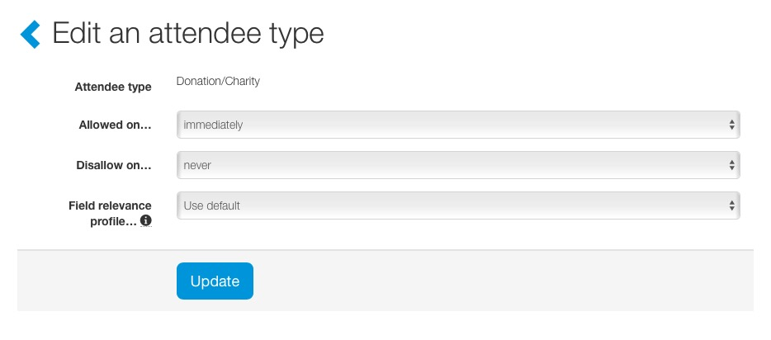
Configure – Attendee Types
Attendee Types:
Like management rights, ticket admin can set triggers for attendee types. Click on the attendee type button (i.e. “Yes” or “No”.) Advanced options appear and ticket admin can set triggers.
Ticket admin can also set a field relevance profile. This allows ticket admin to apply a different profile to tickets while retaining the attendee type name. The field relevancy is the specific fields an attendee type captures. This is not a common feature but is available when needed.

Slide 4
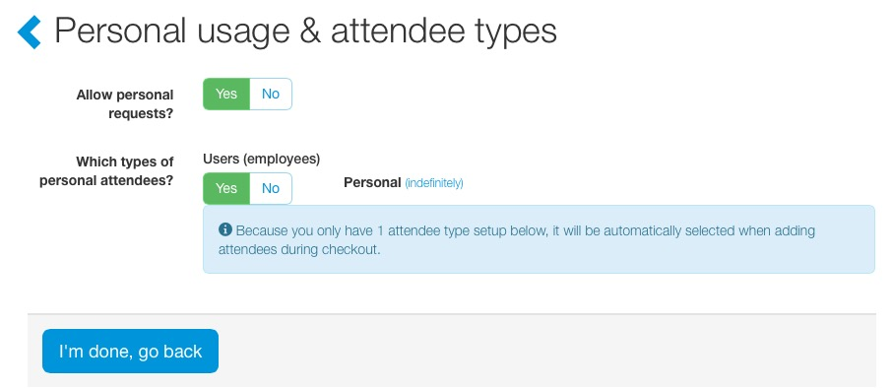
Configure – Attendee Types
Personal Use:
Next to “Personal” click on an attendee type name.
To allow personal requests, click the green “Yes” button.
An attendee type must be selected in order to allow personal use. In the screenshot below, “Personal Use” is marked as “Yes”.

Slide 5
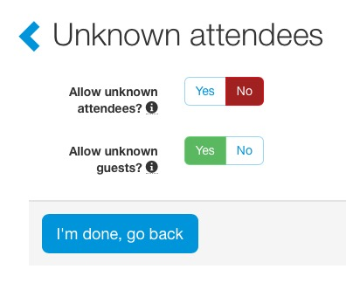
Configure – Attendee Types
Unknown Attendees:
Unknown attendee types give users the ability to make a request even if they don’t know the specific attendee that they will be entertaining.
Unknown Guests:
Unless a compliance reason requires your company to capture primary guest information, it’s recommended that “Allow unknown guests” be set to “Yes”.
When unknown guests are not allowed (set to “No”) requestors must provide a name for every ticket assigned to an attendee (employee or contact). For example, a requestor gives Rick Thomas 2 tickets, the system assigns 1 ticket to Rick, the requestor then has complete information on Rick’s guest (Rick’s +1).

