Slide 1
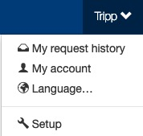
Contacts
The Setup section is where setup admin can control account behaviors. From updating attendee types and data fields, to delivery options for tickets, to branding the site; all is done in the Setup section.
To access the Setup section, click on your name (top of the page), then click “Setup”.

Slide 2
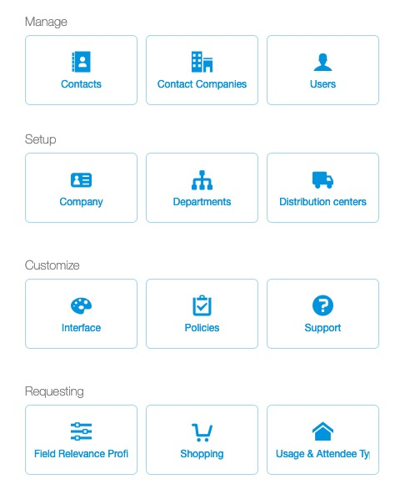
Contacts
To create, edit or manage a contact, click “Setup,” then “Contacts”.
If a company uses Salesforce feed, it may not be possible to add/edit contact details.
If your company uses a contact feed, please contact your account ticket admin for any user related changes.

Slide 3
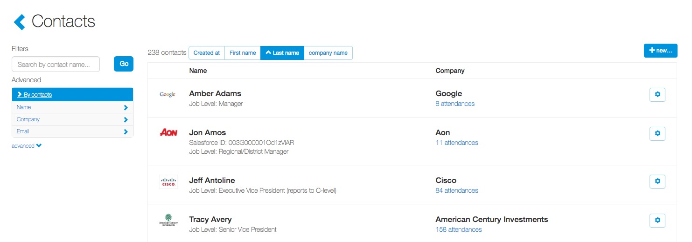
Contacts
In the contact section, ticket admin can use the filters on the left-hand side to search for a contact.
By clicking on “By contacts” underneath the main search bar, ticket admin can easily search by name, company or email address.
To create a new contact, click the “+ new…” icon in the upper right-hand corner.

Slide 4
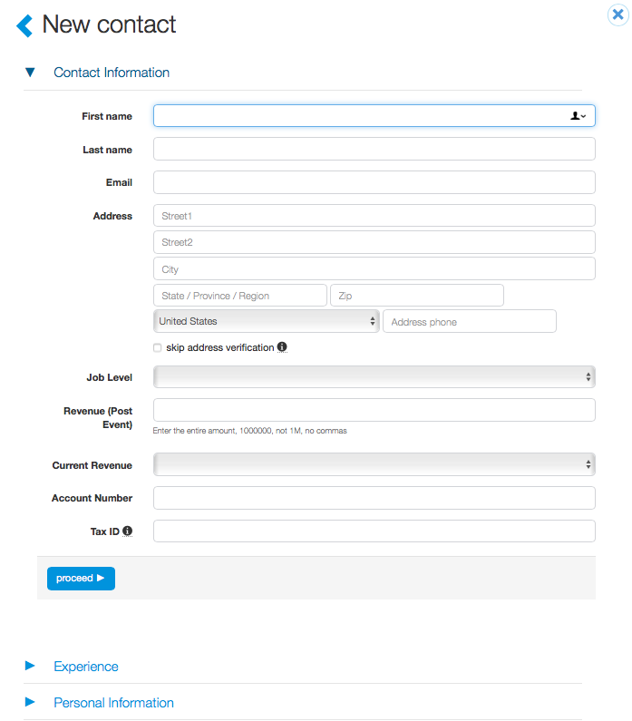
Contacts
Contact fields will vary from company to company. Any fields with an “*” are required.
Once the contact profile has been completed, click “Create”.

Slide 5
Contacts
To edit an existing contact, click the “cog” icon to the right of the contact. This provides ticket admin with several options:
Edit name
Edit company
Edit email address
Edit any content in custom fields
Ticket admin can also merge contacts and delete contacts. Concierge Live does not allow for deletion of a contact who have been included in a request for data integrity reasons.

Slide 6
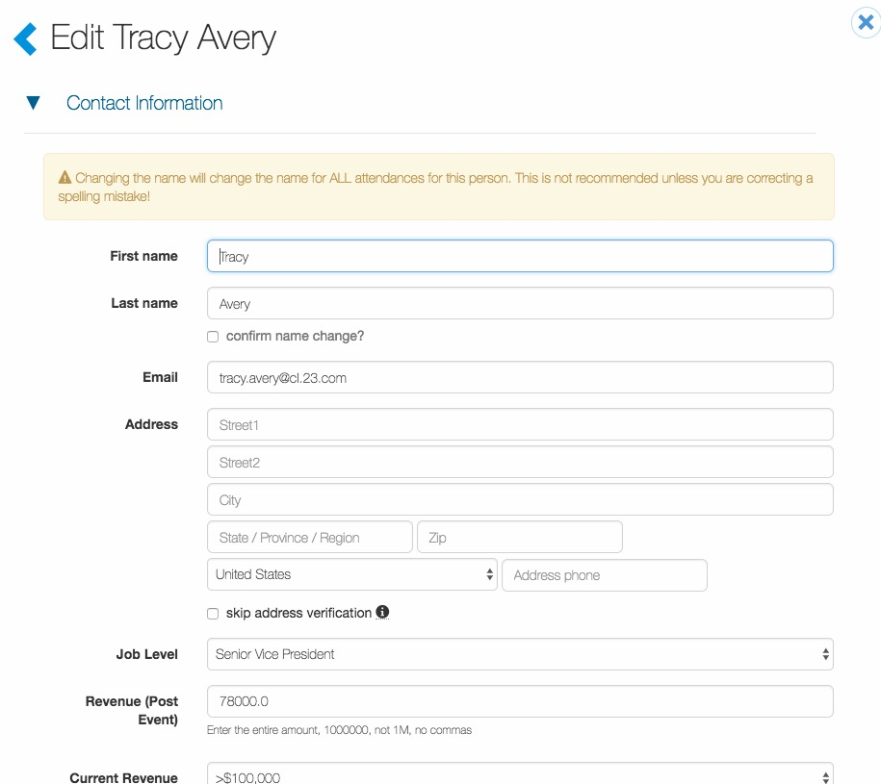
Contacts
To edit a contact’s profile, update any info and click “Update”.
If a ticket admin edits a contact’s name, they must check the box confirming the name change.

Slide 7
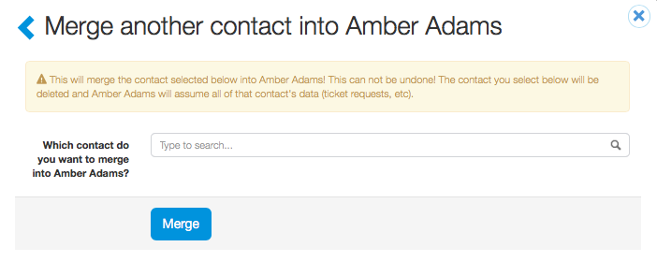
Contacts
To merge contacts, search for and select a contact, then click “Proceed with merge.” Beware, this action cannot be undone.
Concierge Live recommends ticket admin create a new contact to when a contact changes companies to track appropriate company usage. Ex. Amber Adams worked for Google, but now works for Coca-Cola. She should have two contact records; one for Google, one for Coca-Cola to ensure her ticket usage is aligned with the correct company.

Slide 8
Contacts
Tips:
Users cannot edit a contact’s name or company. Only setup ticket admin can edit those fields.
Email addresses are unique to users, meaning contacts cannot share an email address. An error message appears if an email is already tied to a contact is “Email is already tied to another contact. Please search for other variations of the contact’s name (i.e. by company name, Bob, Robert, etc.)”.
Salesforce contact information should not be edited.
When integrated with CRM’s or using contact feeds, in addition to email, other unique identifiers like Salesforce ID’s, Client Numbers, etc. may not be edited by users. Discuss options with your company ticket admin.
If a contact has changed their name or email (marriage/divorce), ticket admin should update the existing contact profile.
If a contact changes companies, a new contact should be created. This ensures proper reporting for entertainment.

