Slide 1
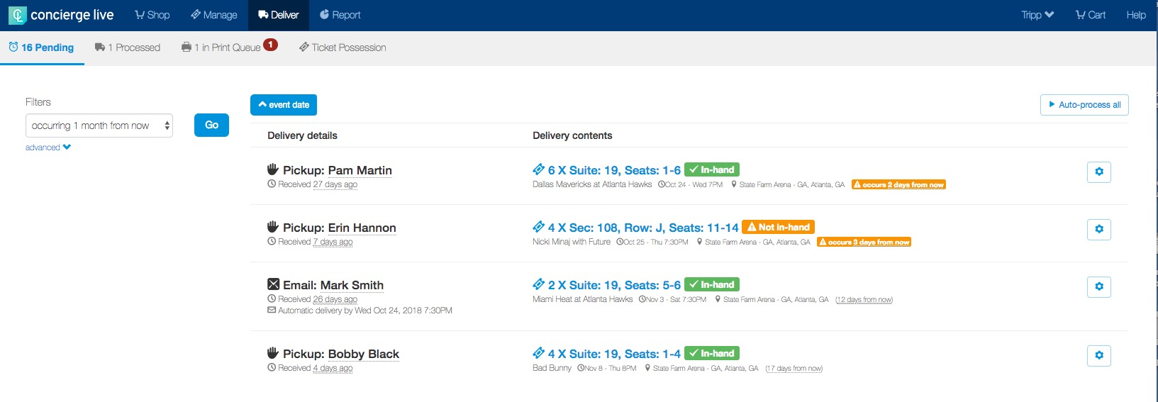
Delivery
As requests are approved/assigned and are configured to be deliverable, they go into the “Deliver” section. To access the Deliver section, click “Deliver” at the top of the page.
The deliveries appear by default 1 month out. To view deliveries more than 1 month out, change the filter on the left-hand side.
Deliveries will appear with the requestor’s name, requested delivery method (i.e. shipment, pick up, etc.) and delivery contents.
When a ticket admin wants to process all the requests in the shipping queue, click “Auto-process all” at the top right of the page. All requests where tickets have been marked in-hand will be processed.

Slide 2
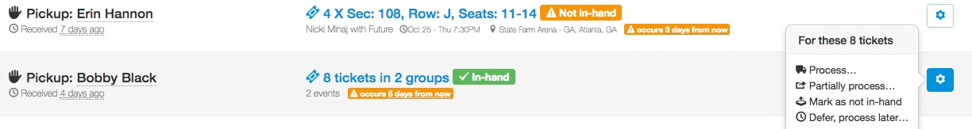
Delivery
If tickets have not been marked in-hand, they must be marked in-hand before a ticket admin can process and ship the tickets. To mark tickets in-hand, click on the wheel icon, then click “mark as in-hand”.
Once tickets have been marked in-hand, the delivery can be processed.
If there are a large number of tickets not marked in-hand, we recommend using the “Ticket Possession” feature at the top of the Delivery page.
To process an individual request, from the menu, select “Process…”.
Shipments are “batched” by the requestor. If a requestor has multiple requests for the same address, a ticket admin can process all a requestor’s requests together or process them individually.
To partially process all the deliveries for a user, click “Partially process...”.

Slide 3
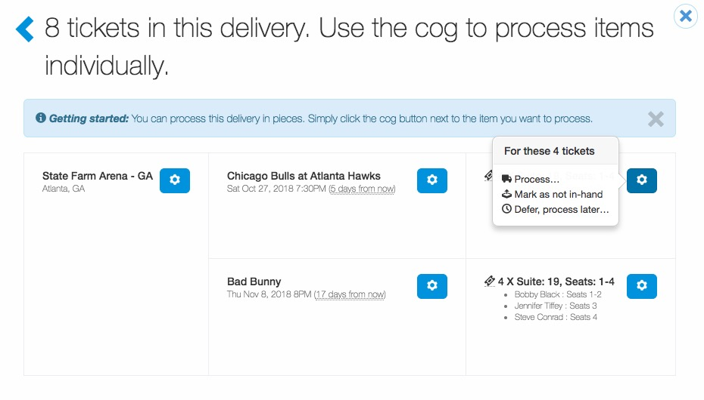
Delivery
To process individual requests for a user, click the wheel icons for each individual event and process, or you can click the wheel icon next to the venue name to process all events at a specific venue.

Slide 4
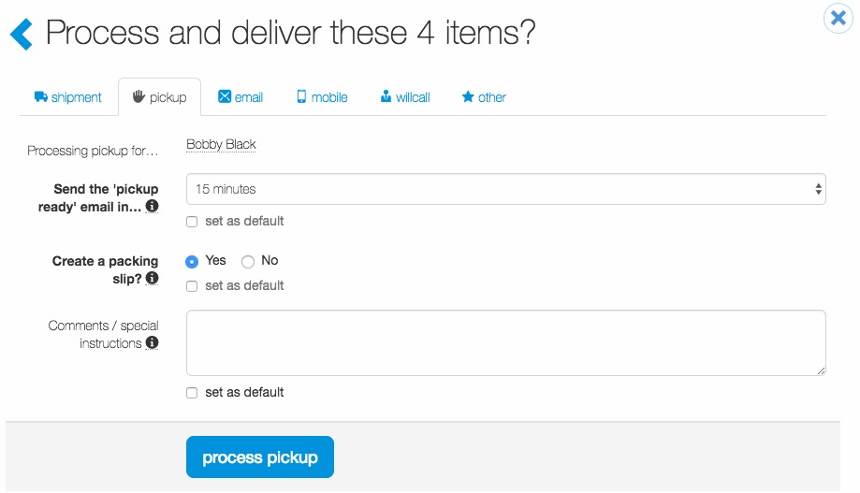
Delivery
When you click process, a separate window will appear.
Ticket admin can process the request based on the delivery method selected or select another delivery method by clicking a tab at the top of the page (i.e. shipment, pickup, other).
Ticket admin can add comments/special instructions that will appear in the shipping email notification. These comments can be unique to an event or requestor, or they can be set as a default and appear in all shipping emails.
This request is for physical tickets and a pick-up delivery.

Slide 5
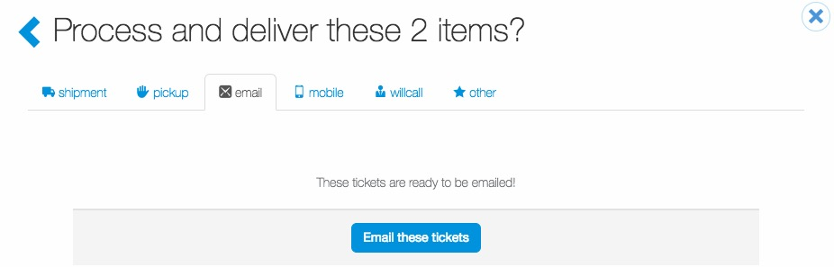
Delivery
This request is for electronic tickets.
Once e-tickets are loaded into Concierge Live, they are in-hands and can be delivered at anytime.
Click “Email these tickets” to deliver the tickets to the requestor. It is the requestor’s responsibility to deliver the tickets to their attendees.

Slide 6
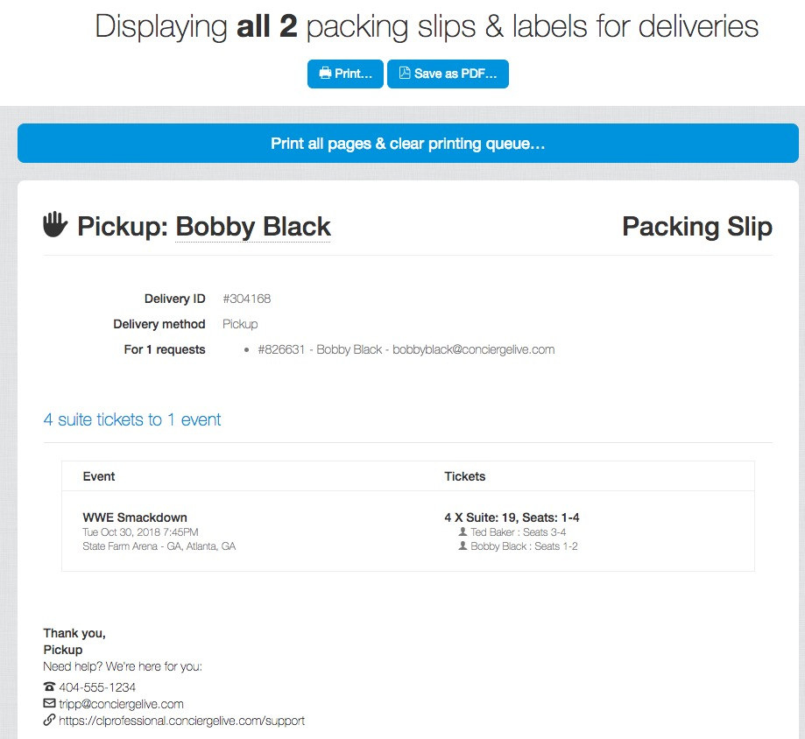
Delivery
Once you process a request(s), you can print the packing slips and mailing labels by clicking the “Deliver” tab and then “x in your print queue.”
Click the “Print all pages” to print all packing slips and labels.
If a delivery is shipped through an overnight carrier, and you have integrated your overnight provider with Concierge Live or you leverage Concierge Live’s overnight delivery, a mailing label will print with the corresponding packing slip.

Slide 7

Delivery
Once everything prints, click “Clear your print queue”.
If you need to re-print a packing slip or mailing label, go to the “Delivery history” tab. Locate the request and click “re-print.”

Slide 8
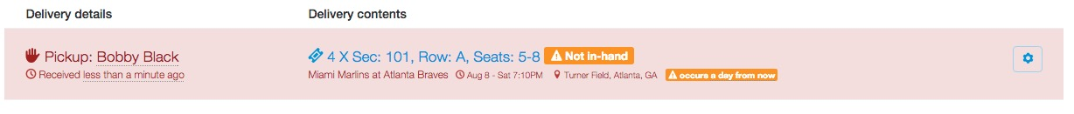
Delivery
If a delivery includes tickets that have been previously shipped, the delivery will be highlighted in red.
To avoid potential confusion, before processing the request, have the ticket’s admin check determine the ticket location. It’s possible the tickets may still be in the possession of the original requestor.

Slide 9
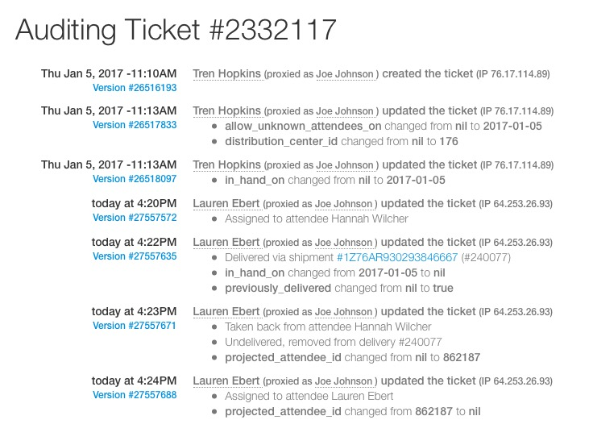
Delivery
If the ticket admin needs to locate the previous shipment, the tracking information can be located in the audit trail of the tickets. If you need assistance in reading the audit trail, please contact support at support@conciergelive.com.

