Slide 1
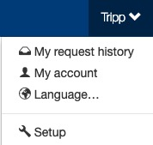
Distribution Centers
Ticket admin determine their ticket delivery options based on their preferences or the type of ticket a venue/team offers (physical, mobile, etc.). Concierge Live leverages “distribution centers” to provide delivery options to users when they make a ticket request. During the checkout process, in the delivery section, users select from a distribution center’s delivery options and possibly view additional information about deliveries.
The Setup section is where setup admin control account behaviors. From updating attendee types and data fields, to delivery options for tickets, to branding the site; all is done in the Setup section.
To access the Setup section, click on your name (top of the page), then click “Setup”.

Slide 2
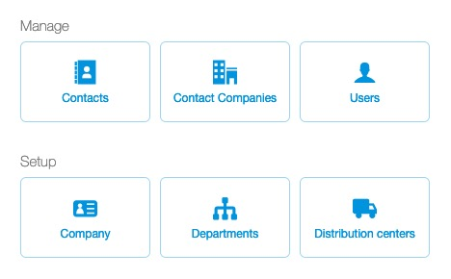
Distribution Centers
To create or manage a distribution center, click the “Distribution Centers” button.

Slide 3
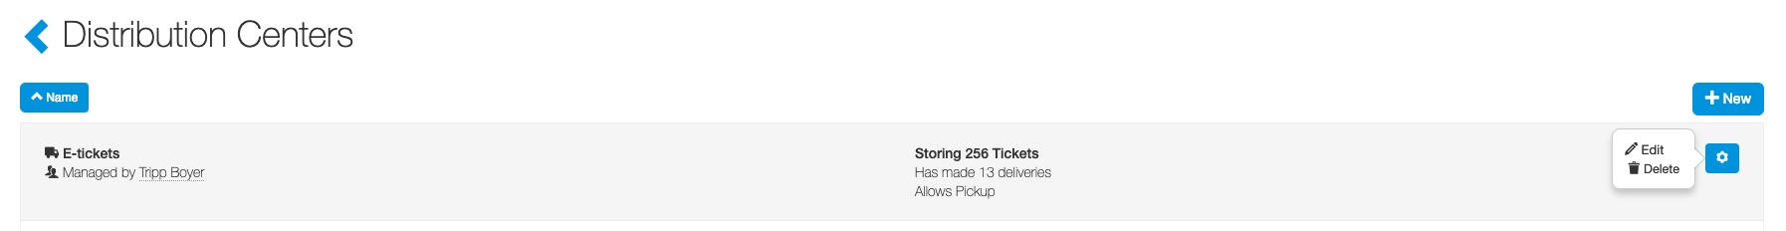
Distribution Centers
Ticket admin determine their ticket delivery options based on their preferences or the type of ticket a venue/team provides (physical, mobile, etc.).
Concierge Live leverages “distribution centers” to provide delivery options to users when they are making a ticket request.
Clients can have multiple distribution centers and each distribution center has its own delivery options.
During the checkout process, in the delivery section, users select a delivery option and possibly view additional information about deliveries.
A ticket’s distribution center is set in the configure section.
When your Concierge Live account is created, there are 3 default “distribution centers”: E-tickets, Mobile and Pick Up.
To create a distribution center, click the “+ New” icon in the upper right-hand corner.
To edit an existing distribution center, click the “cog” for the distribution center and then “Edit”.
Note: You cannot a delete a distribution center if tickets are stored in the distribution center.

Slide 4
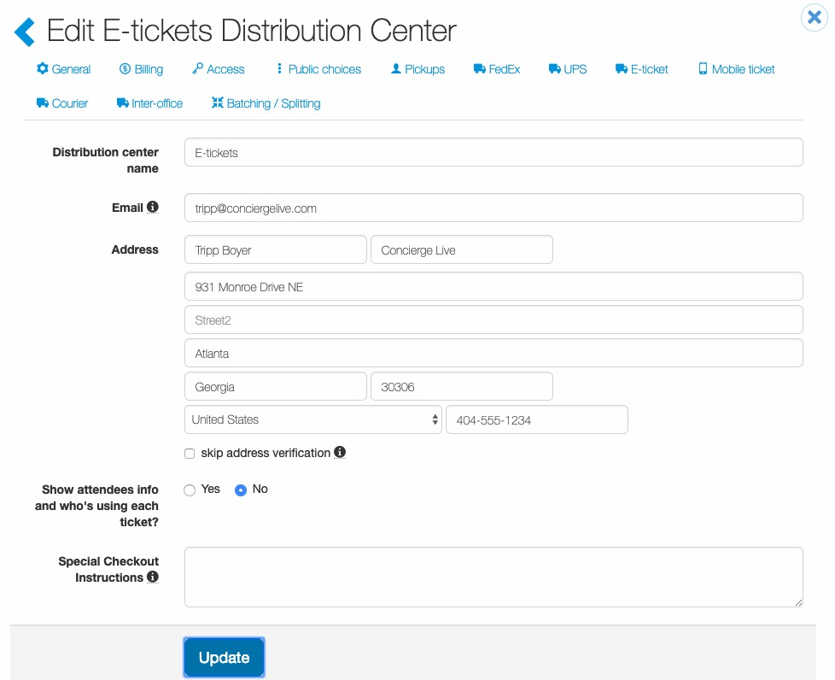
Distribution Centers
For an existing distribution center edit the details as needed, or for a new distribution center enter the details, then click “Update” or “Save”.

Slide 5
Distribution Centers
Ticket admin can edit:
General details
Access
Public Choices
Pickups
FedEx
UPS
E-Ticket
Mobile Ticket
Courier
Inter-office
Batching/Setting
To edit details, click the section name at the top of the screen.

Slide 6
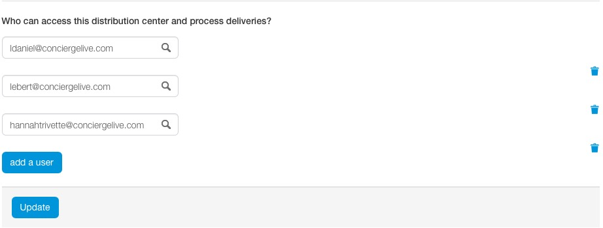
Distribution Centers
Access:
Under the “Access” tab, users need to be given management rights to a distribution center in order to have a “Delivery” tab to process deliveries.
If tickets are placed in a distribution center and no users are listed as managers for the center, then ticket deliveries may not be processed.
Users can be added (through the “add a user” button) or deleted (through the trash can icon). Users must be registered to be added a a delivery admin.

Slide 7
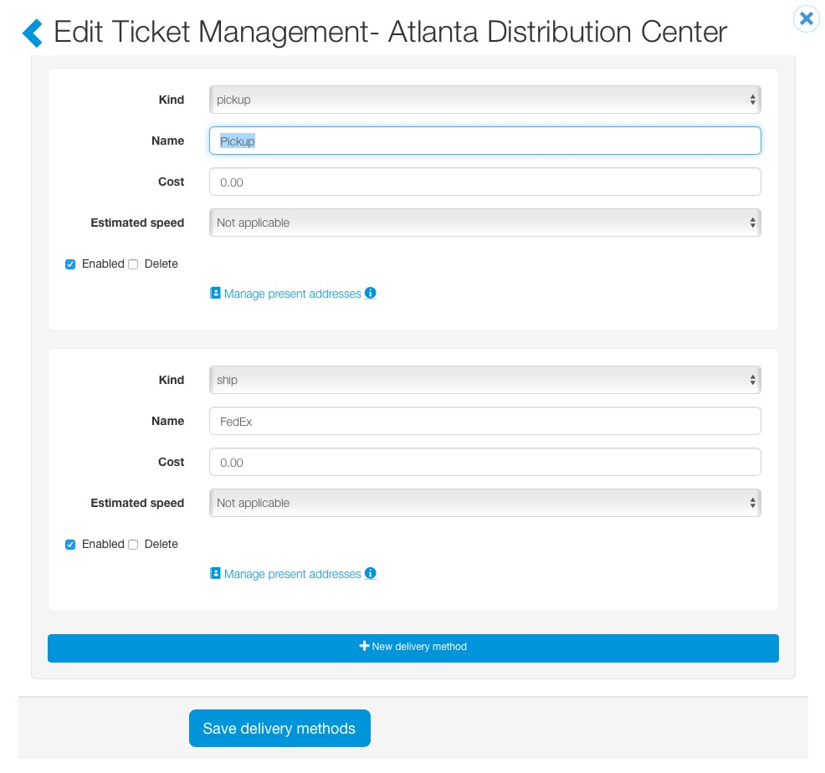
Distribution Centers
Public Choices:
Under the Public Choices tab, ticket admin specify the delivery options a user sees.
Public delivery options are available to users when making a request. Ticket admin can offer multiple delivery options.
Physical, E-tickets and mobile should have their own distribution centers. They are different ticket types or formats and aren’t delivered the same way.
If delivery options are not available when users are requesting tickets, the delivery will populate as “no preference” for the user in the Deliver tab once the tickets are assigned.

Slide 8
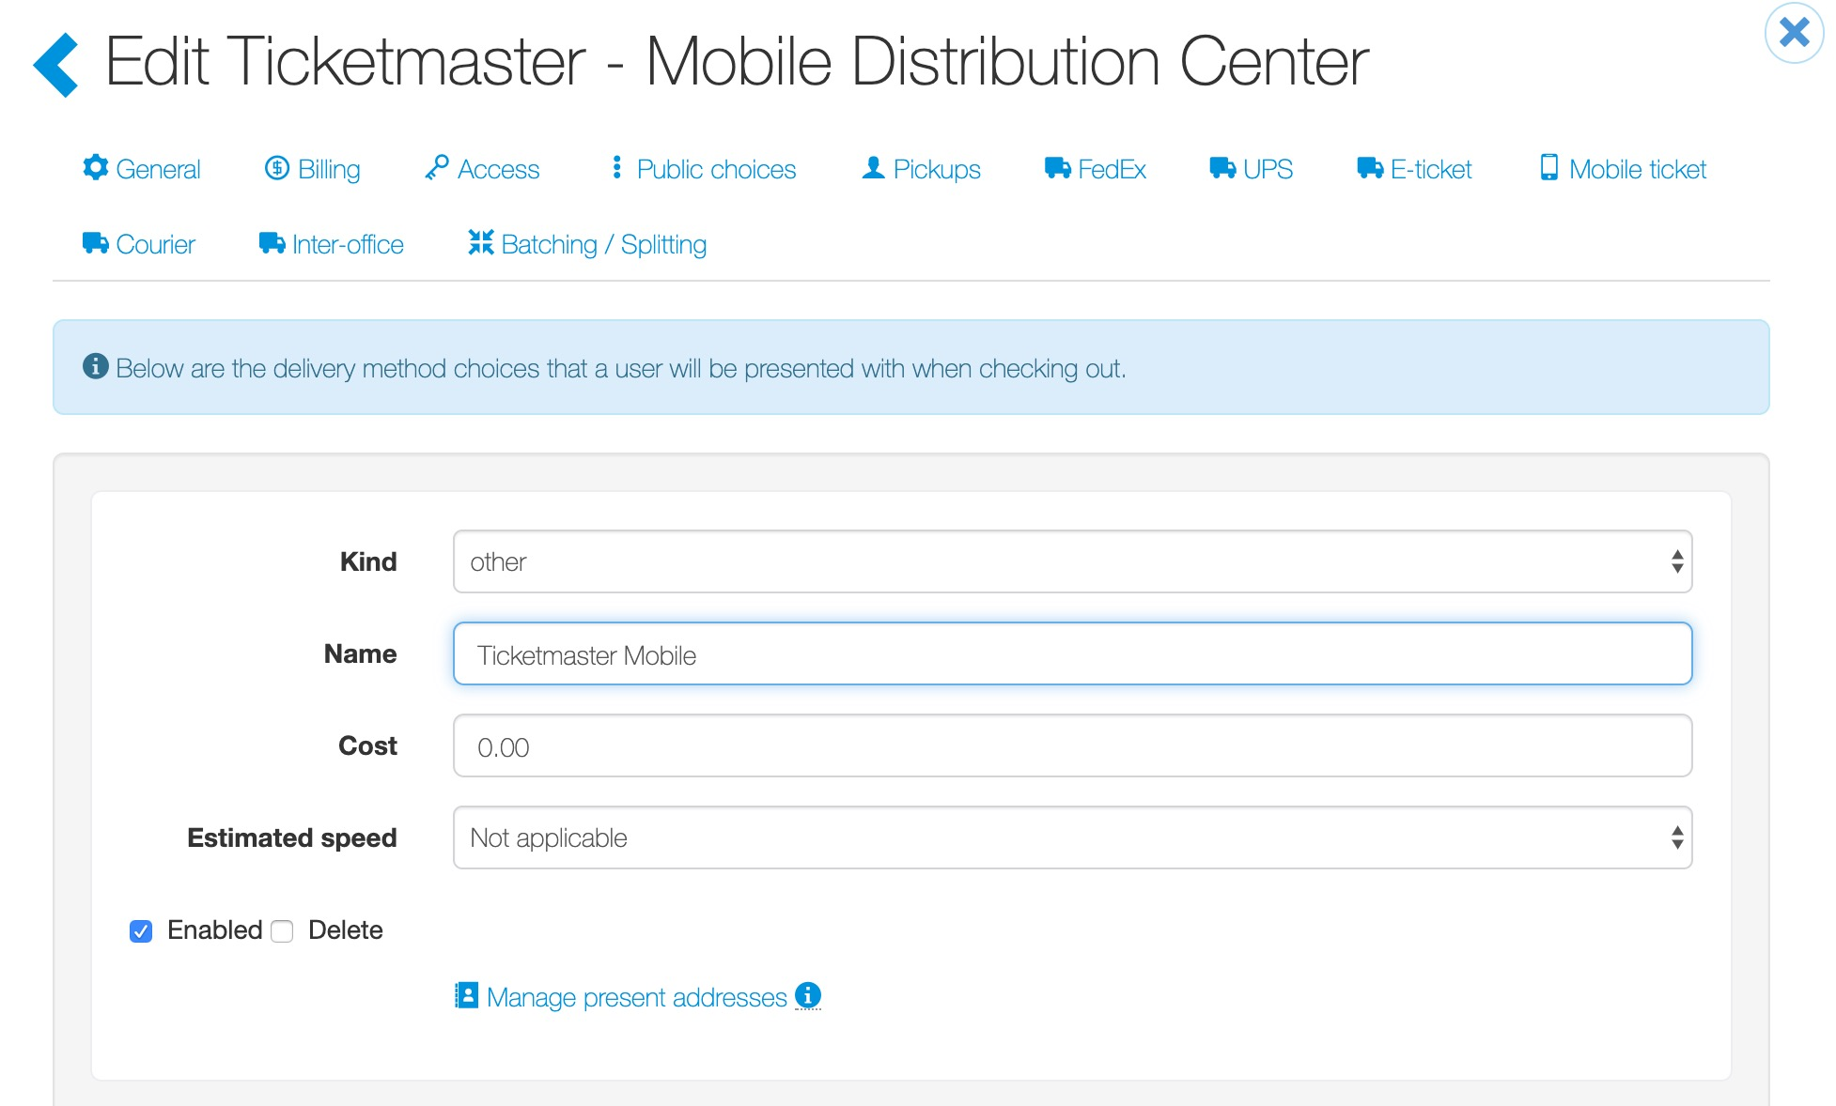
Distribution Centers
Public Choices:
When ticket admin want to edit or add delivery methods, ticket admin specify ”public” delivery:
  Kind: Select “ship”, “pickup”, “will call”, or “other”.
  Name: Enter the delivery name (UPS, Interoffice, Pickup, etc.).
  Cost: Leave as $0.00 unless you charge internally for ticket delivery .
  Estimated Speed: Leave as “not applicable”.
  Enabled: Be sure “Enabled” is checked, then click “Save delivery methods”.

Slide 9
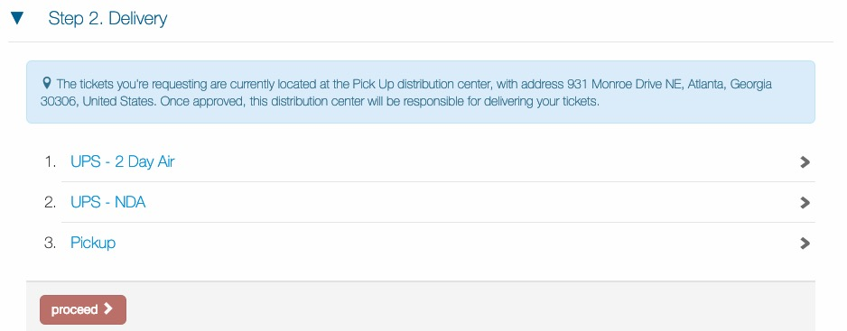
Distribution Centers
Public Choices:
It’s common for physical tickets to have multiple public delivery options (Pickup, UPS, Interoffice) on a single distribution center. Keep in mind, the delivery option a user selects when requesting tickets may not be the delivery method for the tickets.
If you offer multiple delivery options for physical tickets, we recommend changing the distribution center name from “Pickup” to “Physical Tickets” and update the public choses.
A ticket admin determines the actual delivery method. For example, someone on you’re a different floor in your building requests UPS over pickup. When a delivery admin processes the delivery, they can process the delivery as a pickup.

Slide 10
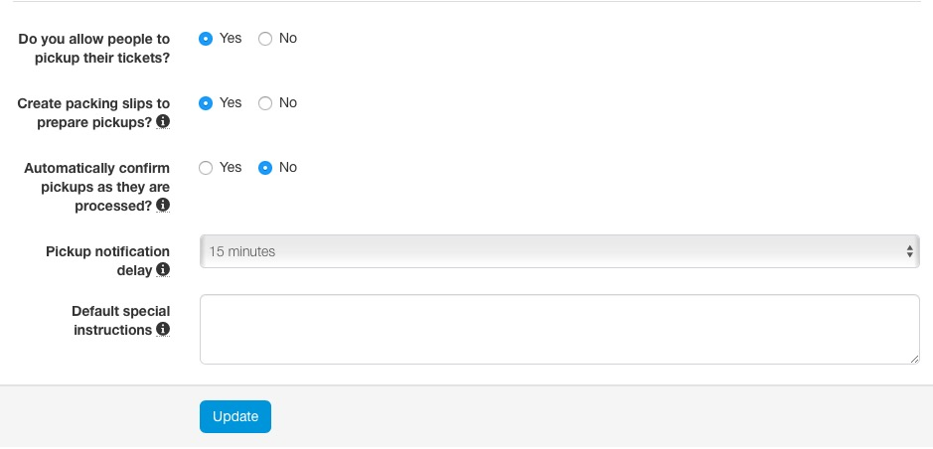
Distribution Centers
Pickup:
For the Pickup tab, the most common delivery method for physical tickets is pick-up.
Delivery admin can also confirm pickups. Concierge Live has the ability for ticket admin to confirm when tickets are actually picked up. Setting this to 'yes' will disable this feature, meaning Concierge Live will assume the tickets were picked up when the delivery is processed.
Special Instructions: Enter any special instructions which are included in the delivery notification email.

Slide 11
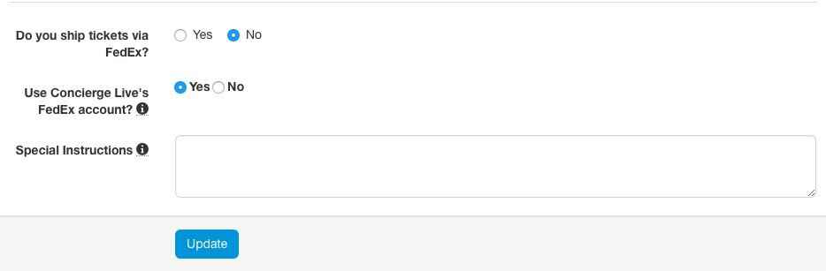
Distribution Centers
FedEx:
On the FedEx tab, Admin can ship tickets through FedEx.
Clients can use Concierge Live’s FedEx account or your company’s FedEx account. If you use the Concierge Live account, you will be invoiced through the system.
To use your FedEx account, ticket admin will need to work with their FedEx rep to secure the information for integration. For more details on FedEx integration, see the details in the Help section.
Special Instructions: Enter any special instructions which are included in the delivery notification email.

Slide 12
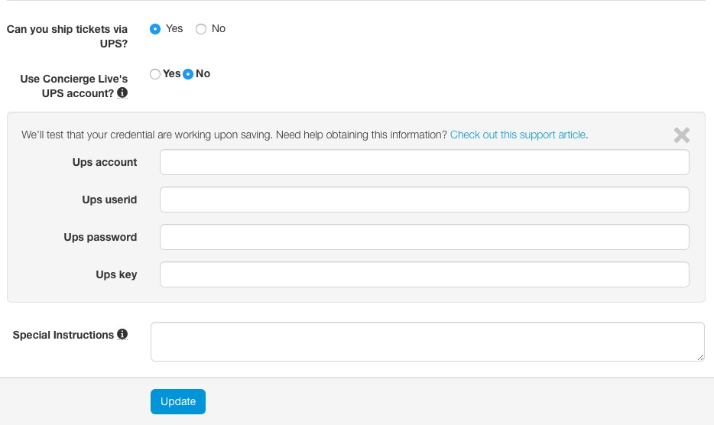
Distribution Centers
UPS:
On the UPS tab, ticket admin can ship tickets through UPS.
Clients can use Concierge Live’s UPS account or your company’s account. If you use the Concierge Live account, you will be invoiced through the system.
To use your UPS account, work with your UPS rep to secure the information below for integration. For more details on UPS integration, see the details in the Help section.

Slide 13
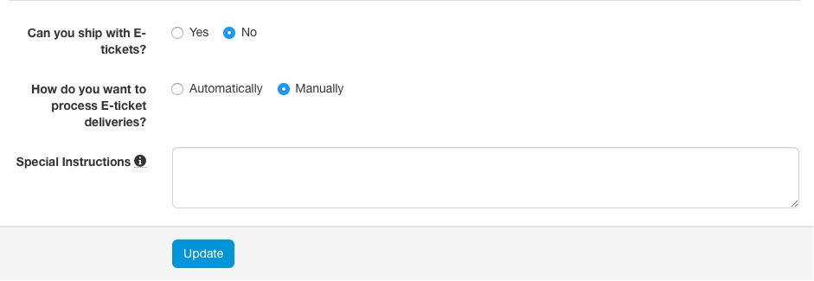
Distribution Centers
E-Ticket:
Ticket admin can deliver tickets via email. Each distribution center will need to be set up to “allow” e-ticket distribution.
Once e-tickets are uploaded and assigned, ticket admin can automate e-ticket delivery. Deliveries will happen immediately unless a timeframe is set for e-tickets to be delivered X number of days prior to the event. If a ticket admin selects to “manually” deliver e-tickets, ticket admin will process e-ticket deliveries via the delivery tab.
Special Instructions: Enter any special instructions which are included in the delivery notification email and also viewable in the Delivery section during the check out process.

Slide 14
Distribution Centers
Mobile
For mobile ticket deliveries, see the “Distribution Center – Mobile” deck in the knowledge base.

Slide 15
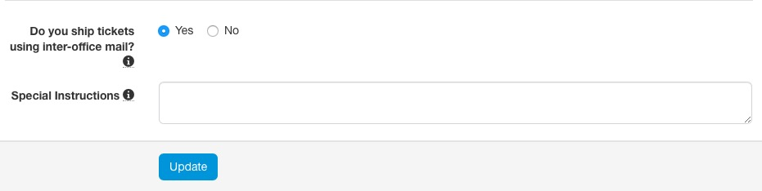
Distribution Centers
Inter-office:
Ticket admin can ship tickets through the inter-office.
Any special instructions entered are included in the email sent to the user when a delivery is processed.
Special Instructions: Enter any special instructions which are included in the delivery notification email.

Slide 16
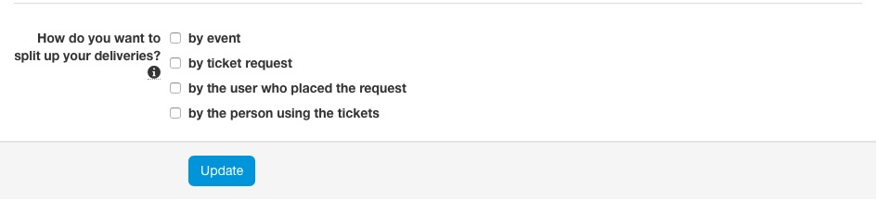
Distribution Centers
Batching:
Batching deliveries can reduce shipping costs for companies and create efficiencies for ticket admin responsible for ticket delivery.
Batching will group tickets for the same requestor, same ticket type and same delivery option.

