Slide 1
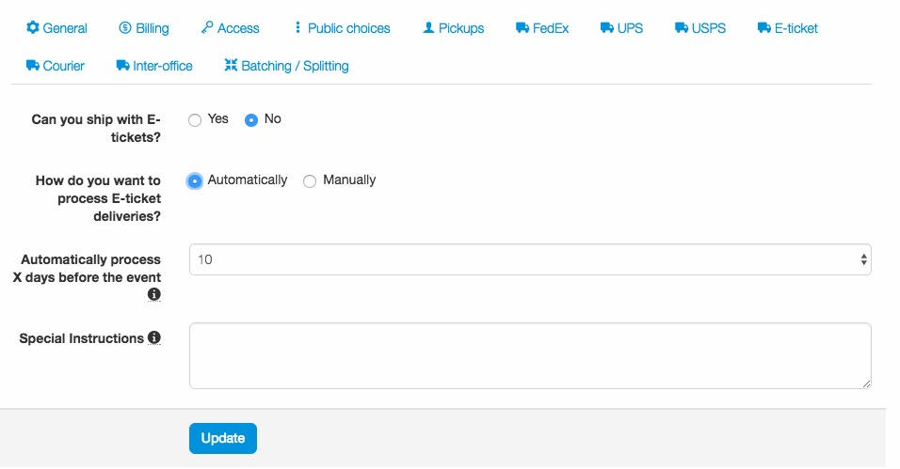
E-tickets
The first step to using e-tickets is to create a distribution center that supports e-tickets. This is done through the Setup section.
For the delivery process, ticket admin can have tickets sent to requestors immediately upon ticket assignment/approvals or set a timeframe which will automatically deliver the tickets X days before the event. If you set a timeframe for delivery, this information will appear in the delivery step when a user is checking out during the request process.
Any instructions will be included in the email sent to the user when a delivery is processed.

Slide 2
E-tickets
Tickets must be downloaded from the primary ticketing company and loaded into Concierge Live. Once you have downloaded the e-tickets, there are two primary options for loading them into Concierge Live:
Individual Events – via the configure option for the tickets.
Mass importing – this can be done through mass configure options.
In either case, when loading in e-tickets:
Depending on the ticket file size, you may be limited to loading a few games at a time (weekly, monthly, etc.) due to time out issues.
When uploading electronic tickets, you will receive an error message if the selected ticket counts and PDF page counts don’t match.
When uploading tickets to multiple events, the e-ticket PDF will be uploaded based on the file and the events/tickets you select. Be sure your file is in the same sequence as the tickets you are applying them too (i.e. be sure you select the correct games).

Slide 3
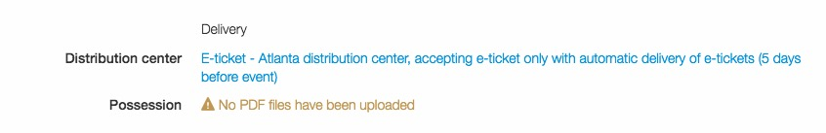
E-tickets
From the tickets page or in mass configure, select the tickets you would like to load in e-tickets for, and select ”Configure”.
Be sure the tickets are set to a distribution center that supports e-ticket delivery. If the tickets were not set up as e-tickets, you will need to click on ”Ticket Details” an update the ticket kind to ”electronic.”
In the configure section, under “Possession” click “No PDF files have been uploaded.”

Slide 4
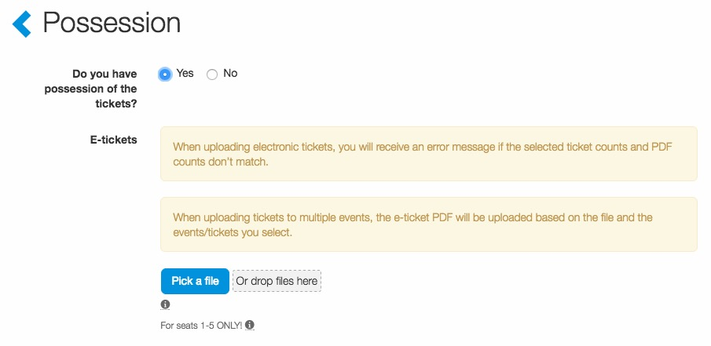

E-tickets
In the ”Possession” section, select ”Yes”.
Pick a file on your computer or drag and drop a ticket file where is says “Or drop files here”.
Once the file is successfully uploaded, the file will appear in the file box.
Click “Save”.

Slide 5
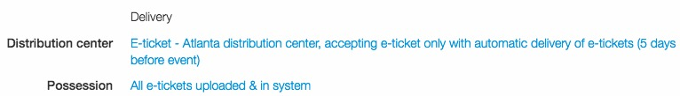
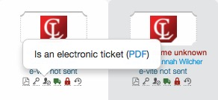
E-tickets
Once e-tickets are uploaded, the configure page will reflect their status.
On the tickets page, admin can view the actual e-ticket by moving their mouse over the e-ticket icon under a ticket and clicking “PDF.”
When loading multiple games, we recommend spot checking a few tickets to ensure the ticket file matched the tickets in Concierge Live.

Slide 6
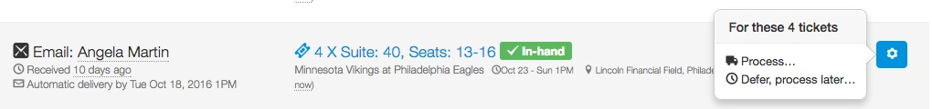
E-tickets
In the Deliver section, if a ticket admin sets e-tickets to be automatically delivered, you can view the scheduled delivery date in the delivery details.
At the designated time, the e-tickets will automatically be sent to the requestor.
If an e-ticket delivery needs to be processed before the automated timeframe, your shipping admin can simply process the delivery.

Slide 7
E-tickets
E-Tickets Tips
We use filestack (formerly filepicker) to import e-tickets. If you find that you do not see the option to upload tickets, please contact your company’s IT to have filestack whitelisted. https://developers.filepicker.com/docs/support/general/21
If your inventories include e-tickets and physical tickets, we recommend creating two distribution centers: one for physical tickets and one for e-tickets. When creating tickets, ticket admin must select whether a ticket is physical or electronic, it can’t be both. Of course, ticket admin can modify the ticket kind (i.e. physical or electronic). We have found it is easier to maintain the tickets in two different distribution centers.
Our e-ticket loader cannot read your barcodes or seating locations. The splitter dices the pages to parse out each ticket set. We recommend going type by type if you have multiple locations versus uploading your full season of parking, suite, club, etc. all in one document to ensure you are putting each ticket with the correct seat.
If you re-assign tickets and re-deliver tickets in Concierge Live, the same barcode will be used again. We are not integrated with any system that will re-barcode a ticket. Be aware that if a user gives a ticket out twice, it will be first come, first served at the venue. We recommend setting a release for a trigger on tickets closer to the event date to minimize this possibility.

