Slide 1
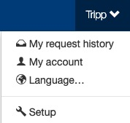
Field Relevancy
The Setup section is where setup admin control account behaviors. From updating attendee types and data fields, to delivery options for tickets, to branding the site; all is done in the Setup section.
To access the Setup section, click on your name (top of the page), then click “Setup”.

Slide 2
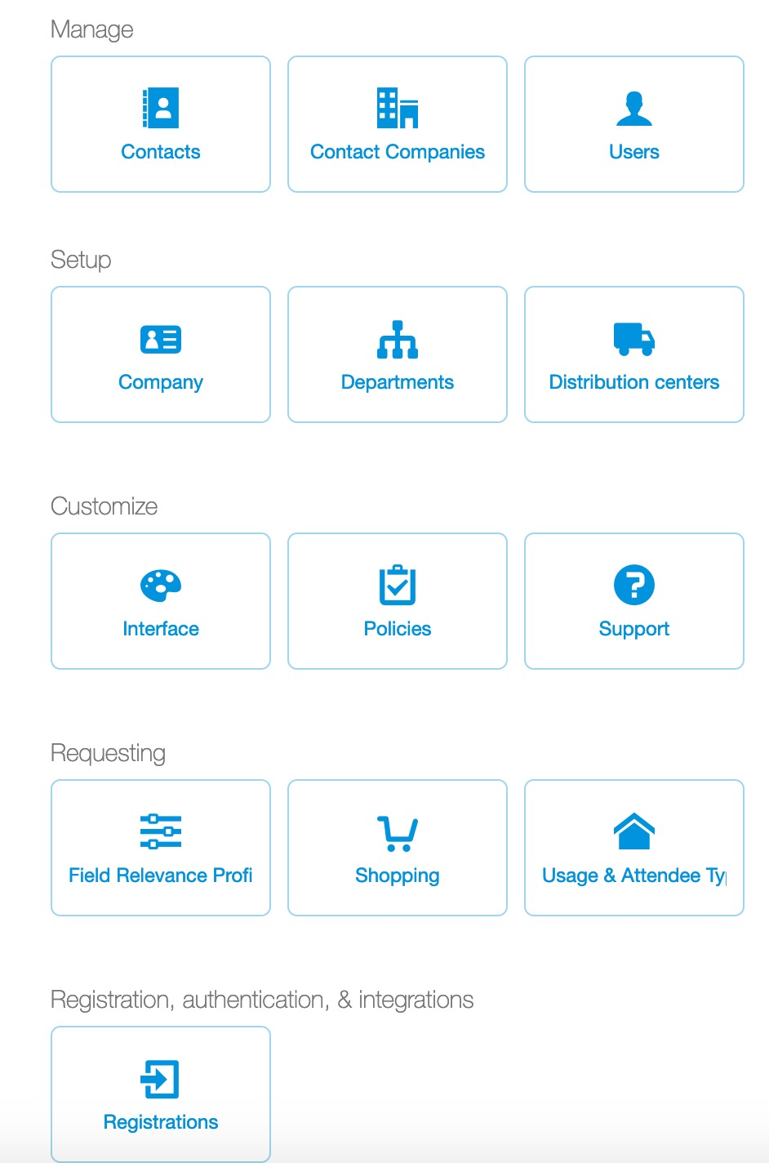
Field Relevancy
Field relevancy is where a Setup ticket admin defines the field requirements a user must complete when entertaining an attendee.
Field requirements may include name, company, title, etc. and can be set as not relevant, not required or required.
Concierge Live has pre-set field requirements by default based on commonly used fields; however, Setup ticket admin can update them based on their needs.
Once field relevancies are created, they are applied to an attendee type.
Click “Field Relevance Profile” to view, edit or add a field relevancy.

Slide 3
Field Relevancy
By default new Concierge Live accounts are created with the following attendee types and field requirements:
  Charity = Name (o); Title (o) Company Name (r); Tax ID (r)
  Client = Name (o); Company Name (r); Title (r); Purpose of Entertainment (r)
  Employee = Name (o); Email (r); Title (r); Phone (r)
  Prospect = Name (o); Company Name (r); Title (r); Purpose of Entertainment (r)
  O = Optional
  R = Required
For mobile tickets, if you allow ticket requestors to transfer tickets directly to their attendees, email should be a required for your attendee types. Without an attendee email address, tickets cannot be transferred to attendees.
This deck shows setup ticket admin how to update field requirements. Once a field relevancy is created and saved, it can be applied to an attendee type (see attendee type deck for how to apply a field relevancy to an attendee type).

Slide 4
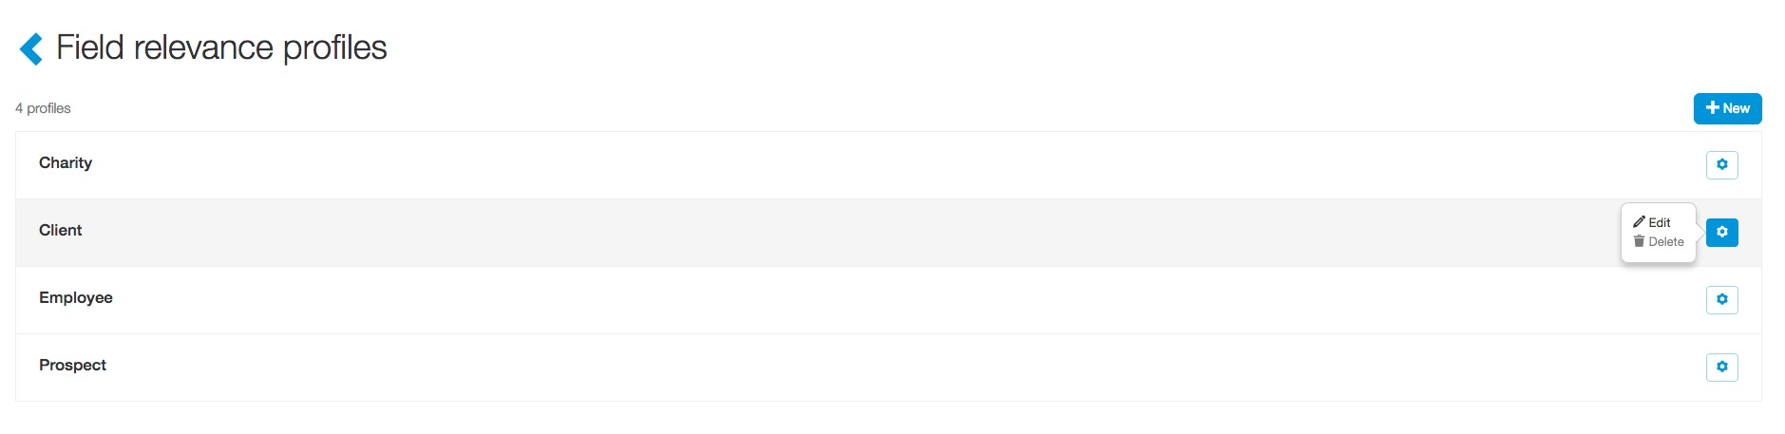
Field Relevancy
To view or edit an existing field relevancy profile, click the cog icon on the right-hand side of the field relevancy line item of interest, then click “Edit”.

Slide 5
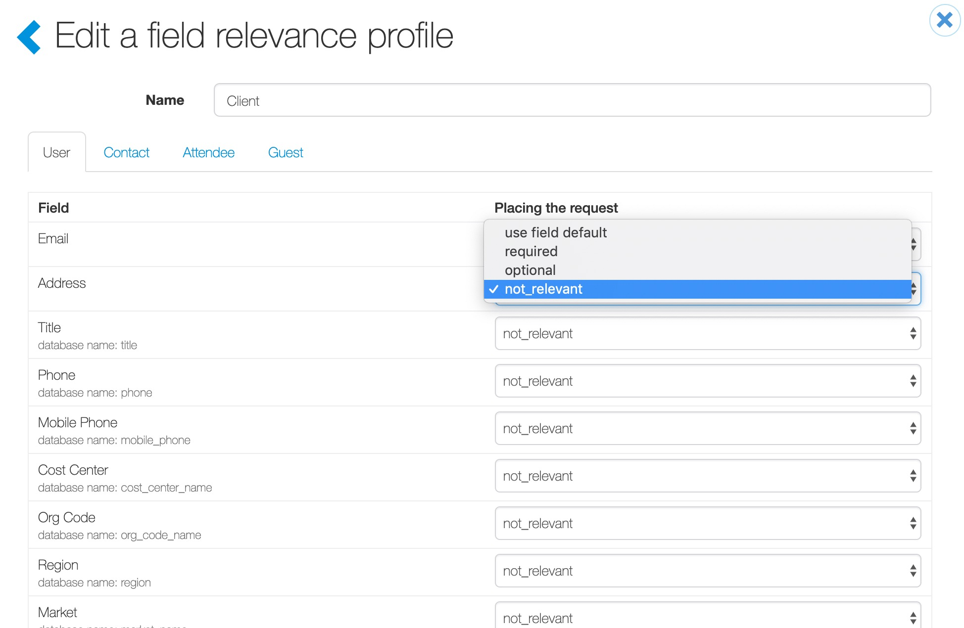
Field Relevancy
When editing field relevancy, there are four tabs with fields: user, contact, attendee and guest.
A user is an employee, someone who accesses Concierge Live to make a ticket request.
“User” fields are only relevant to users; an external attendee doesn’t see or complete user fields.
For each field, a ticket admin selects optional, required or not relevant. This will determine if a user sees and must enter data for the field.

Slide 6
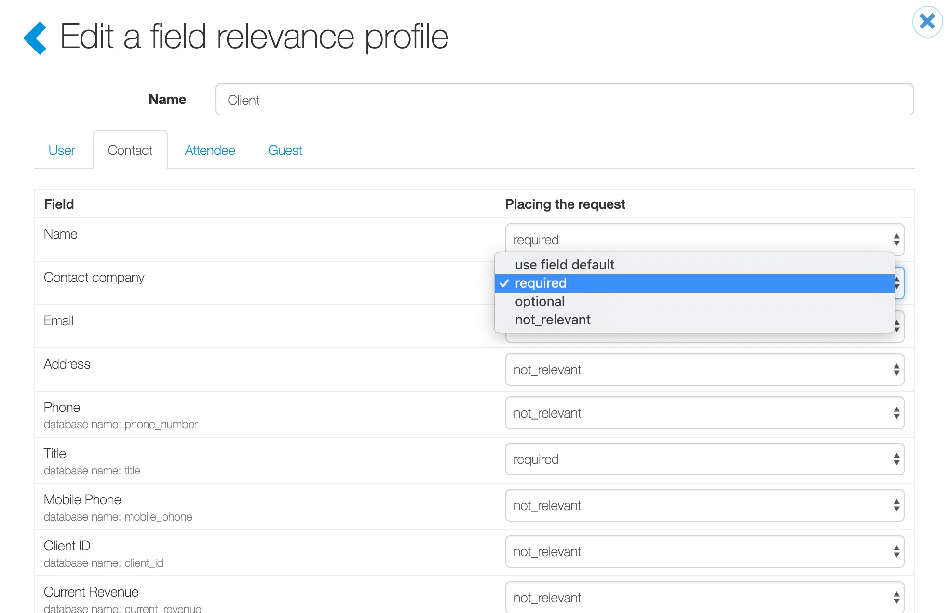
Field Relevancy
The second tab is called Contact.
Once a contact field is completed, the data is retained and populates the next time the attendee is entertained. For example, when a user enters an attendee’s name, company and/or title, that information will auto-fill the next time the attendee is entertained.
For mobile tickets, if you allow ticket requestors to transfer tickets directly to their attendees, email must be a required field for your attendee types.
Update fields (i.e. optional, required, not relevant) based on need, then click the “Attendee” tab.

Slide 7
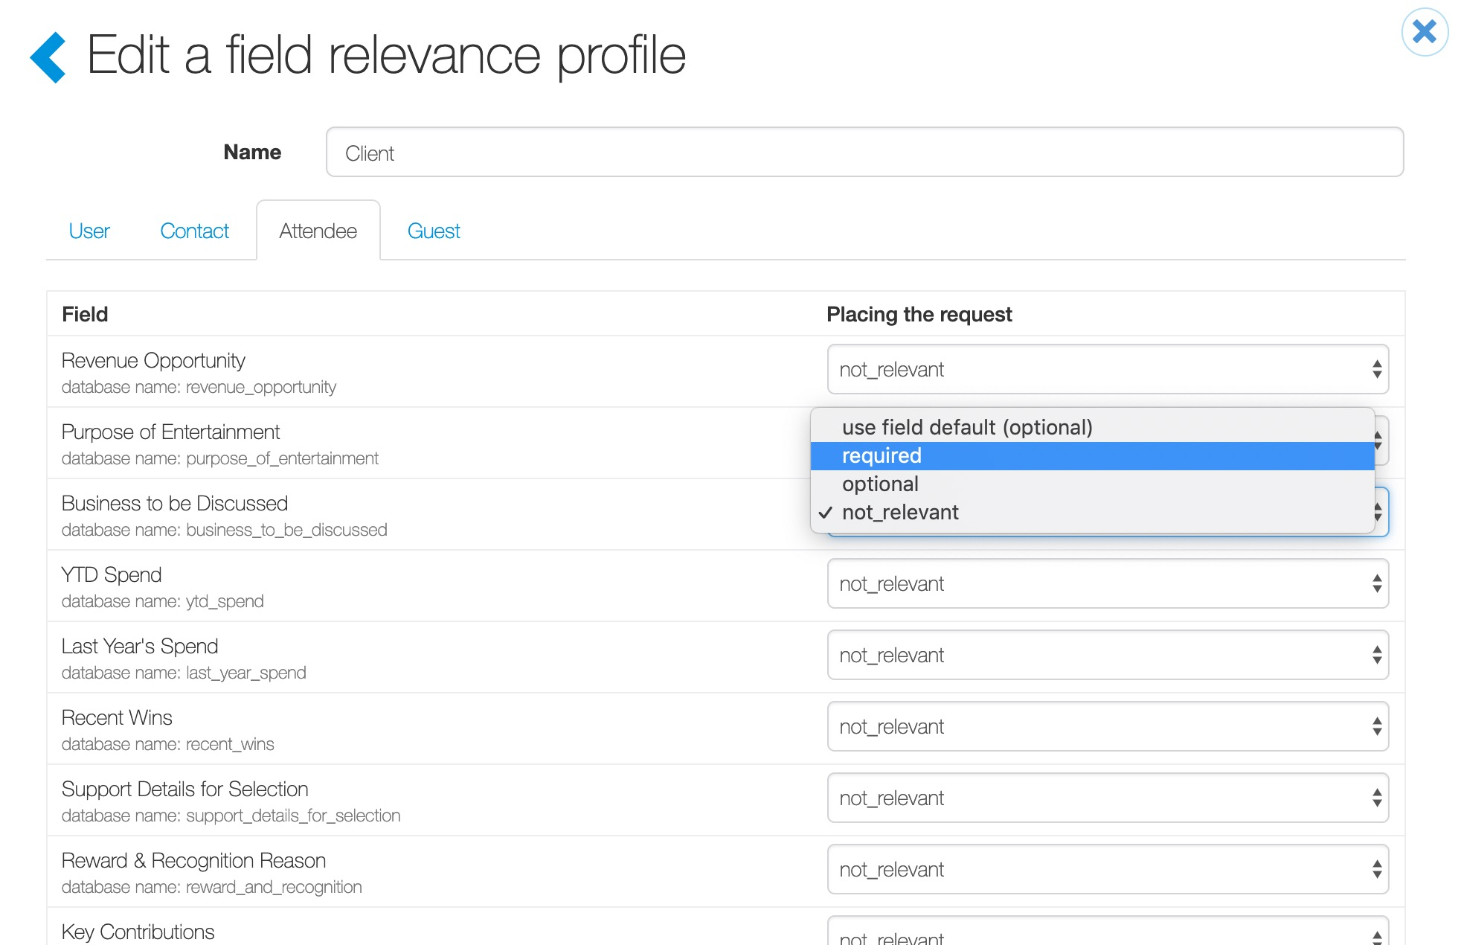
Field Relevancy
The next tab is the Attendee tab. Attendee fields must be completed each time an attendee is entertained.
Attendee fields can be used for users (employees) and contacts (external attendees).
This information may have changed since the last time an attendee was entertained. A common example of an attendee field is ”Purpose of Entertainment”.

Slide 8
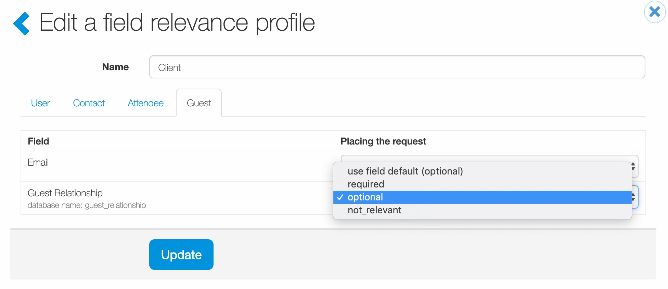
Field Relevancy
The next tab is the Guest tab.
Guest fields are applicable to users (employees) and contacts (external attendees).
Depending on configuration settings for ”Unknown Guests” is enabled, users can or are required to provide info on primary attendee guests (an attendees +1).
Concierge Live recommends the “Guest Relationship” guest field be set to optional.
Concierge Live does not recommend enabling the guest email field. This can create confusion when ticket requestors can send tickets directly to their attendees.
  Guests are the +1 (they have a ticket as a result of someone’s attendance). As a result all guest tickets are sent to a primary attendee (user or external contact), so inclusion of an email can create confusion that tickets will be sent to a guest of a primary attendee.

Slide 9
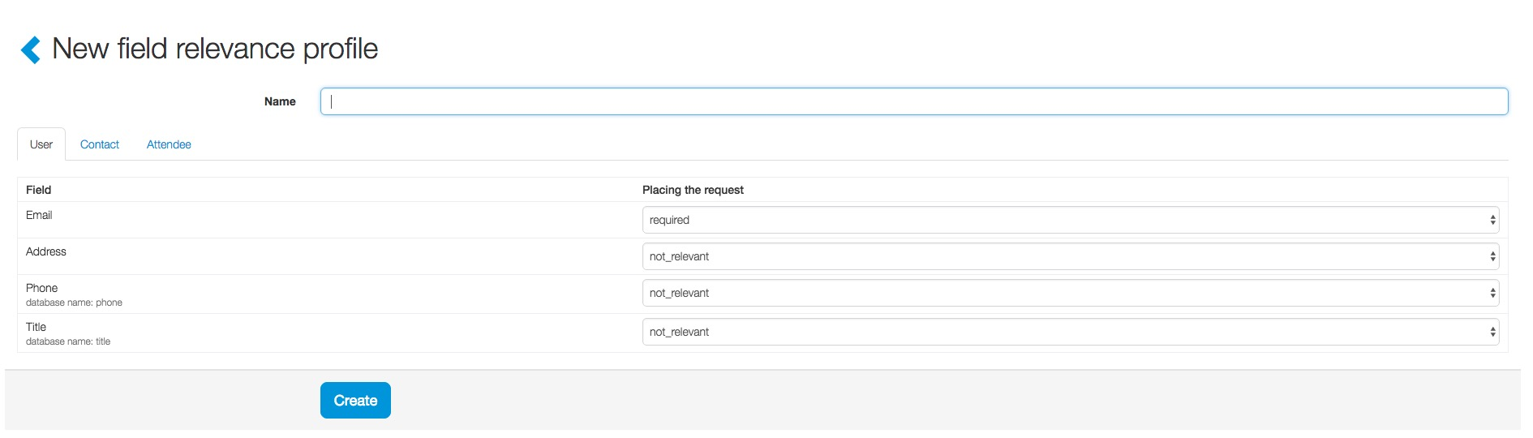
Field Relevancy
Field requirements do not have to be the same for all attendee types. We do recommend some consistency for reporting, but field relevancy is a company decision.
If a ticket admin wants to create a new field relevancy, click on the “+ New”.
Enter the name of the field relevancy, update the fields on the user, contact and attendee tabs and click “Create”.

