Slide 1
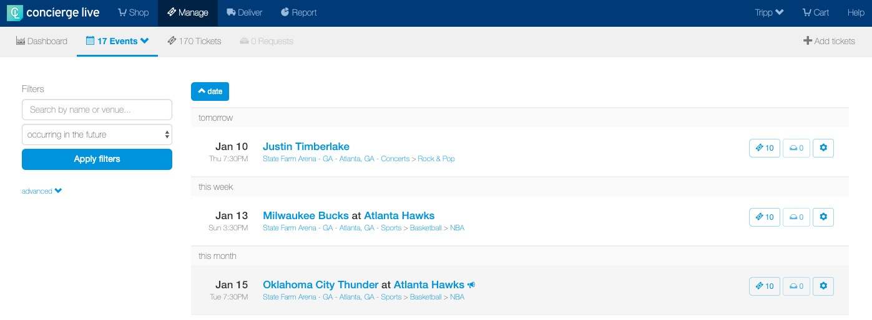
Making a Request on Behalf of a User - Personal
Ticket admin can make a request on behalf of a user/employee for the tickets that they manage.
On the Manage page, locate the event of interest and click the ”ticket” icon for the event.

Slide 2
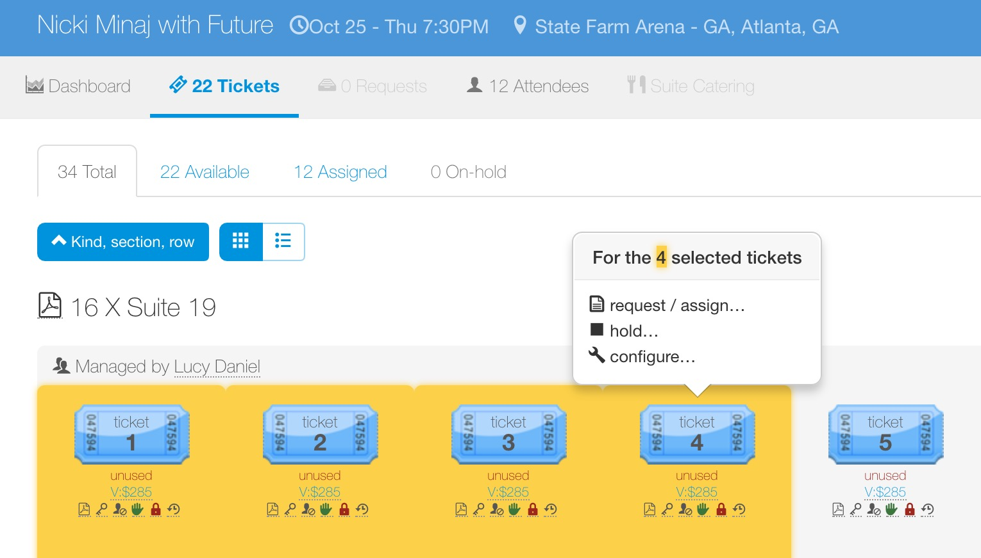
Making a Request on Behalf of a User - Personal
On the tickets page for an event, blue tickets are available.
Tickets are individual, if the requestor wants 4 tickets, the ticket admin must click on 4 tickets.
As the ticket admin clicks tickets, they are highlighted in yellow.
Once the tickets to be requested have been selected, click “request/assign…” in the pop-up window.

Slide 3
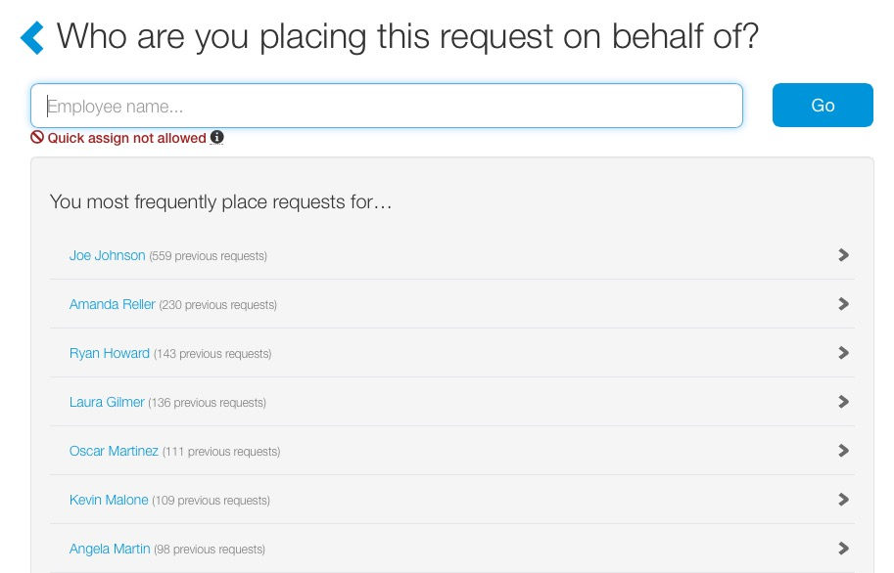
Making a Request on Behalf of a User - Personal
Ticket admin will search for the user/employee they are placing the request on behalf of.
The user/employee selected here receives all the notifications associated with the request.
Frequent requestors appear on the screen and can be selected, without searching.
Ticket admin can also search for a user/employer and click “Go”.
For this ticket request, select Ryan Howard.

Slide 4
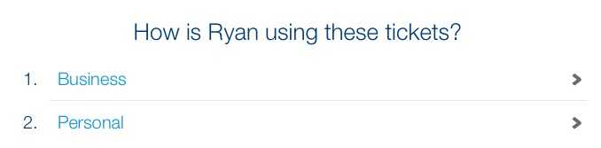
Making a Request on Behalf of a User - Personal
If tickets are available for “Business” and “Personal” requests, the ticket admin selects how the requestor will be using the tickets.
If tickets are only available for either business or personal requests, this step will be omitted. In this case, Ryan will be using the tickets for personal use, so select “Personal”.

Slide 5
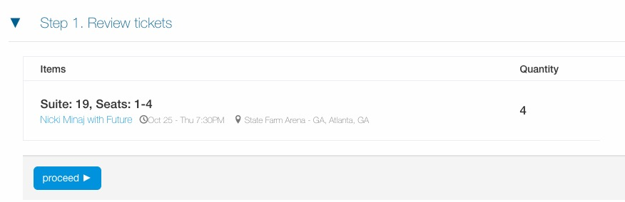
Making a Request on Behalf of a User - Personal
The first step in a personal request is confirming the event and ticket details.
Requestors are not required to provide attendee data for personal requests.

Slide 6
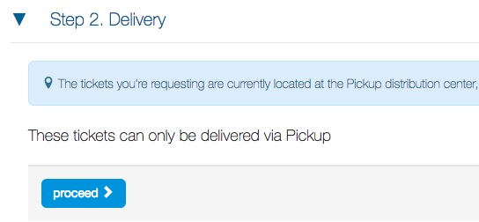
Making a Request on Behalf of a User - Personal
Depending on a ticket’s configuration, users may have to select a delivery method.
Ticket delivery options will vary based on the ticket type and ticket admin. Options may include pick-up, interoffice, UPS, mobile, electronic, etc.
If there are no delivery options, the delivery step will be skipped.
For physical tickets deliveries, users can enter and save addresses for future deliveries.

Slide 7
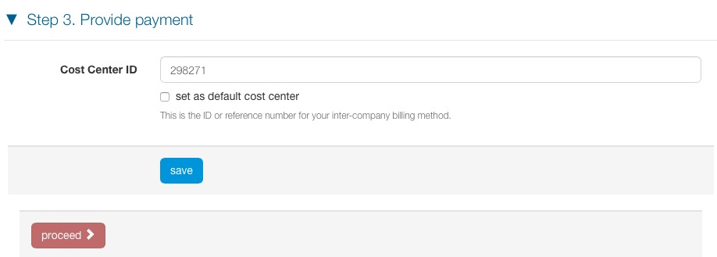
Making a Request on Behalf of a User - Personal
When requestors are charged for tickets, a cost center or a credit card number will be required.
If a cost center is used for billing, requestors can enter and set a default cost center.
If a credit card is used for billing, requestors can enter and save credit data for future purchases.

Slide 8
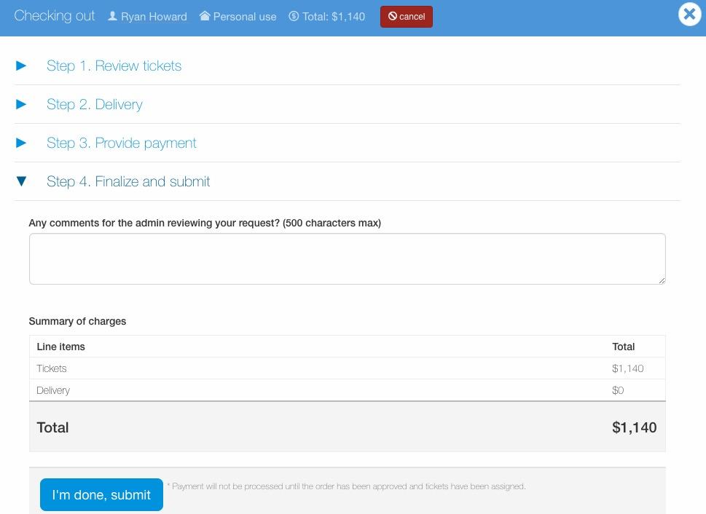
Making a Request on Behalf of a User - Personal
Before a requestor submits a request, it can be reviewed and edited.
Requestors also have the option add comments viewable to the ticket admin.
Once satisfied with the request, click “I’m done, submit”.

Slide 9
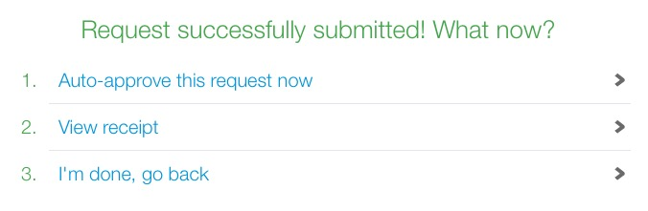
Making a Request on Behalf of a User - Personal
After submitting a request, as a ticket admin for the tickets, three options appear:
  Auto-approve this request now: assigns the exact tickets selected for request.
  View receipt: allows the ticket admin to view the request summary. The request is in a pending state in the request queue and available for processing.
  I’m done, go back: takes the ticket admin back to the event tickets page (where the request process began). The request is in a pending state in the request queue and available for processing.
Requestors receive all notifications associated with requests on their behalf (i.e. request receipt, assigned, delivery, etc.).
Requestors can edit requests (i.e. attendees) in their request history.

