Slide 1
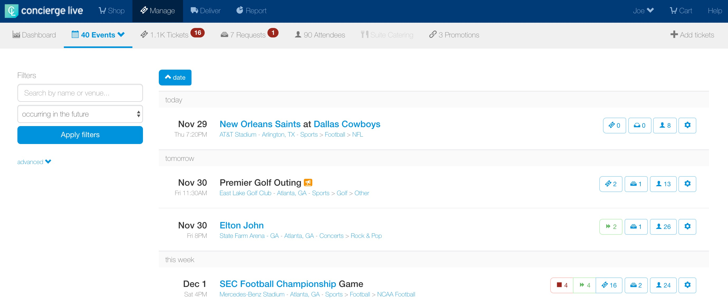
Making a Request on Behalf of a User
Ticket admin can make a request on behalf of a user/employee for their tickets under management.
On the Manage page, locate the event of interest and click the ”ticket” icon for the event.

Slide 2
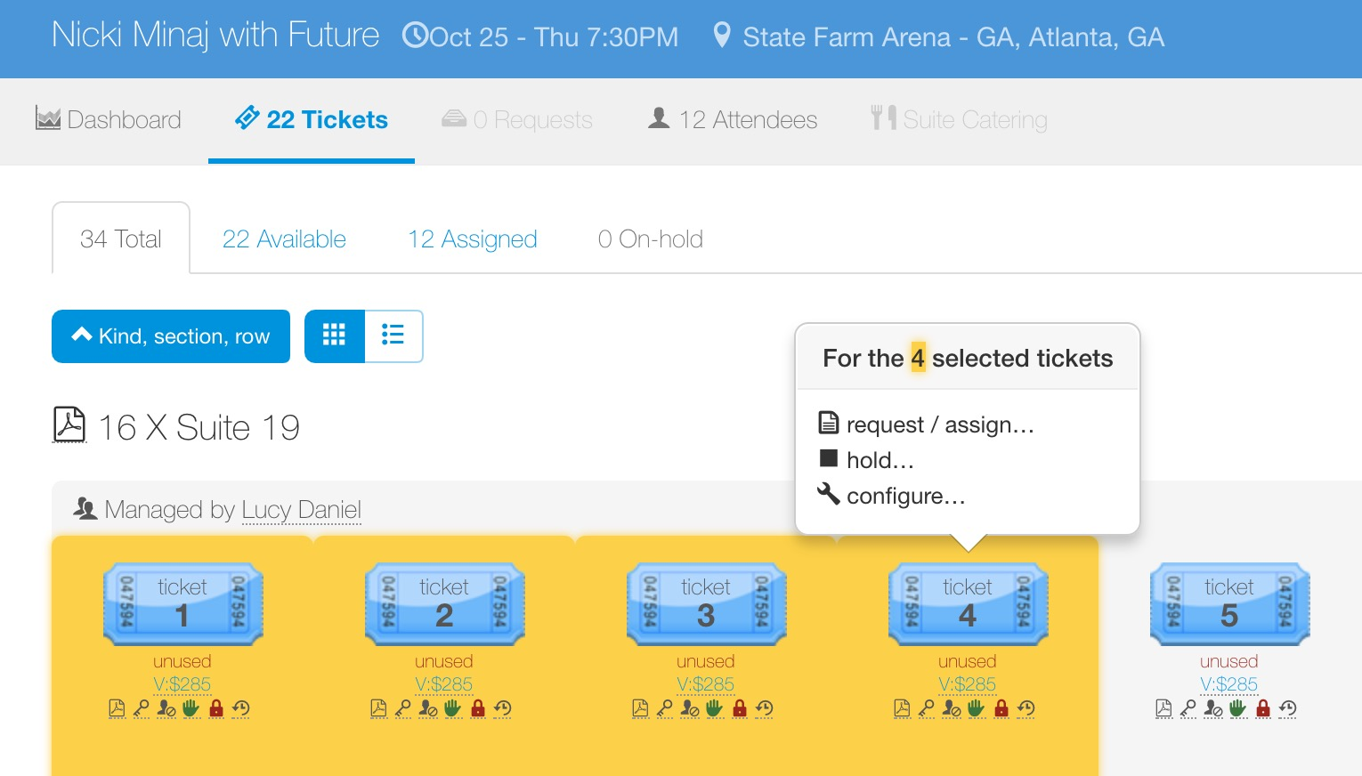
Making a Request on Behalf of a User
On the tickets page for an event, blue tickets are available.
Tickets are individual, if the requestor wants 4 tickets, the ticket admin must click on 4 tickets.
As the ticket admin clicks tickets, they are highlighted in yellow.
Once the tickets to be requested have been selected, click “request/assign…” in the pop-up window.

Slide 3
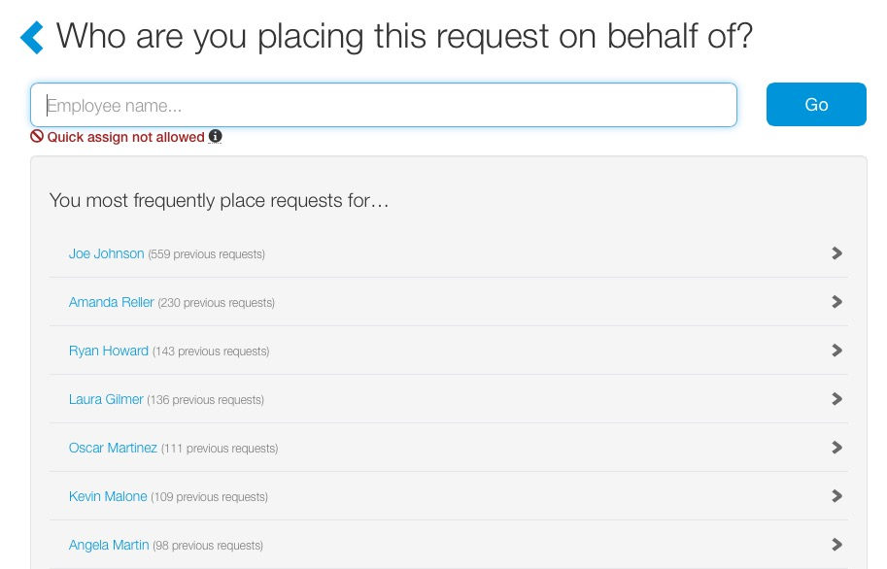
Making a Request on Behalf of a User
Ticket admin will search for the user/employee they are placing the request on behalf of.
The user/employee selected here receives all the notifications associated with the request.
Frequent requestors appear on the screen and can be selected, without searching.
Ticket admin can also search for a user/employer and click “Go”.
For this ticket request, select Ryan Howard.

Slide 4
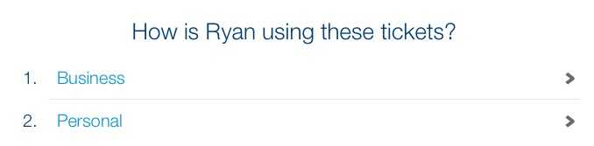
Making a Request on Behalf of a User
If tickets are available for “Business” and “Personal” requests, the ticket admin selects how the requestor will be using the tickets.
If tickets are only available for either business or personal requests, this step will be omitted. In this case, Ryan will be using the tickets for business use, so select “Business”.

Slide 5
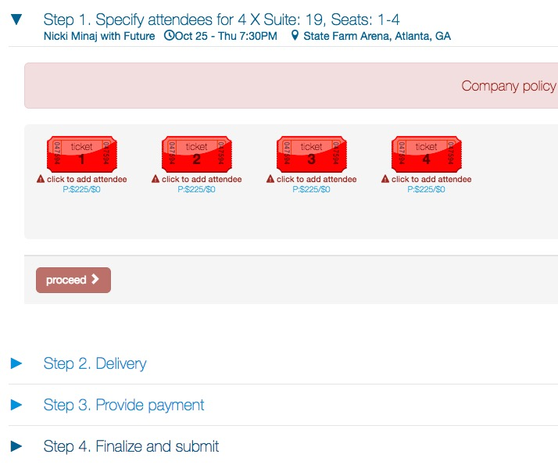
Making a Request on Behalf of a User
When making a request on a user’s behalf, the checkout process is the same as the user request process.
The first step, is identifying the attendees who will be using the tickets.

Slide 6
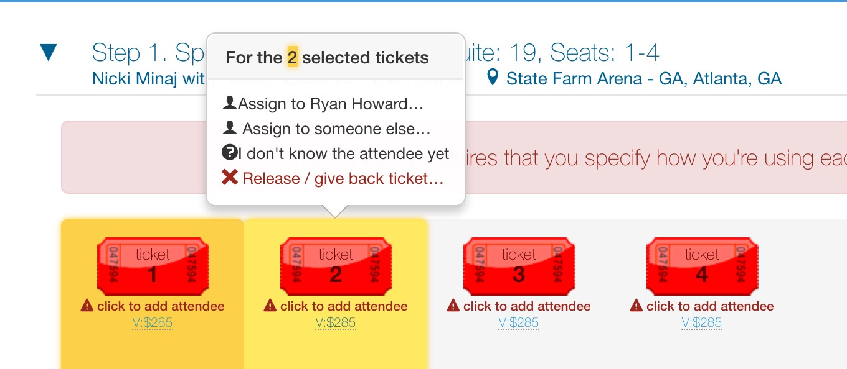
Making a Request on Behalf of a User
Click the specific tickets you would like to give the first primary attendee (this would include any tickets the attendee’s non-business guests will be using (i.e. spouse, child, friend).
If the requestor will be attending the event, select “Assign to Ryan Howard…” from the pop-up.
If the requestor is not attending the event, select “Assign to someone else…” to give these tickets to another attendee or when available “I don’t know the attendee yet”.
In this example, Ryan will be attending with his client, so select “Assign to Ryan Howard…”.

Slide 7
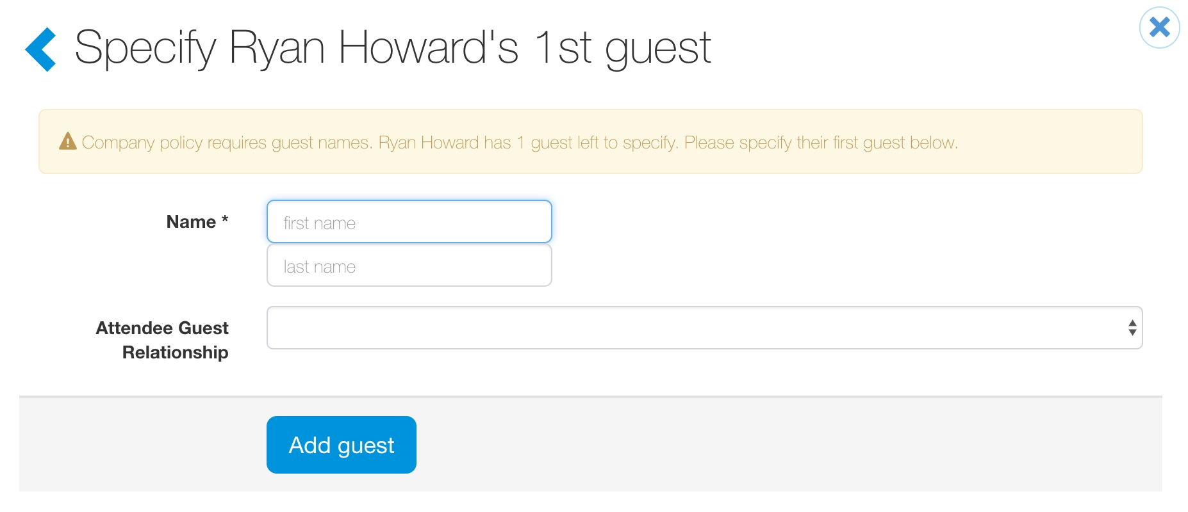
Making a Request on Behalf of a User
Depending on company settings, requestors may be required to provide primary attendee guest information.
When required, requestors will be prompted to complete guest information (i.e. spouse, significant other, child, etc.) for the primary attendee.
Attendee guest information can be required for users/employees and/or external contacts.
This step will be omitted if attendee guest information is not required.

Slide 8
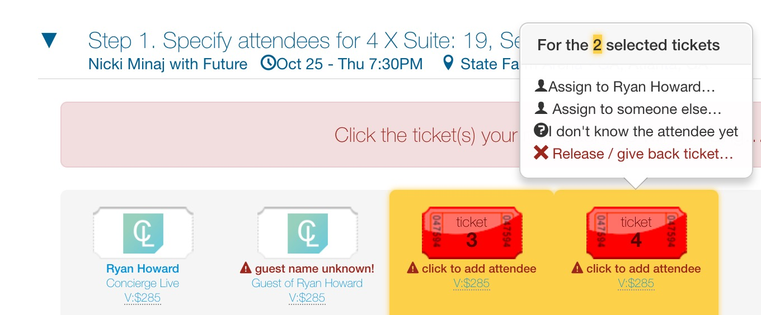
Making a Request on Behalf of a User
All requested tickets must be assigned to an attendee in order to proceed to the next step.
You will continue to select tickets and add attendees until all the tickets are assigned.
Ticket can be released, by clicking “Release ticket, give back ticket…”.
In this example, Ryan is bringing a client so select the remaining tickets, then from the pop-up, select “Assign to someone else…”.

Slide 9
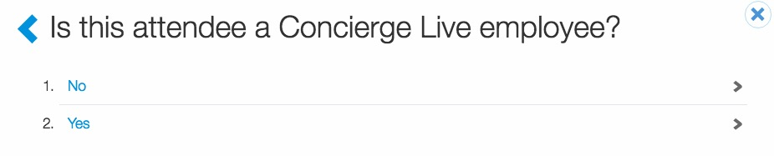
Making a Request on Behalf of a User
Based on the type of attendee the requestor plans to entertain, select whether they are an employee of your company or an external attendee (i.e. client, prospect, etc.).
In this example, Ryan is bringing a client, so select “No”.

Slide 10
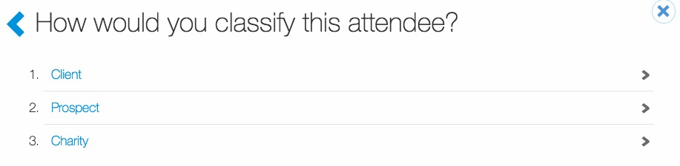
Making a Request on Behalf of a User
Based on the type of attendee Ryan plans to entertain, select an attendee type.
Attendee type options will vary from company to company and different events may have different attendee types.
In this example, select “Client”.

Slide 11
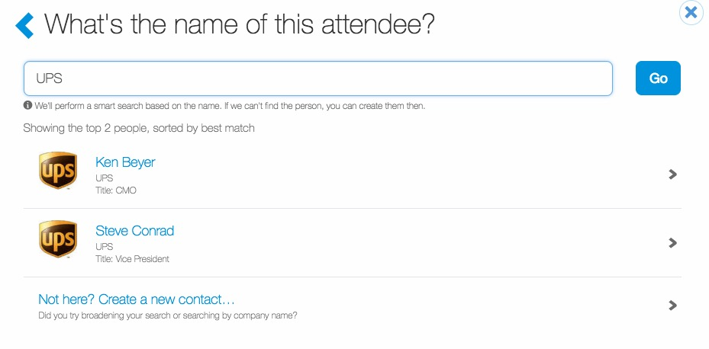
Making a Request on Behalf of a User
Enter the attendee’s name or company and click “Go”.
If the attendee has previously been entertained, their name will appear. If the attendee does not appear, you will need to create a new contact ”Not here? Create a new contact…”.
Once a contact has been created, requestors are not required to re-create them for future entertainment opportunities.
In this example, Ryan is bringing “Ken Beyer” with UPS, click his name.

Slide 12
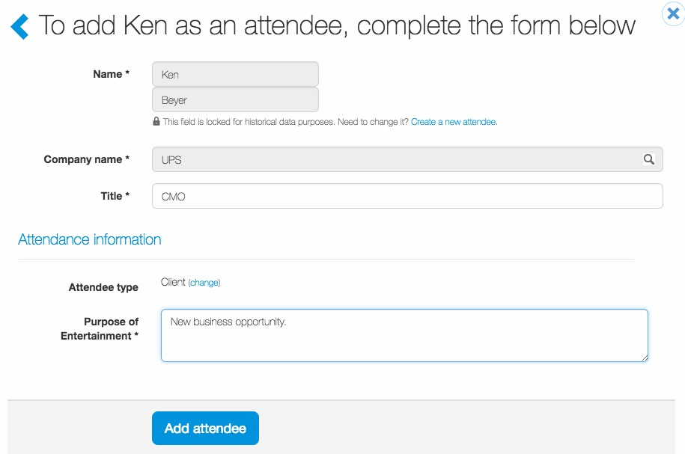
Making a Request on Behalf of a User
For Ken’s profile, requestors may be required to complete fields before adding the attendee to tickets.
Once all required fields have been completed, click “Add attendee”.

Slide 13
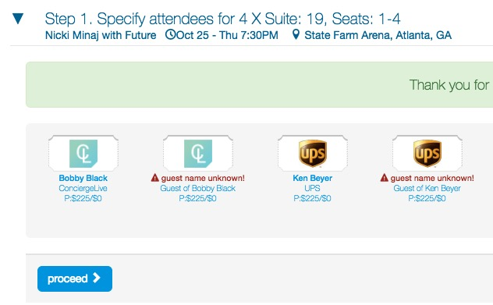
Making a Request on Behalf of a User
Once all the requested tickets are assigned to an attendee, the “proceed” button turns blue and the requestor can proceed to the next step.

Slide 14
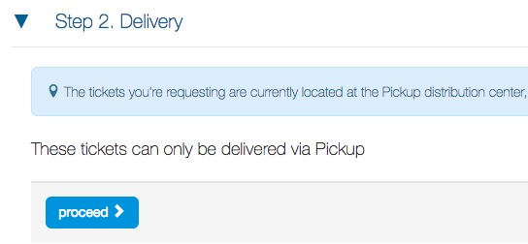
Making a Request on Behalf of a User
Depending on a ticket’s configuration, users may have to select a delivery method.
Ticket delivery options will vary based on the ticket type and ticket admin. Options may include pick-up, interoffice, UPS, mobile, electronic, etc.
If there are no delivery options, the delivery step will be skipped.
For physical tickets deliveries, users can enter and save addresses for future deliveries.

Slide 15
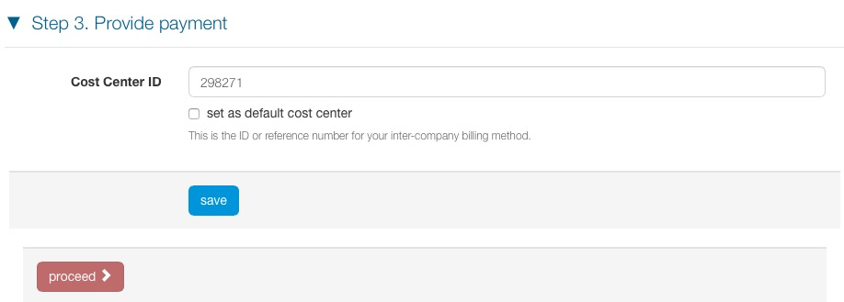
Making a Request on Behalf of a User
When requestors are charged for tickets, a cost center or a credit card number will be required.
If a cost center is used for billing, requestors can enter and set a default cost center.
If a credit card is used for billing, requestors can enter and save credit data for future purchases.

Slide 16
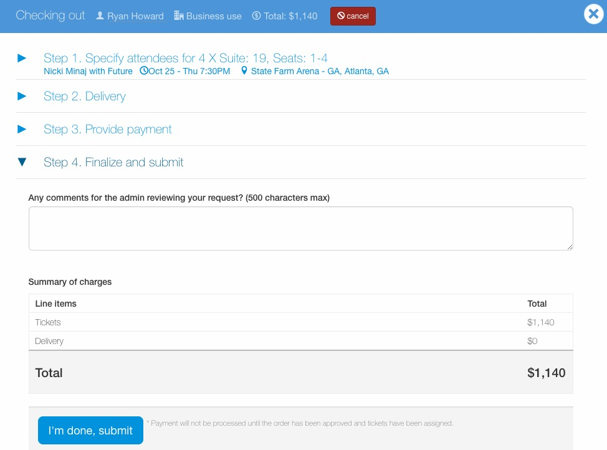
Making a Request on Behalf of a User
Before a requestor submits a request, it can be reviewed and edited.
Requestors also have the option add comments viewable to the ticket admin.
Once satisfied with the request, click “I’m done, submit”.

Slide 17
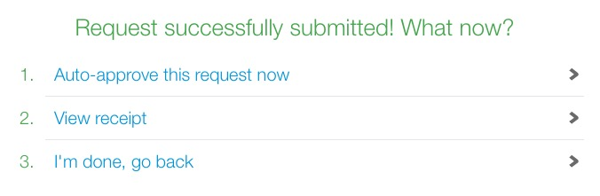
Making a Request on Behalf of a User
After submitting a request, as a ticket admin for the tickets, three options appear:
  Auto-approve this request now: assigns the exact tickets selected for request.
  View receipt: allows the ticket admin to view the request summary. The request is in a pending state in the request queue and available for processing.
  I’m done, go back: takes the ticket admin back to the event tickets page (where the request process began). The request is in a pending state in the request queue and available for processing.
Requestors receive all notifications associated with requests on their behalf (i.e. request receipt, assigned, delivery, etc.).
Requestors can edit requests (i.e. attendees) in their request history.

