Slide 1
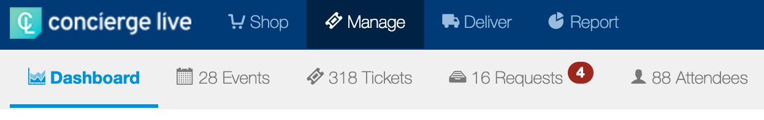
Manage Page
Manage is the homepage for ticket admin. Only the tickets a ticket admin has management permissions for appear on their manage page. The manage page is designed and engineered to maximize productivity and handle your daily ticket management tasks all from a single page.
Manage Page tabs include:
Dashboard: Ticket admin view high level data points on their tickets.
Events: Outlines the events a ticket admin has tickets for. This is the default page for the Manage Page.
Tickets: Outlines all the tickets the ticket admin has management permissions for. This tab is most used for ”mass configure”.
Requests: Ticket admin can view all the requests for their tickets. This is called the “All Request Queue”.
Attendees: Ticket admin can view all the attendees assigned their tickets. This is called the “All Attendees Queue”.
The red number represents new tickets, requests or attendees have been added.

Slide 2
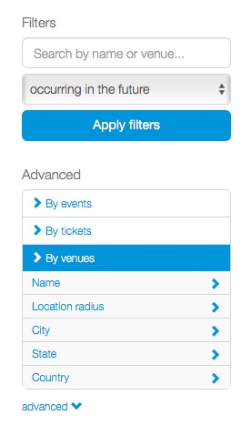
Manage Page
To filter by date, please select the “in the future” box on the top left of the page to additional options.
Advanced filters are available on the left-hand side of the page. Ticket admin can view these by selecting the drop down.
Ticket admin can filter by event, ticket, venue, etc.
To see additional filter options, ticket admin can click on a filter.

Slide 3
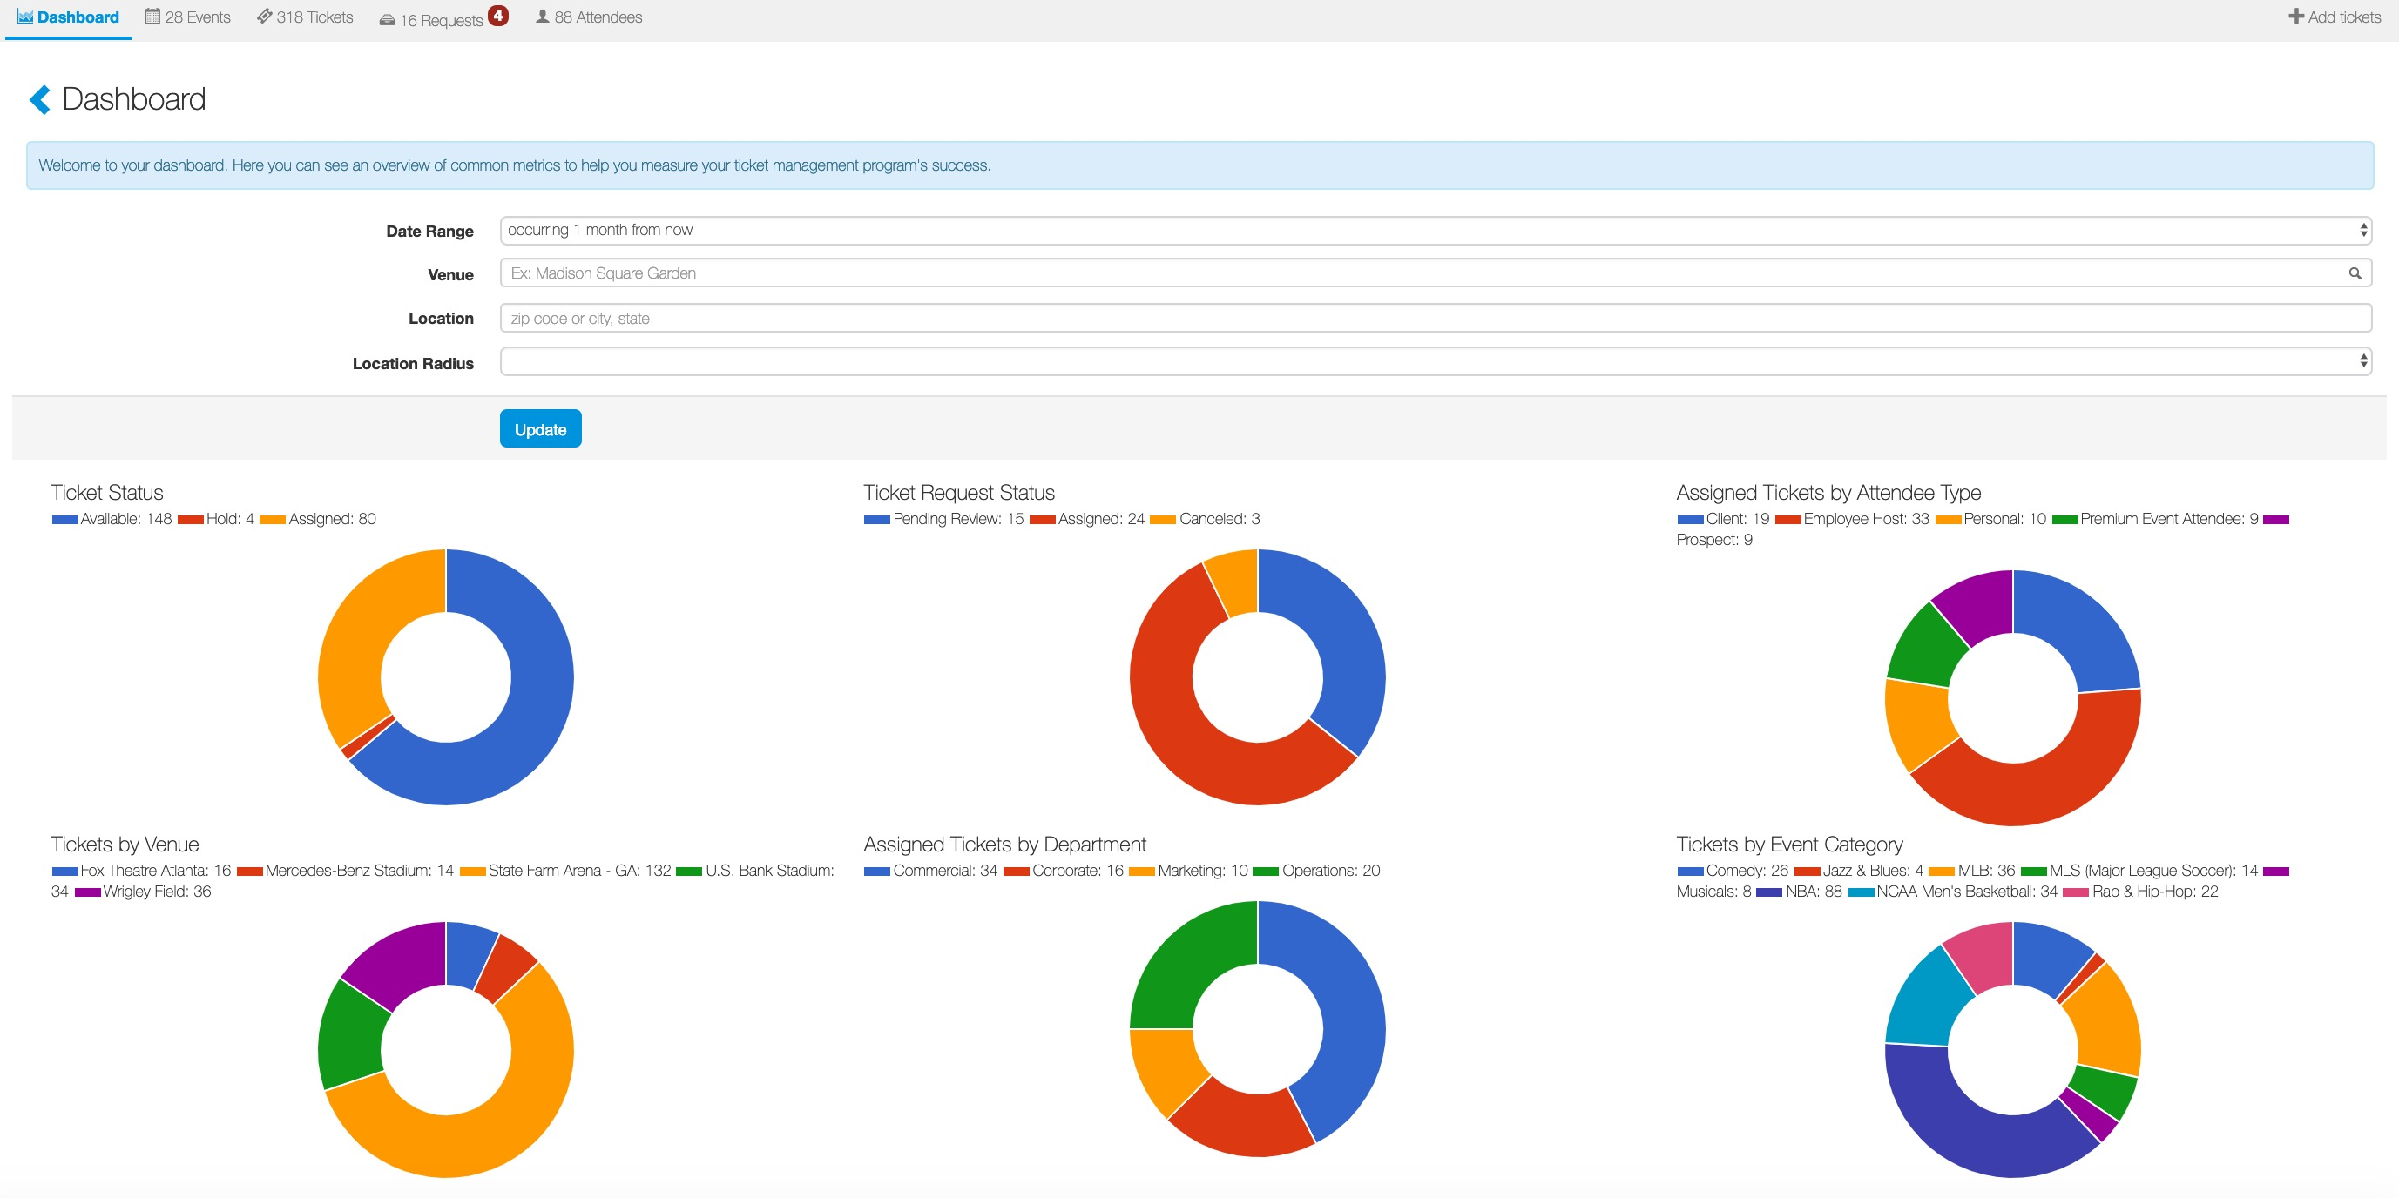
Manage Page
The dashboard allows ticket admin to view key ticket details including ticket status, request status, attendee type data and more.
Ticket admin can use filters to adjust data points.

Slide 4
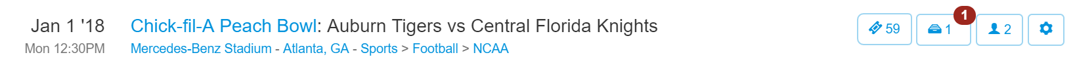
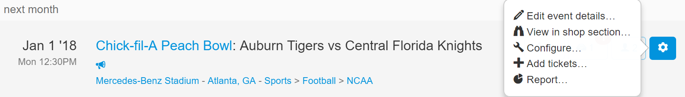
Manage Page
When viewing events, to the right of the event details, ticket admin have three management options for their tickets. The first tab with the ticket icon allows ticket admin to view their tickets for the event (screenshot below), the second tab with the paper tray icon allows ticket admin to view their pending requests, and the third tab (portrait icon) allows ticket admin to view their attendees for that event.
If tickets have a status (available, hold, auto-assign) other than the available, the status will show on the dashboard.
Click the “cog” icon for five options: ticket admin can select “Configu” to configure all tickets for this event, “+ Add tickets” to add additional inventory to this event, “Report” to report on tickets for this event, or “View in shop section” to see the user’s ticket view page. “Edit event details” is only available for events that have been created privately for your company’s account.

Slide 5
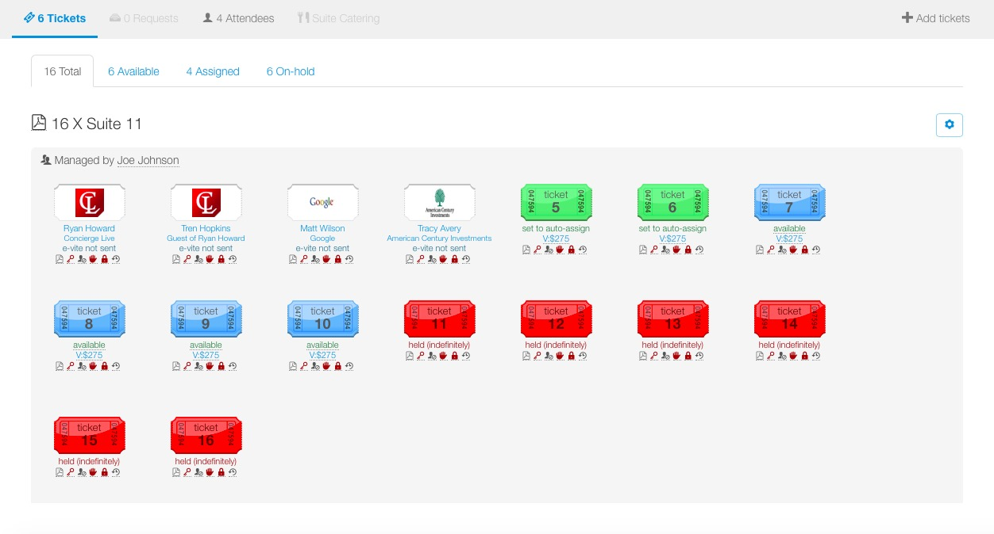
Manage Page
On the tickets tab, ticket admin can see the ticket status:
Assign/Approved: has a logo on the ticket
Auto-Assign: green
Held: red
Blue: available

Slide 6
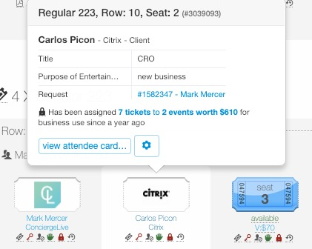
Manage Page
When a ticket admin moves their mouse over an assigned ticket, a pop-up appears with key information.
Clicking the “cog” icon provides the ticket admin with several options including; view the attendee, changing tickets, cloning, and printing name badges.

Slide 7
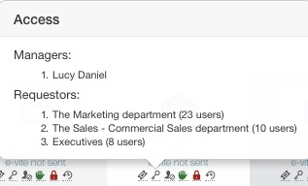
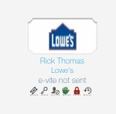
Manage Page
On the tickets page, ticket admin can view several icons below tickets. When a ticket admin moves their mouse over an icon, a pop-up window will appear.
Icons include:
Ticket Type (paper, e-ticket, non-ticketed)
Managers and Access
Attendee Types
Delivery Status/In-hands Status (possession of the tickets)
Auto-assign Status
Notes
Audit Trail - The audit trail shows the life cycle of a ticket from creation, to approvals, to shipping. If you need assistance interpreting the audit trail, please feel free to call support or your client services manager.

