Slide 1
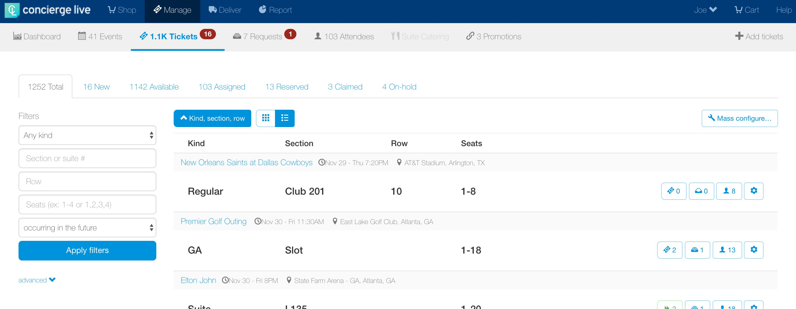
Mass Configure
Mass configuring is a way for ticket admin to make the same edits to the same tickets in mass, vs. having to configuration event by event.
On the Manage page, click on the “Tickets” tab in the navigation then click “Mass configure…”.
On the tickets page, click the “Mass Configure” button.

Slide 2
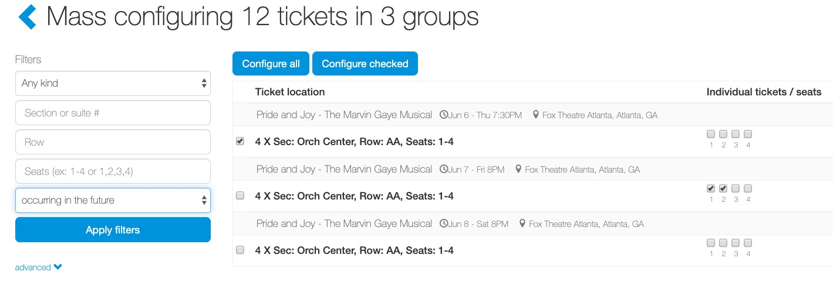
Mass Configure
On the mass configure page, ticket admin can use filters to narrow the results to a venue, ticket location, etc.
Be sure the date filter is set to “occurring in the future”.
Click ”advanced” to view additional filters to narrow ticket results (i.e. venue name).

Slide 3
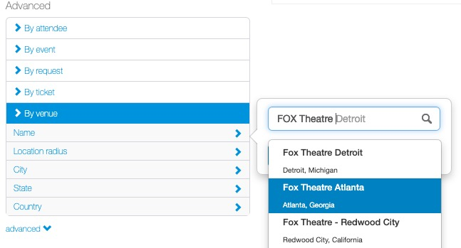
Mass Configure
In the advanced filter section, ticket admin can filter by several options including the event name, an event category and the most used advanced filter, venue name.

Slide 4
Mass Configure
Once tickets are narrowed to the targeted results, ticket admin can:
  Select specific tickets groups or individual tickets and click “Configure checked”.
  Select “Configure all” to configure all the tickets.
  If a ticket admin selects a ticket group (checks the box to the left of a ticket group) that is the same as selecting all the individual tickets in a ticket group.
  If individual tickets have also been selected, but the entire ticket group has also been selected (the check box to the left of the ticket group) ALL the tickets will be selected for configuration.

Slide 5
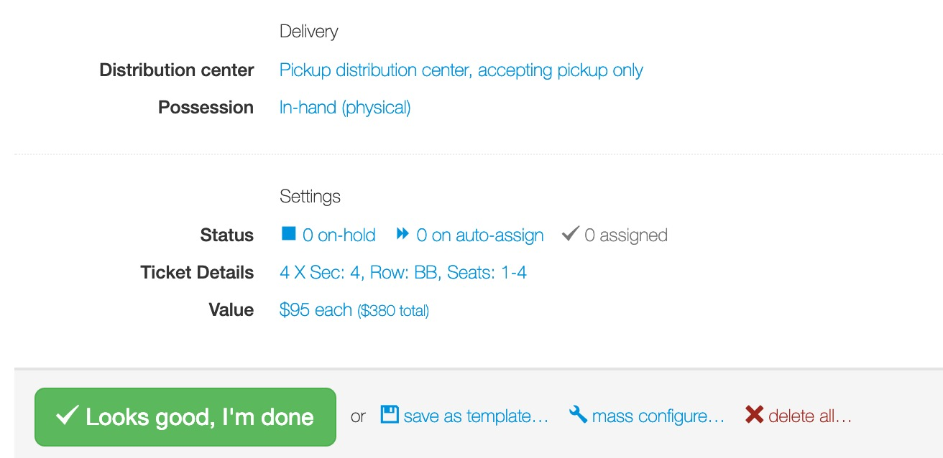
Mass Configure
The easiest way to configure tickets is to apply a configuration template.
When applying a configuration template, if billing is part of the configuration, remember to update the billing cost (the actual billing cost a user will be charged for assigned tickets is not part of configuration templates).
Once on the configure page, ticket admin can edit configuration settings.
After making updates to configuration settings, click “Looks good, I’m done”.

Slide 6
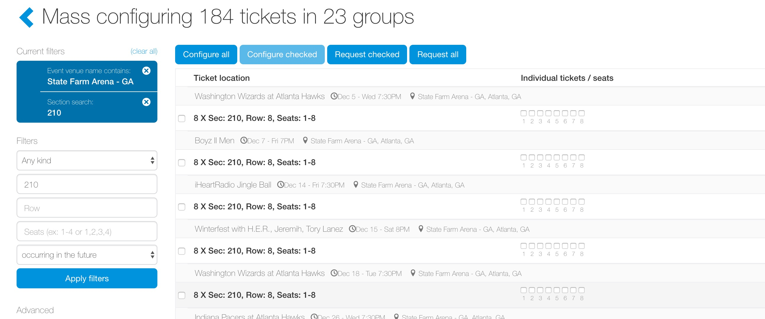
Mass Configure
The ticket admin will return to the tickets page where the selected tickets that were just configured are removed from the page, and the ticket admin can continue with other configure updates.

Slide 7
Mass Configure
Configure Tips:
If a ticket admin uses the filters to configure specific tickets, then you may need to reset or apply different filters to see other tickets when the ticket admin finalizes the configuration settings and returns to the tickets page.
Ticket admin can re-configure tickets at anytime through the tickets page or through their Manage page.
For a single event or certain tickets at a single event, we recommend using the Manage Page for configuring tickets. For mass edits/configurations (i.e. across season tickets, multiple events), we recommend the tickets page.
Not all configuration settings are part of a configuration template. For example, billing will vary from event to event and/or ticket to ticket.

