Slide 1
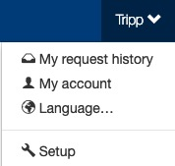
Secondary Pop-Up Language
The Setup section is where setup admin can control account behaviors. From updating attendee types and data fields, to delivery options for tickets, to branding the site; all is done in the Setup section.
To access the Setup section, click on your name (top of the page), then click “Setup”.

Slide 2
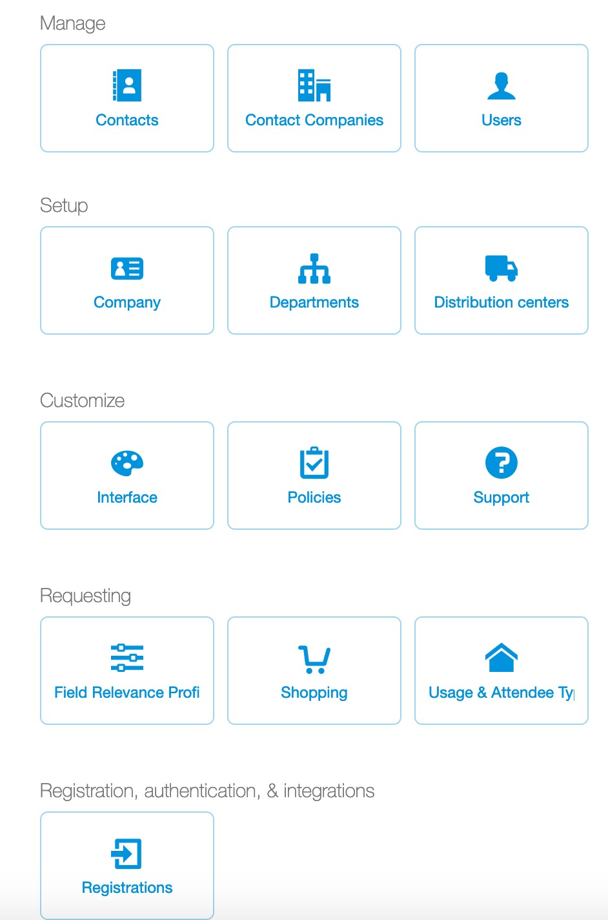
Secondary Pop-Up Language
Ticket admin can create a secondary pop-up users see each time they select a Concierge Live marketplace event (i.e. secondary event) on the Shop page or tickets view page.
This is a different pop-up from secondary market policies, which when created and enabled appear when a user begins the secondary market ticket check out process.
When the secondary pop-up is enabled it must be reviewed and accepted before a user sees secondary market ticket listings.
To create a secondary pop-up, select “Setup”, then click “Shopping”.

Slide 3
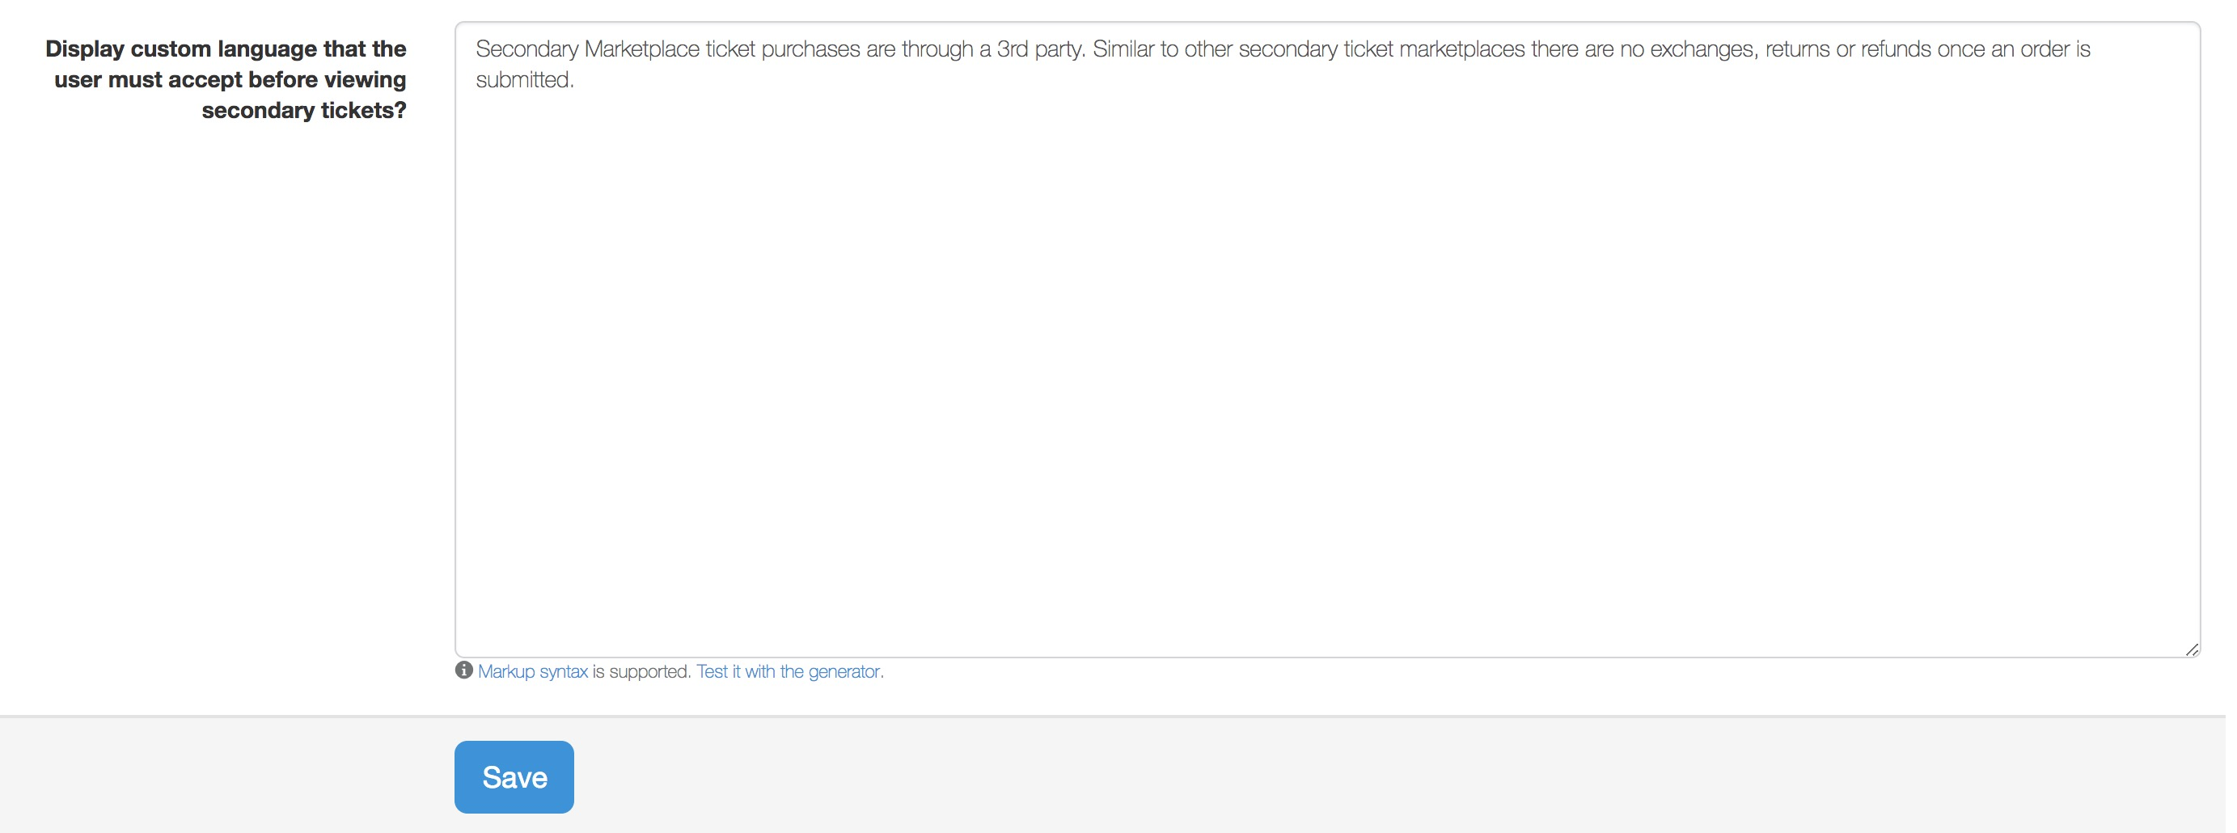
Secondary Pop-Up Language
Once in the Shopping Setup section, enter your desired language and click save.
Common language includes a description of what the marketplace and secondary tickets means.
This language can be important for users who don’t entertain regularly and aren’t familiar with StubHub, Ticketmaster Exchange, Vivid Seats and other common secondary marketplaces.
For example:
  Tickets purchased on the Concierge Live Marketplace are managed the same as purchasing through other secondary marketplaces; no exchanges or refunds are accepted.
  Tickets purchased on the Concierge Live Marketplace are charged to your credit card and expensed in accordance with company T&E policies.

Slide 4
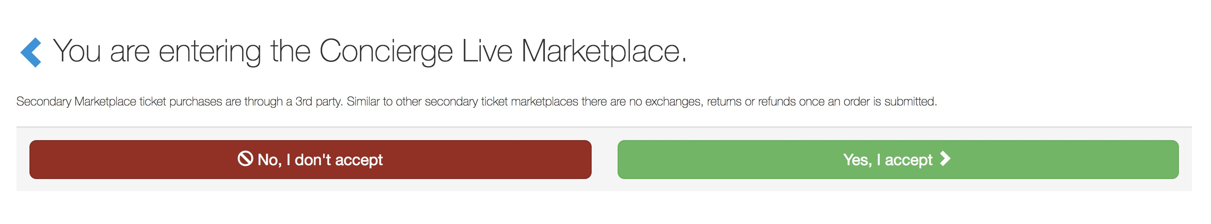
Secondary Pop-Up Language
On the Shop page, when a user clicks to views Concierge Live marketplace tickets, they see any Concierge Live marketplace language.
The user must accept to continue to view Concierge Live marketplace listings.
If the user selects ”No, I don’t accept”, they are taken back to their Home page.
The action of accepting or declining the Concierge Live marketplace pop-up occurs every time a user attempts to view Concierge Live marketplace ticket listings.

