Slide 1
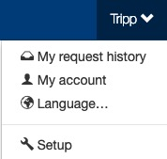
Registration
The Setup section is where setup admin can control account behaviors. From updating attendee types and data fields, to delivery options for tickets, to branding the site; all is done in the Setup section.
To access the Setup section, click on your name (top of the page), then click “Setup”.

Slide 2
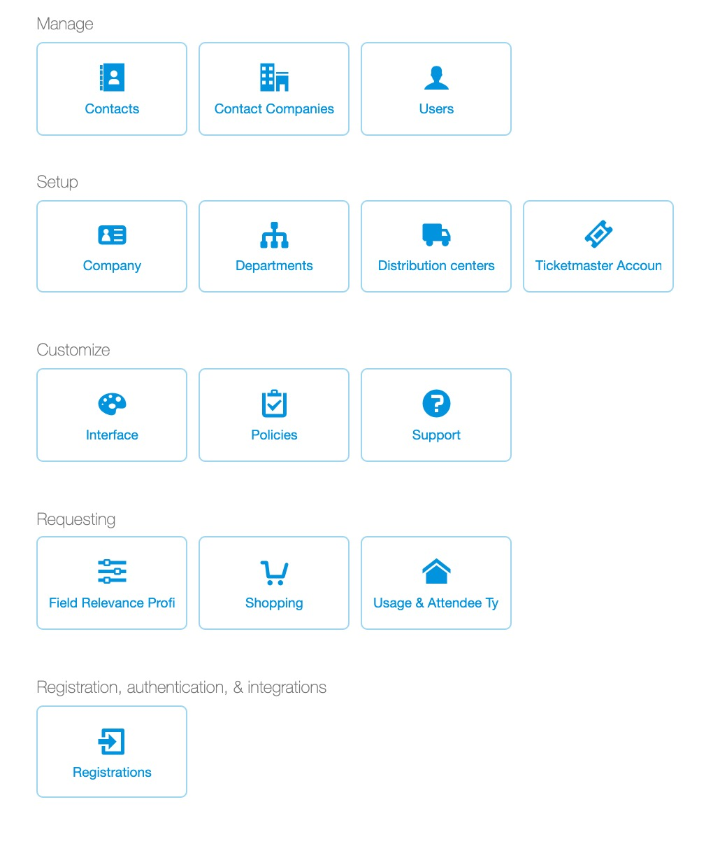
Registration
Only ticket admin with access to the Setup section have the ability set registration requirements. To review or edit registration settings for your Concierge Live account in the Setup section, click the “Registrations” button.

Slide 3
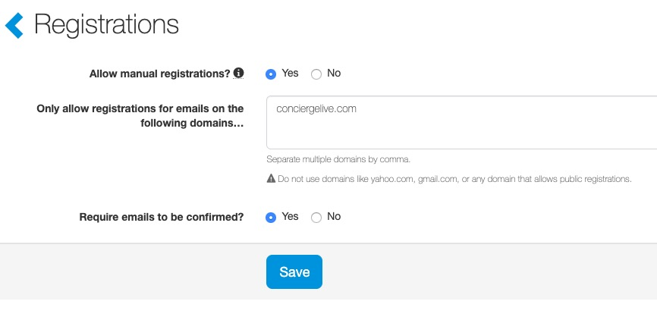
Registration
Allow manual registrations. The default will be yes, this allows users to register for a Concierge Live account. This would be set to “No”, if your company uses single sign-on (SSO).
Only allow registrations for emails on the following domains: specify any email domains for your users. If you list multiple email domain, separate them with a comma.
Require emails to be confirmed? The default setting is ”Yes” and the recommended setting. As part of the registration process, an authentication email is sent to the user’s email address with a link they must confirm to access Concierge Live. Once the authentication email is confirmed, the user can login to Concierge Live. Each user has a unique login and password for Concierge Live.

