Slide 1
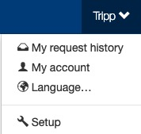
Setup
The Setup section is where setup admin can control account behaviors. From updating attendee types and data fields, to delivery options for tickets, to branding the site; all is done in the Setup section.
To access the Setup section, click on your name (top of the page), then click “Setup”.

Slide 2
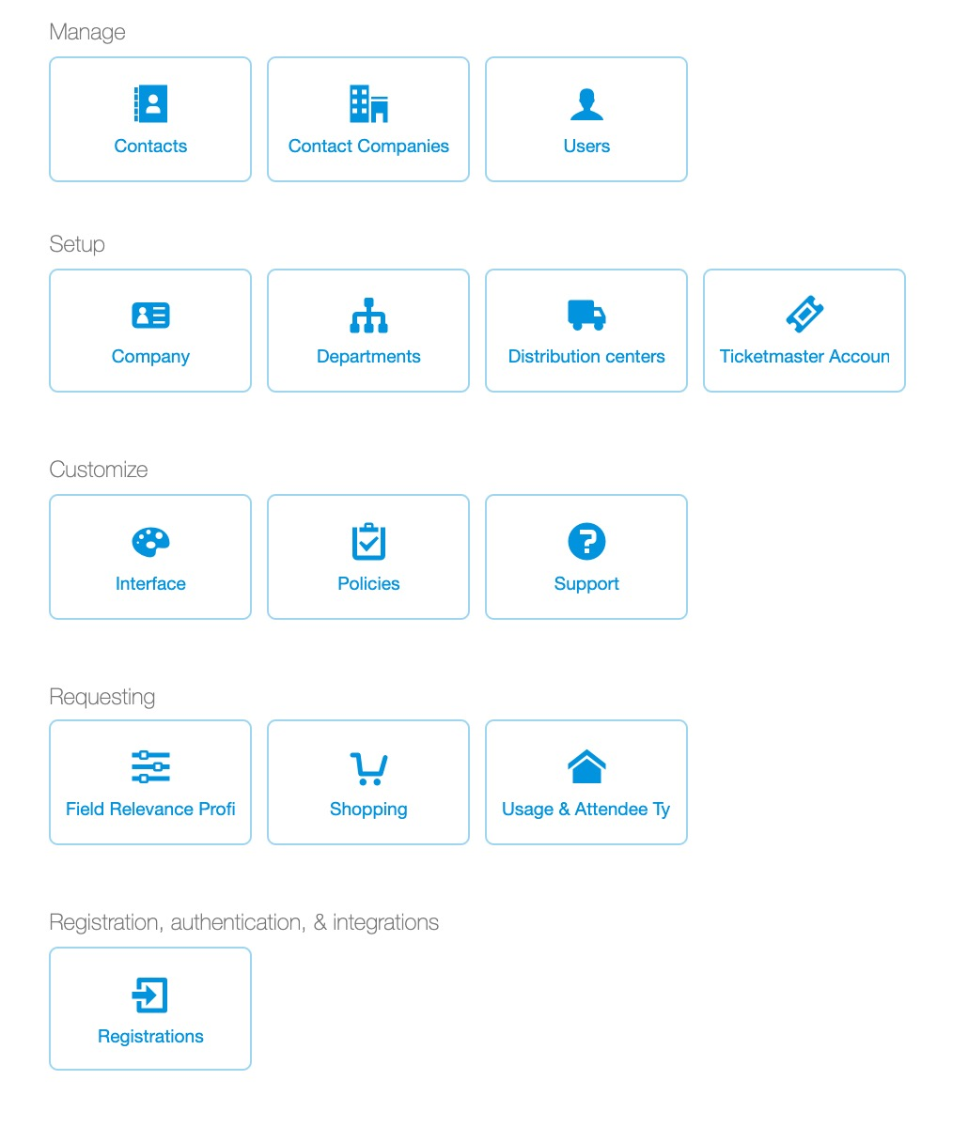
Setup
When your account is activated, certain defaults have been established based on common use cases for ticket management.
There are individual decks available in the knowledge base support for the setup sections.

Slide 3
Setup
One key default new Concierge Live accounts include the following attendee types and field requirements:
  Charity = Name (o); Company Name (r); Tax ID (r)
  Client = Name (o); Company Name (r); Title (r); Purpose of Entertainment (r)
  Employee = Name (o); Email (r); Title (r); Phone (r)
  Prospect = Name (o); Company Name (r); Title (r); Purpose of Entertainment (r)
  O = Optional
  R = Required
The attendee type deck and field relevancy deck outline how to create and edit attendee types and field requirements.
Other Setup decks include:
  Users
  Contacts
  Policies
  Distribution Centers
  Departments

