Slide 1
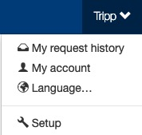
Support
The Setup section is where setup admin can control account behaviors. From updating attendee types and data fields, to delivery options for tickets, to branding the site; all is done in the Setup section.
To access the Setup section, click on your name (top of the page), then click “Setup”.

Slide 2
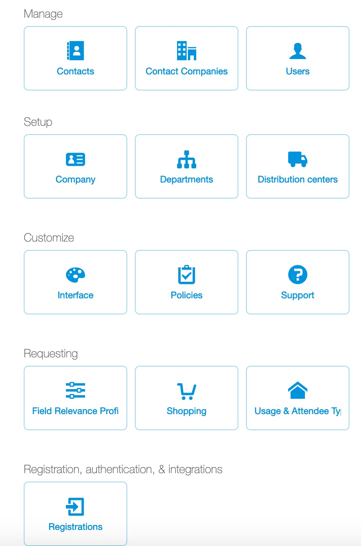
Support
To update support options, click “Support”.
Changes in this section, impact what a user sees when viewing the Help page.

Slide 3
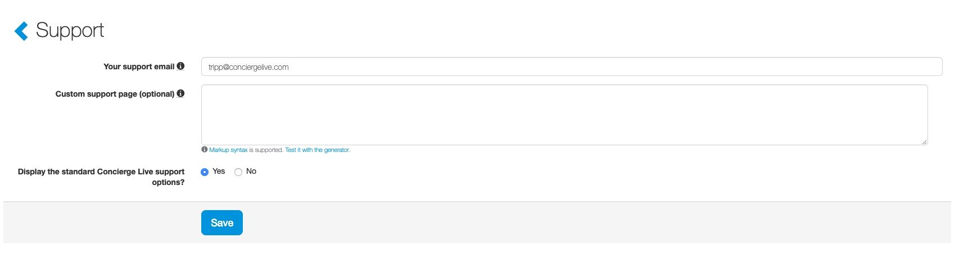
Support
Ticket admin can update the information users see when they view the “Help” page.
Your support email: Allow users to contact ticket admin for company policies or questions. All support requests will be directed to this email.
Custom support page: Create a “company” support section to outline your contact information. This can improve user satisfaction since many support tickets are related to company policies not technical or “how to” questions.
Display standard Concierge Live Support options: The default setting is “yes”. Some clients want all support calls/emails to come to their internal teams. When set to “No” users will not see Concierge Live support information on the Help Page.

