Slide 1
Processing a Request
As users request tickets, the ticket admin who manages the tickets receives the request. Ticket admin can access their requests in two ways.
The first and most common option is viewing requests for a specific event on the Manage page. Use the filters on the left-hand side to locate a specific event. Once you locate the event, click the request icon (file in box) to view the requests for that event.
The second option to review requests is the “All Request Queue.” Ticket admin can view all the requests for all tickets they manage. From the top navigation, click “X Requests”.

Slide 2
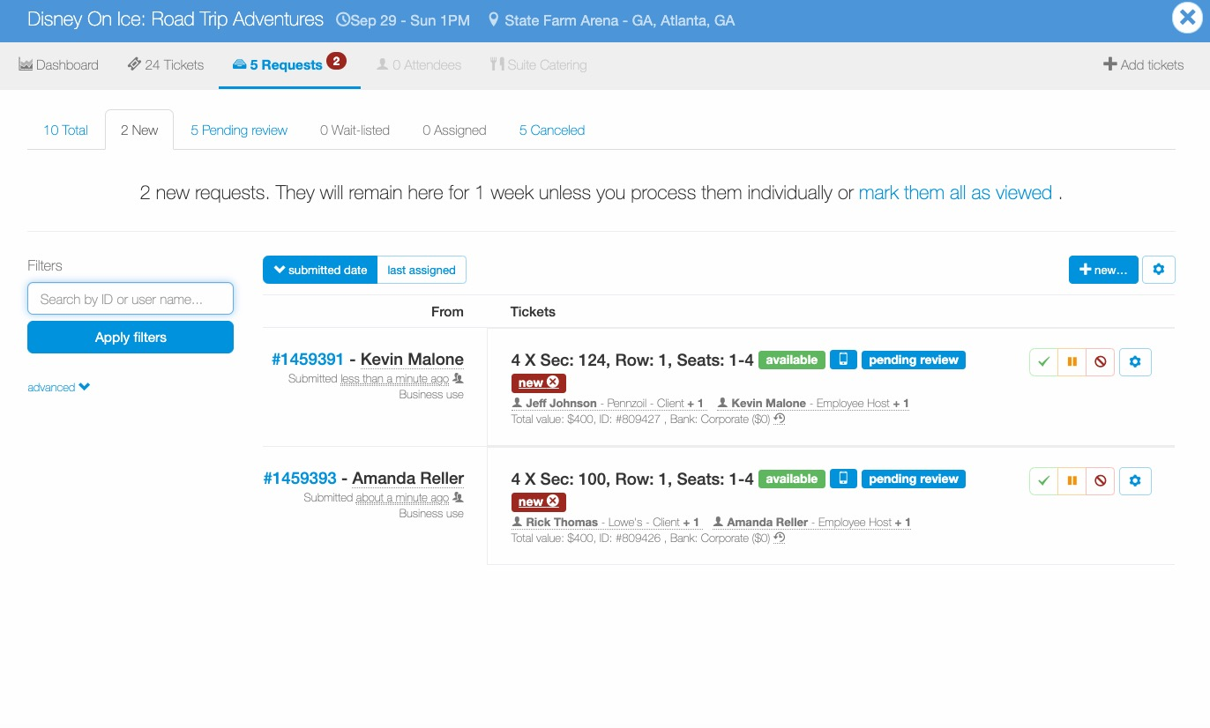
Processing a Request
“New requests” is the default request queue view.
New requests will remain in the new queue until they are processed or marked as viewed. If you just view the request, it will still remain in the queue if no action is taken.
New requests will also appear under the “pending review” tab.
Ticket admin can also click on tabs to view pending review, wait list, assigned (i.e. approved) and canceled requests.

Slide 3
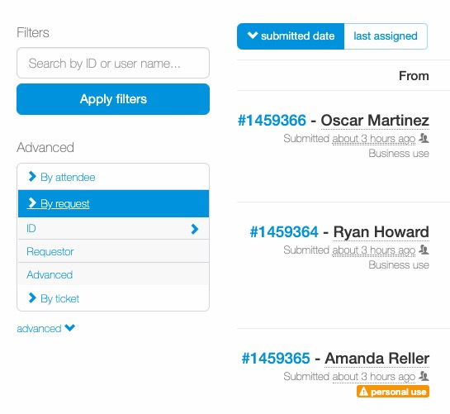
Processing a Request
Ticket admin can use the filters to locate a specific request or click “advanced” to see additional filter options.
Requests by default appear in the request queue based on submitted date.
The ”last assigned” option sorts ticket requests based on ticket requestors last assigned request.
The initial click of the “last assigned” option, orders ticket requests in reverse, so the ticket requestor most recently assigned tickets is at the bottom of the queue.
To see the most recently assigned ticket requestor, click the “last assigned” option two (2) times.
If a ticket requestor has never been assigned tickets, they will appear at the top of the request queue.

Slide 4
Processing a Request
Ticket admin can quickly determine if a request is a business or personal request.
Ticket admin can also review the tickets requested and the attendee make-up of the request.
In addition to an attendee’s name, the ticket admin can see how many tickets have been assigned to the attendee (i.e. Ben Pautsch – Adobe – Client +1).
Ben Pautsch is the attendee name
Adobe: is Ben’s company
Client: is Ben’s attendee type
+1: Ben is using 2 tickets; 1 for himself and one for his guest (+1)

Slide 5
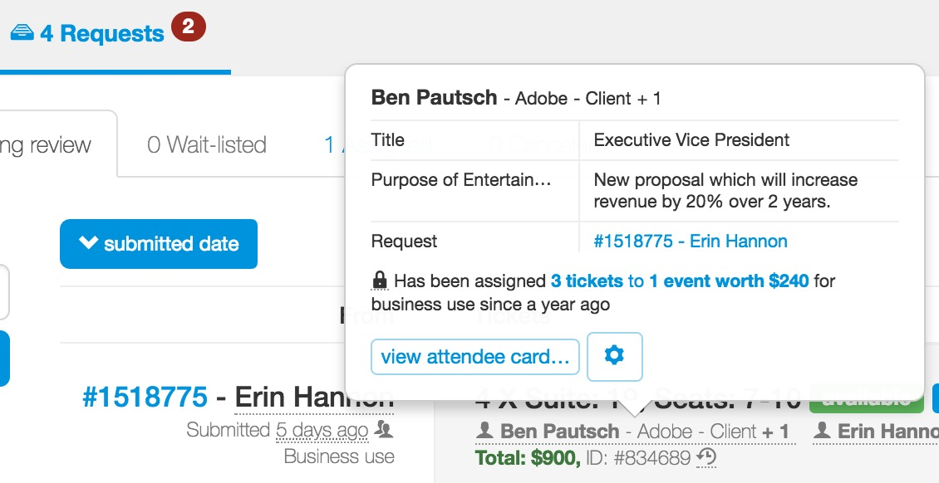
Processing a Request
Ticket admin can roll their mouse over an attendee’s name to see additional details about the attendee. This is applicable to external and internal attendees.
When a ticket admin clicks the “view attendee card” they can view and edit the attendee’s information.

Slide 6
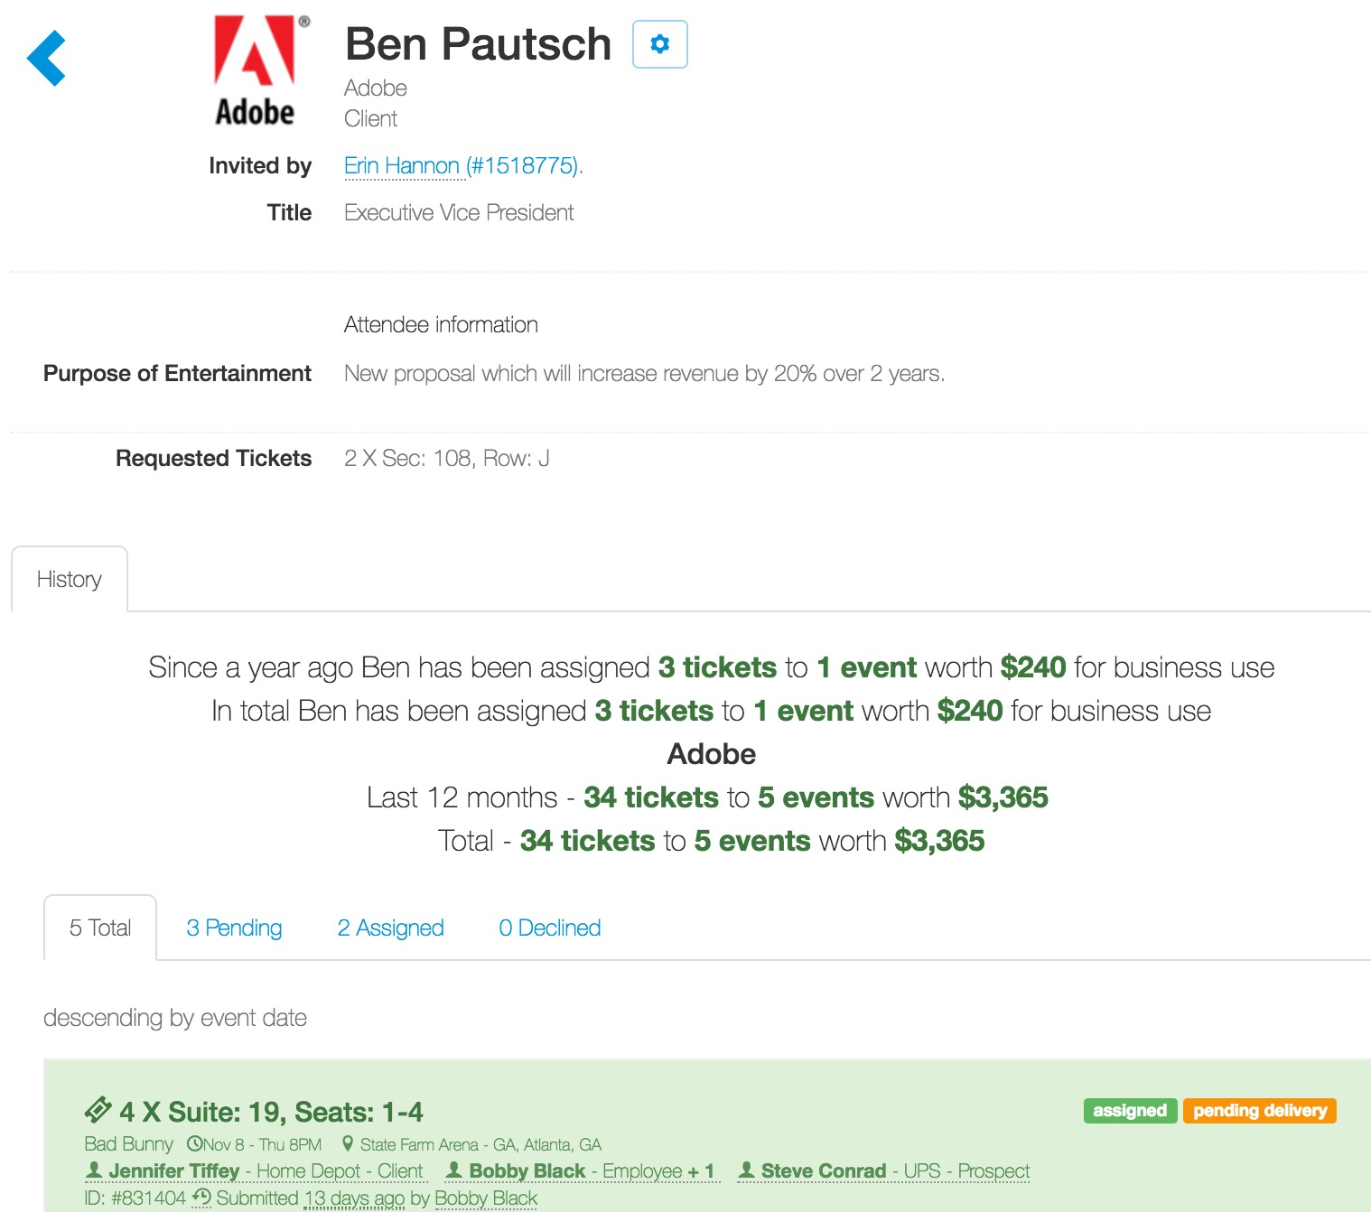
Processing a Request
When a ticket admin clicks on “view attendee card…”, they see the attendee’s profile information (all information captured in the attendee type) and their usage information (all previous requests for the attendee).

Slide 7
Processing a Request
When a ticket admin is ready to take action on a request, they can select from the icons on the right-hand side of the request.
Options for processing a request include:
Process: (green check icon): When selected, a ticket admin can auto-process (magic wand or manually process (hand) the request. Auto-processing requests will approve the request with the desired location and quantity (if available). Manually processing requests allows a ticket admin to select the specific tickets to be assigned to the request. The system communicates if the requested tickets are still available or unavailable.
Other processing options:
Wait-list: (orange icon): allows ticket admin to hold a request and communicate information to the requestor.
Cancel: (red circle with a line through it icon): ticket admin can do a generic decline or if available can select a cancellation reason from a drop-down list.

Slide 8
Processing a Request
Advanced options (“wheel” icon) processing a request include:
Edit request: Allows a ticket admin to edit request details (attendees, ticket counts, delivery information, etc.).
Move to another event: If the requested event no longer has tickets, a ticket admin can move the request to another event. Please be aware if you move the request to another event, the configuration details are overridden. Ex. Event 1 allows charity requests, event 2 does not. If you move a request from event 1 to event 2, the charity request is still allowed because at the time of the request, the event requested allows them to place a request for a charity.
Change requested tickets/quantity: For pending requests, ticket admin can increase or decrease the ticket quantity of a request. After you edit a request ticket quantity, review your attendees and attendee counts to ensure the request reflects the correct usage.

Slide 9
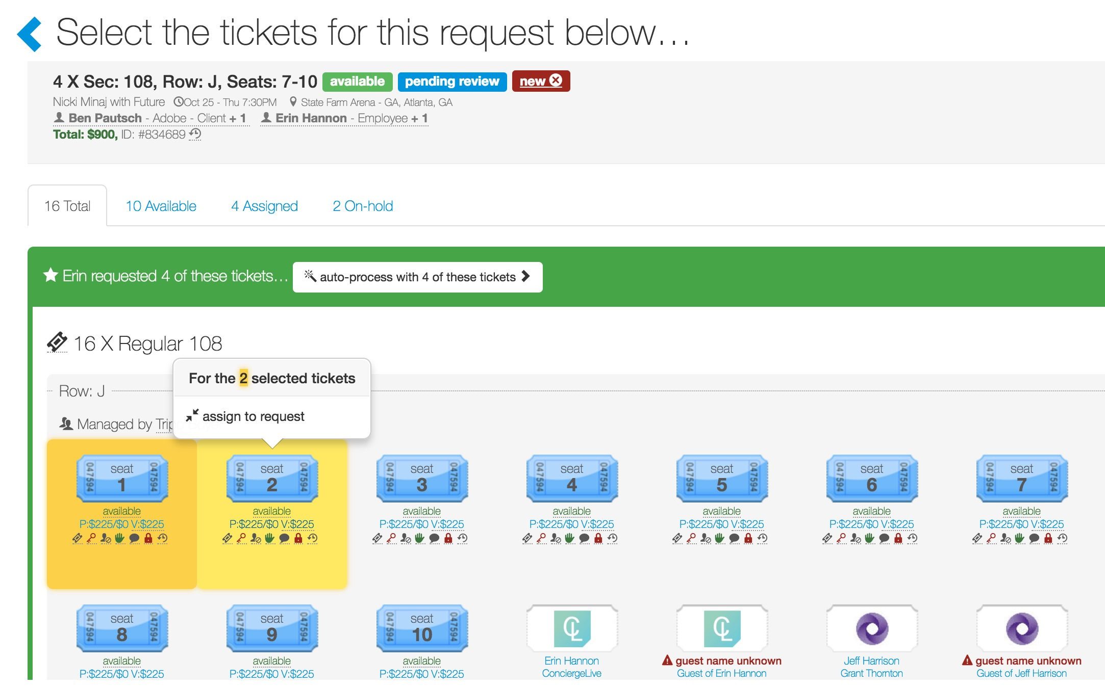
Processing a Request
When a ticket admin manually processes a request, they select specific tickets to assign to the request.
The system highlights the location and quantity requested. Ticket admin can either:
Auto-process with X of these tickets.
Select individual tickets by clicking on them. If a ticket admin selects two tickets, the requestor will receive two tickets regardless of the number of tickets requested.
As a ticket admin selects tickets or clicks to highlight them, a pop-up appears prompting the ticket admin to “assign to request”.

Slide 10
Processing a Request
Once the request is assigned tickets, the status of the request is now changed to “assigned” and if the tickets are part of a distribution center with delivery options, the ticket admin (and the user) will be able to see the request’s delivery status (in the example below the delivery status is “pending delivery”).
Once a request is approved or declined, a ticket admin can still modify the request.
Through the request queue navigation, locate the request.

Slide 11
Processing a Request
If an assigned (approved) request needs to be cancelled, locate the request, click the wheel icon for the request.
Click “Decline this request…”.
If the tickets for this request have been delivered, you will be alerted. While a business decision, not a Concierge Live decision, we recommend getting the tickets back before you cancel the request.
If a declined request needs to be re-activated or assigned tickets, locate the request, click the wheel icon for the request.
Click “Move back to pending review”. At this point you can approve the request, waitlist the request or move to another event.
Based on the actions you take; users will receive a notification regarding the status of the request.

Slide 12
Processing a Request
Assigning Ticket Tips:
A request is the user’s desired location and quantity. As a ticket admin, you can assign the tickets and quantity requested or any quantity and available tickets.
The system will highlight specific ticket groups the user requested as well as the quantity. You can select any available tickets and quantity for a request.
Remember tickets are individual tickets. If you select one ticket, that’s all that will be assigned/approved to the user’s request. Blue tickets are available.
As you select tickets, they are highlighted in yellow and the ticket count in the pop-up changes.
Once you select the location and quantity of tickets, click the “assign to request” button.
As a request moves through the process, users receive email notifications as the status of an order changes (i.e. declined, assigned/approved tickets, tickets have been shipped, etc.).

