Slide 1
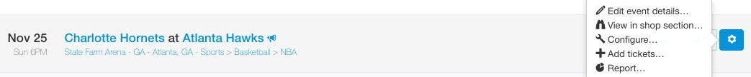
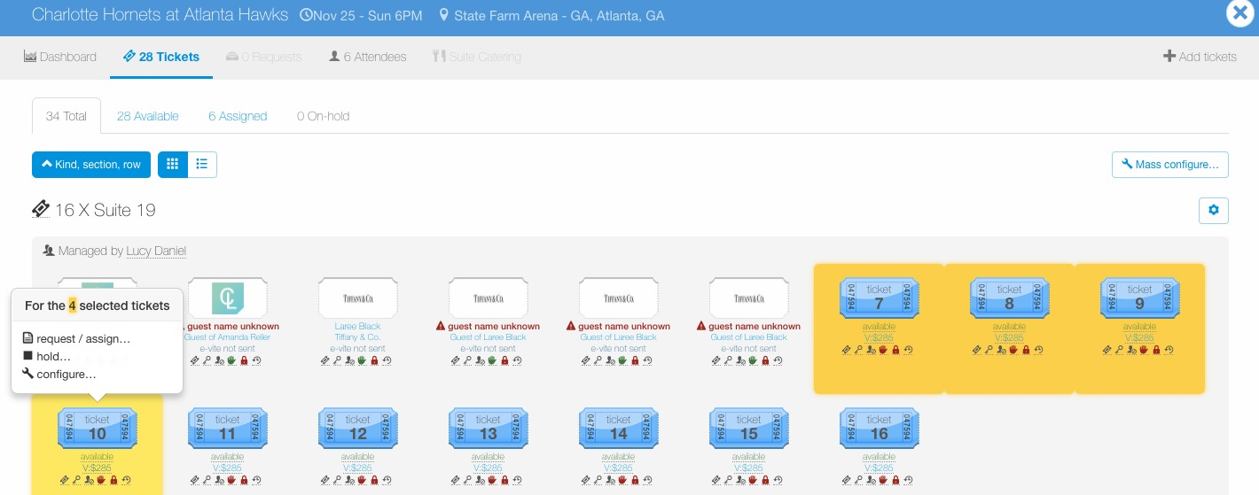
Configure – Auto-Assign
To configure tickets for an entire event, go to the Manage page, find the event, click the wheel icon to the right of the event and then click “Configure…”.
To configure a certain ticket group or individual tickets within an event, go to the Manage page, find the event and click the ticket icon to view tickets for the event.
Once in the event, click the “cog” icon next to the ticket group to edit an entire ticket group or click individual tickets to configure, then select “configure…”.

Slide 2
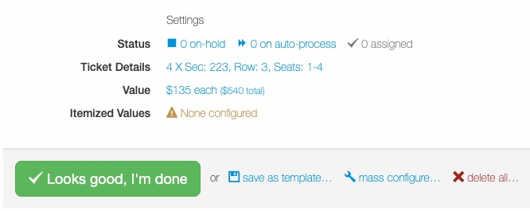
Configure – Auto-Assign
To enable auto-assign, click ”X on auto-process” in the Settings section of Configure.

Slide 3
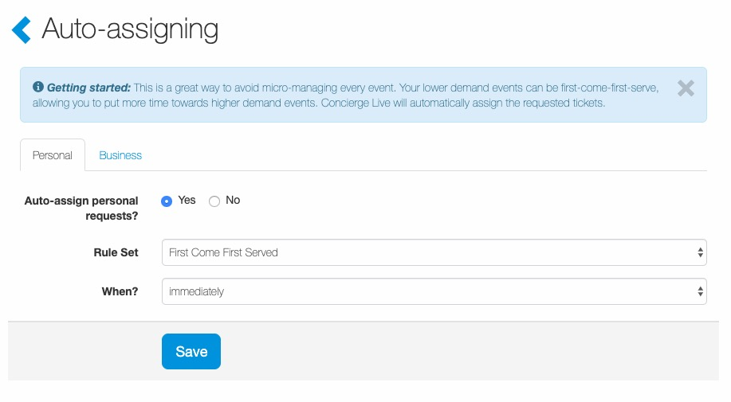
Configure – Auto-Assign
Auto-assign:
When auto-assign is enabled, ticket admin do not review ticket requests; if tickets are available the request is automatically assigned/approved for the ticket requestor.
Ticket admin can enable auto-assign for personal and/or business requests (the default tab is Personal, select the Business tab to enable auto-assign for business requests).
To enable auto-assign, from the “Rule Set” dropdown select “First Come, First Served”.
Ticket admin can set a “trigger” for when auto-assign goes into effect “X” days before the event. (i.e. 5 days before the event date, ticket requests will auto-assign).
Once the business rules have been entered, select “Save”.

